Slide 1
Consonant clusters: th sh ch
2
Identify, recognize and print 3 consonant clusters and review 3 vowel clusters.
th /θ/, sh /ʃ/, ch /tʃ/.
The ABC song (audio & video)
Consonant clusters 1 printing sheet
Blackboard / Whiteboard with chalk / markers
Pencils and paper
Use this mini-lesson within your main lesson for vowel and consonant cluster practice.
Audio is played for the letters and words. If you do not wish the audio to play, please mute your speakers.

Slide 2
Consonant clusters: th sh ch
- Lesson 2 -

Slide 3


Teacher’s notes are here on every lesson slide.
Sing “The ABC song” Start this section of the lesson with the ABC song to indicate that it’s alphabet time.
Bring everyone’s attention to this slide and play the song.
Encourage everyone to clap along as you sing – after a few classes everyone will be able to sing along with you.
Lyrics for “The ABC song”
A B C D E F G
H I J K L M N
O P Q R S T U
V W and X Y Z
I can sing my ABCs,
Won’t you sing along with me?
Repeat
The ABC song
a
c
e
g
b
d
f
j
m
Song audio and video
only available to ESL KidStuff members.
Click here to remove message.
n
i
h
Song audio and video
only available to ESL KidStuff members.
Click here to remove message.
k
l
SAMPLE FOR EVALUATION
Join ESL KidStuff
to view without watermark.
Click to play song
o
p
q
r
s
t
u
Play song audio
v
w
x
y
z
Play song video
2 | © ESLKidStuff.com
[ Press space bar or left-mouse click to move to the next slide ]

Slide 4




Review the previous clusters
Run quickly through the sounds and pictures by clicking the [ space bar ].
Have everyone chant along as you go through them.
Let’s review
oo
ee
ou
SAMPLE FOR EVALUATION
Join ESL KidStuff
to view without watermark.
oo /ʊ/
ee /i:/
ou /aʊ/
is for
is for
is for
foot
bee
cloud
[ Press space bar or left-mouse click to move to the next slide ]

Slide 5

th
/θ/
Vowel sound introduction
1. Bring everyone's attention to the letters on this slide.
[ Press space – audio ]
2. Everyone repeats and choruses the sound 3x.
[ Press space ]
3. Say “is for ..."
[ Press space ]
4. Show the picture - encourage students to say what it is, if they know.
[ Press space – audio ]
5. Everyone repeats and choruses the word 3x.
6. Quickly run through once more – point to the letters in the top-left and ask, “What’s this?” (elicit the sound). Then point at the picture and say, “Is for?” and elicit the word.
th
th
SAMPLE FOR EVALUATION
Join ESL KidStuff
to view without watermark.
is for
three
[ Press space bar to continue ]
[ Press space bar or left-mouse click to move to the next slide ]

Slide 6
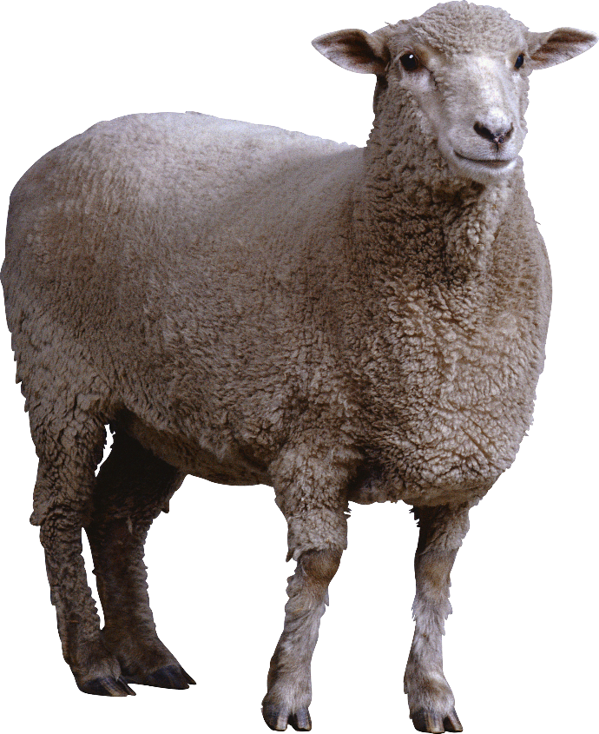
sh
/ʃ/
Vowel sound introduction
1. Bring everyone's attention to the letters on this slide.
[ Press space – audio ]
2. Everyone repeats and choruses the sound 3x.
[ Press space ]
3. Say “is for ..."
[ Press space ]
4. Show the picture - encourage students to say what it is, if they know.
[ Press space – audio ]
5. Everyone repeats and choruses the word 3x.
6. Quickly run through once more – point to the letters in the top-left and ask, “What’s this?” (elicit the sound). Then point at the picture and say, “Is for?” and elicit the word.
sh
sh
SAMPLE FOR EVALUATION
Join ESL KidStuff
to view without watermark.
is for
sheep
[ Press space bar to continue ]
[ Press space bar or left-mouse click to move to the next slide ]

Slide 7

ch
/tʃ/
Vowel sound introduction
1. Bring everyone's attention to the letters on this slide.
[ Press space – audio ]
2. Everyone repeats and choruses the sound 3x.
[ Press space ]
3. Say “is for ..."
[ Press space ]
4. Show the picture - encourage students to say what it is, if they know.
[ Press space – audio ]
5. Everyone repeats and choruses the word 3x.
6. Quickly run through once more – point to the letters in the top-left and ask, “What’s this?” (elicit the sound). Then point at the picture and say, “Is for?” and elicit the word.
ch
ch
SAMPLE FOR EVALUATION
Join ESL KidStuff
to view without watermark.
is for
chin
[ Press space bar to continue ]
[ Press space bar or left-mouse click to move to the next slide ]

Slide 8
Check the letters
Run quickly through the letters, sounds and pictures by clicking the
[ space bar ].
Have everyone chant along as you go through them.
Let’s check
th
sh
ch
SAMPLE FOR EVALUATION
Join ESL KidStuff
to view without watermark.
th /θ/
sh /ʃ/
ch /tʃ/
is for
is for
is for
three
sheep
chin
[ Press space bar or left-mouse click to move to the next slide ]

Slide 9






Introduce new words
We’re going to read some simple words containing today’s consonant cluster sounds. First, we need to teach / elicit the words.
[ Press space to start ]
Bring everyone's attention to first picture on this slide. Teach / Elicit the word. Then chorus 3-5 times.
[ Press space for next picture ]
Repeat for all the pictures.
Answers:
ship
chips
mouth
chest
cloth
brush
[ Press space bar to start]
SAMPLE FOR EVALUATION
Join ESL KidStuff
to view without watermark.
[ Press space bar or left-mouse click to move to the next slide ]

Slide 10
Test new words
Can your students remember the new words?
[ Press space to start ]
The first image slowly reveals itself – encourage students to shout out what it is as soon as they can.
[ Press space for next picture ]
Repeat for all the pictures.
Answers:
cloth
chest
brush
chips
mouth
ship
[ Press space bar to start]
SAMPLE FOR EVALUATION
Join ESL KidStuff
to view without watermark.
[ Press space bar or left-mouse click to move to the next slide ]

Slide 11
Read the words
(slide 1 of 6)
[ Press space to start ]
1. Bring everyone's attention to the letters on this slide.
2. Encourage your students to say the sound of each letter – you can click the audio icon to hear the sound.
3. Elicit the word.
[ Press space to see the picture ]
4. Check the picture to see if everyone is correct!
[ Press space to go to the next word ]
Let’s read!
c
p
i
s
h
SAMPLE FOR EVALUATION
Join ESL KidStuff
to view without watermark.
[ Press space bar to see picture]
[ Press space bar or left-mouse click to move to the next slide ]

Slide 12
Read the words
(slide 2 of 6)
[ Press space to start ]
1. Bring everyone's attention to the letters on this slide.
2. Encourage your students to say the sound of each letter – you can click the audio icon to hear the sound.
3. Elicit the word.
[ Press space to see the picture ]
4. Check the picture to see if everyone is correct!
[ Press space to go to the next word ]
Let’s read!
u
o
m
h
t
SAMPLE FOR EVALUATION
Join ESL KidStuff
to view without watermark.
[ Press space bar to see picture]
[ Press space bar or left-mouse click to move to the next slide ]

Slide 13
Read the words
(slide 3 of 6)
[ Press space to start ]
1. Bring everyone's attention to the letters on this slide.
2. Encourage your students to say the sound of each letter – you can click the audio icon to hear the sound.
3. Elicit the word.
[ Press space to see the picture ]
4. Check the picture to see if everyone is correct!
[ Press space to go to the next word ]
Let’s read!
b
u
s
r
h
SAMPLE FOR EVALUATION
Join ESL KidStuff
to view without watermark.
[ Press space bar to see picture]
[ Press space bar or left-mouse click to move to the next slide ]

Slide 14
Read the words
(slide 4 of 6)
[ Press space to start ]
1. Bring everyone's attention to the letters on this slide.
2. Encourage your students to say the sound of each letter – you can click the audio icon to hear the sound.
3. Elicit the word.
[ Press space to see the picture ]
4. Check the picture to see if everyone is correct!
[ Press space to go to the next word ]
Let’s read!
h
t
o
l
c
SAMPLE FOR EVALUATION
Join ESL KidStuff
to view without watermark.
[ Press space bar to see picture]
[ Press space bar or left-mouse click to move to the next slide ]

Slide 15
Read the words
(slide 3 of 6)
[ Press space to start ]
1. Bring everyone's attention to the letters on this slide.
2. Encourage your students to say the sound of each letter – you can click the audio icon to hear the sound.
3. Elicit the word.
[ Press space to see the picture ]
4. Check the picture to see if everyone is correct!
[ Press space to go to the next word ]
Let’s read!
s
p
i
h
SAMPLE FOR EVALUATION
Join ESL KidStuff
to view without watermark.
[ Press space bar to see picture]
[ Press space bar or left-mouse click to move to the next slide ]

Slide 16
Read the words
(slide 6 of 6)
[ Press space to start ]
1. Bring everyone's attention to the letters on this slide.
2. Encourage your students to say the sound of each letter – you can click the audio icon to hear the sound.
3. Elicit the word.
[ Press space to see the picture ]
4. Check the picture to see if everyone is correct!
[ Press space to go to the next word ]
Let’s read!
c
e
s
h
t
SAMPLE FOR EVALUATION
Join ESL KidStuff
to view without watermark.
[ Press space bar to see picture]
[ Press space bar or left-mouse click to move to the next slide ]

Slide 17
Write on the board
Give a marker / chalk to a student and have them come to the board.
Show him/her one word from the previous slides on a piece of paper, but don’t let the rest of the class see.
The student writes the word on the board and the rest of the students must shout out the word.
Repeat for the other words with different students.
Write on the board
SAMPLE FOR EVALUATION
Join ESL KidStuff
to view without watermark.
[ Press space bar or left-mouse click to move to the next slide ]

Slide 18
Writing quiz
Get everyone sitting down with a pencil and piece of paper.
[ Press space to start ]
Get everyone to write down the words for the pictures.
When everyone has finished, go back to the previous slides to check their answers.
1
2
3
Writing quiz
Can you write the words?
Press space to start.
SAMPLE FOR EVALUATION
Join ESL KidStuff
to view without watermark.
4
5
6
[ Press space bar or left-mouse click to move to the next slide ]

Slide 19
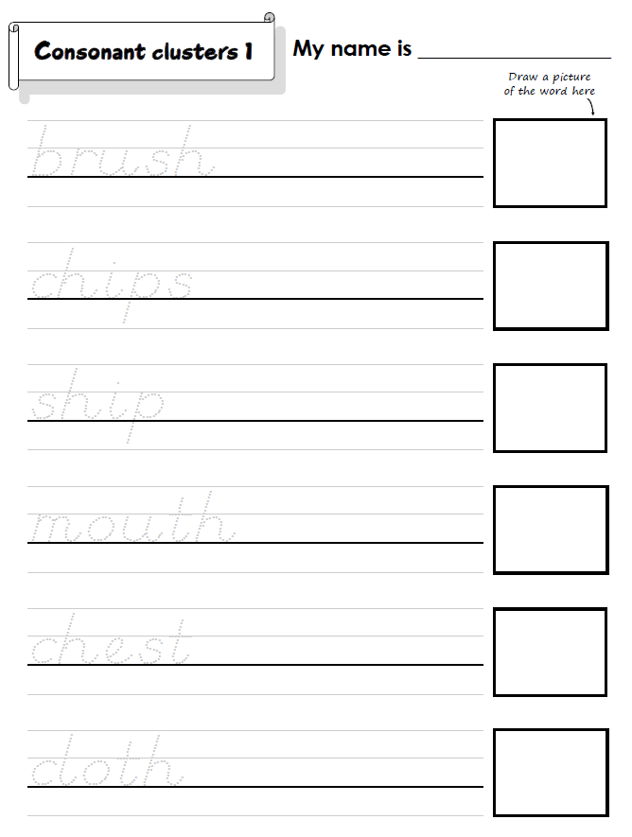
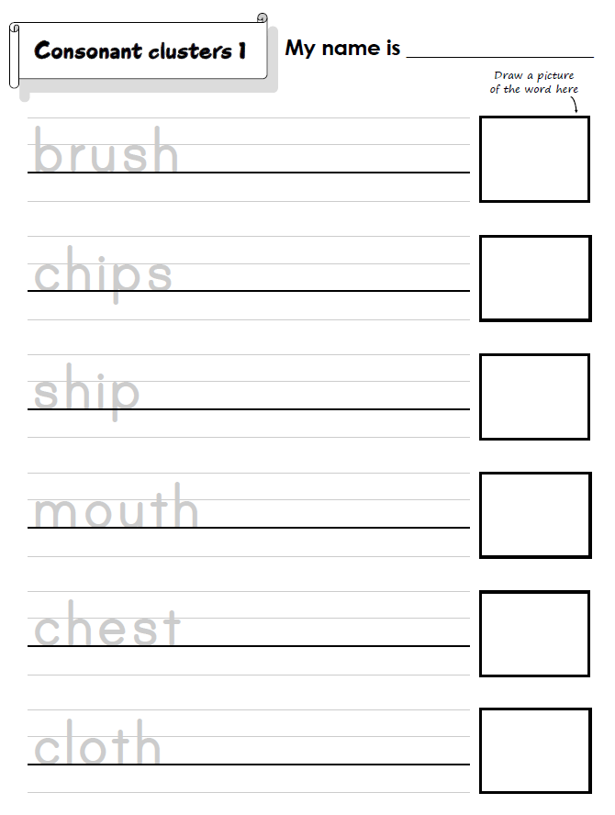

Do the “Consonant clusters 1” printing sheet
We’ll finish with some printing practice.
Hold up the worksheet and model tracing and printing each letter. Clearly show the directions of printing each letter and emphasize the importance of staying on the line. Then draw a picture of the first word.
Have your students work on their worksheets. Spend time with each student helping, asking what the letter is, and praising.
The printing sheet is available in clear print letters or D’Nealian script. D'Nealian is a style of writing in cursive and print (block) handwriting.
Click to see
SAMPLE FOR EVALUATION
Join ESL KidStuff
to view without watermark.
Regular printing sheet
D’Nealian printing sheet
18 | © ESLKidStuff.com
[ Press space bar or left-mouse click to move to the next slide ]

Slide 20
SAMPLE FOR EVALUATION
Join ESL KidStuff
to view without watermark.

