Slide 1
Alphabet – A B C D E
1
Identify, recognize and print 5 uppercase letters.
A, B, C, D, E.
The ABC song (audio & video)
A-E flashcards
A-E printing sheet
Blackboard / Whiteboard with chalk / markers
Use this mini-lesson within your main lesson for alphabet practice. Students should have completed the lower-case alphabet lessons before starting these upper-case alphabet lessons.
Audio is played for the letters and words. If you do not wish the audio to play, please mute your speakers.

Slide 2
A B C D E
- Lesson 1 -

Slide 3


Teacher’s notes are here on every lesson slide.
Sing “The ABC song” Start this section of the lesson with the ABC song to indicate that it’s alphabet time.
Bring everyone’s attention to this slide and play the song.
Encourage everyone to clap along as you sing – after a few classes everyone will be able to sing along with you.
Lyrics for “The ABC song”
A B C D E F G
H I J K L M N
O P Q R S T U
V W and X Y Z
I can sing my ABCs,
Won’t you sing along with me?
Repeat
The ABC song
A
B
C
D
E
F
G
H
I
K
L
M
N
Song audio and video
only available to ESL KidStuff members.
Click here to remove message.
J
Song audio and video
only available to ESL KidStuff members.
Click here to remove message.
SAMPLE FOR EVALUATION
Join ESL KidStuff
to view without watermark.
Click to play song
O
P
Q
R
S
T
U
Play song audio
V
X
Y
Z
W
Play song video
2 | © ESLKidStuff.com
[ Press space bar or left-mouse click to move to the next slide ]

Slide 4

a
Match the letters
Your students have already studied the lower-case letters of the alphabet, so they will find matching the uppercase letters quite easy – you’ll be surprised!
Press space to start. Ask your students to match the first letter – then click space to show the answer.
Continue for all the letters.
E
b
C
Match the letters.
Click space to start.
c
A
SAMPLE FOR EVALUATION
Join ESL KidStuff
to view without watermark.
d
D
e
B
[ Press space bar or left-mouse click to move to the next slide ]

Slide 5
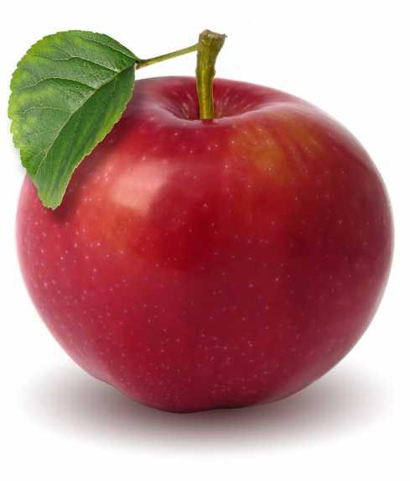




Alphabet letter introduction
Press space to get started.
1. Bring everyone's attention to the first letter on this slide and chorus the letter.
[ Press space ]
2. Say “is for ...“ – elicit the sound.
[ Press space - audio ]
3. Check it is correct.
[ Press space ]
4. Say “is for ...“ – elicit the word.
[ Press space – audio ]
5. The picture is revealed.
[ Press space – next letter ]
Continue for all the letters.
A
is for
/æ/
is for
B
is for
/b/
is for
C
Say the letters, sounds and words.
Click space to start.
is for
/k/
is for
SAMPLE FOR EVALUATION
Join ESL KidStuff
to view without watermark.
D
is for
/d/
is for
E
is for
/e/
is for
[ Press space bar or left-mouse click to move to the next slide ]

Slide 6
Review letters with games
Let’s play a couple of quick games to reinforce these letters. In future lessons you can include previously leaned letters as well.
These games can be rotated each week.
Hold it up
Give out all the letter flashcards to the students. Each student can have more than one letter. Say a letter and the student holding that card must hold it up in the air. Variation: say different actions as well - the student holding the card must do them, e.g. “The student with card “A”, jump 5 times!”
Letter touch
Place the alphabet letter cards, face-up, on the floor. Students sit in a circle around the cards. Tell everyone to hold up their hands. The teacher then says a letter and the students must race to touch that letter first. The person who touches the letter first picks up the card and keeps it. At the end of the game, the
student with the
most letter cards
is the winner.
Find it
Hold up a letter flashcard and the students search around the room for an object beginning with that letter. (e.g. A - Arm, B - Book, C - Clock).
SAMPLE FOR EVALUATION
Join ESL KidStuff
to view without watermark.
Slow motion
Hold the pack of alphabet flashcards with the letters facing towards yourself. The first letter card should be turned around, so the letter is facing the students but is hidden as it is behind the pack. Slowly pull the flashcard up inch by inch so the students can only see part of the letter. As the letter is slowly revealed, students try to guess
what it is. The first student to guess
correctly keeps the card (for
1 point). Variation: to make
it a little more difficult, turn
each letter flashcard upside
down.
Vanishing alphabet flashcards
Stick the flashcard letters to the board. Tell everyone to close their eyes. Take away one of the flashcards and then tell your students to open their eyes again. The first student to shout out
the missing letter
can keep that
flashcard.
At the end of the
game, the student
with the most letter
cards is the winner.
[ Press space bar or left-mouse click to move to the next slide ]

Slide 7
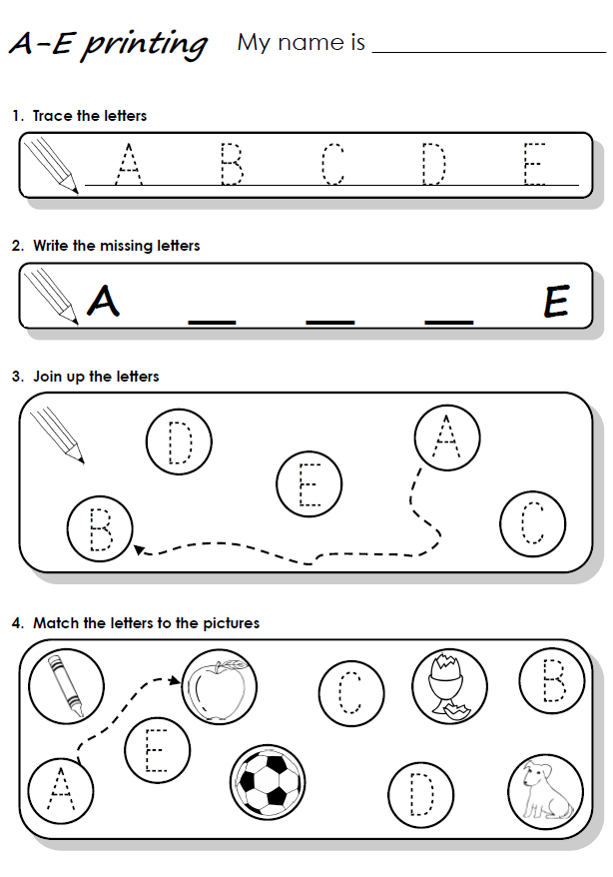

Do the “A-E printing” sheet
We’ll finish with some printing practice.
Hold up the worksheet and model tracing and printing each letter in exercises 1 and 2. Clearly show the directions of printing each letter and emphasize the importance of staying on the line.
Then show how to do exercises 3 and 4 – joining the letters in alphabetical order and then matching to the pictures.
Have your students work on their worksheets. Spend time with each student helping, asking what the letter is, and praising.
SAMPLE FOR EVALUATION
Join ESL KidStuff
to view without watermark.
Click to see
printing sheet
6 | © ESLKidStuff.com
[ Press space bar or left-mouse click to move to the next slide ]

Slide 8
SAMPLE FOR EVALUATION
Join ESL KidStuff
to view without watermark.

