Slide 1
Paula the penguin
2
Read, understand and write a simple text.
None
None
Paper and pens/pencils for each student.
Use this mini-lesson within your main lesson for reading and writing practice.

Slide 2
Paula the penguin
- Lesson 2 -

Slide 3

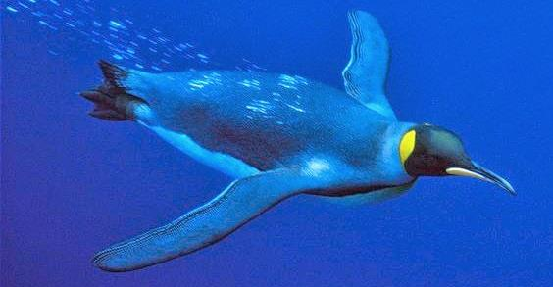
1
Read the story
(Slide 1 of 3)
We are going to read a short story together line-by-line.
Press space to start.
Bring everyone's attention to the first sentence. Read together as a class – help out with sounds and vocabulary.
Press space for each new sentence – there are also some pictures.
Continue through all the slides to the end of the story.
When finished, have everyone do a final read through at a faster pace.
Read the story
This is Paula. She is a penguin.
SAMPLE FOR EVALUATION
Join ESL KidStuff
to view without watermark.
Every day she swims in the sea.
[ Press space bar for next sentence ]
Can you read this story?
Press space bar
to start.

Slide 4
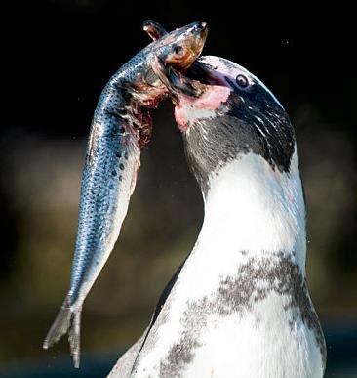
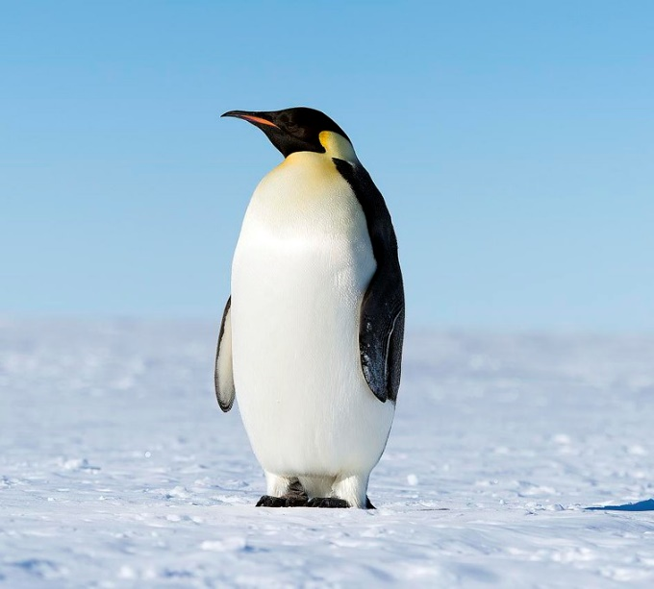
2
Read the story
(Slide 2 of 3)
We are going to read a short story together line-by-line.
Press space to start.
Bring everyone's attention to the first sentence. Read together as a class – help out with sounds and vocabulary.
Press space for each new sentence – there are also some pictures.
Continue through all the slides to the end of the story.
When finished, have everyone do a final read through at a faster pace.
Read the story
Paula eats fish. She loves fish.
SAMPLE FOR EVALUATION
Join ESL KidStuff
to view without watermark.
She can’t walk fast.
[ Press space bar for next sentence ]

Slide 5
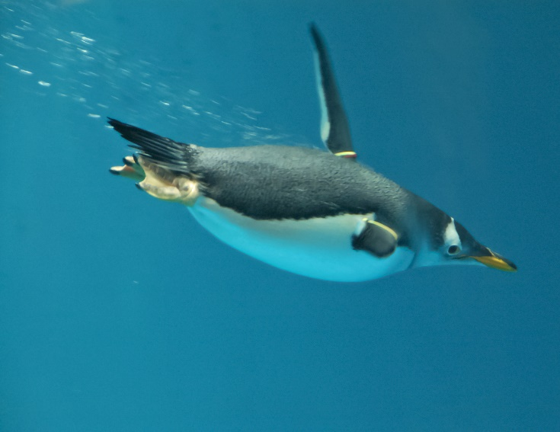
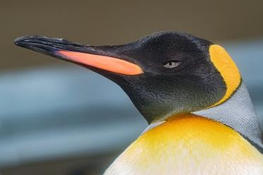
3
Read the story
(Slide 3 of 3)
We are going to read a short story together line-by-line.
Press space to start.
Bring everyone's attention to the first sentence. Read together as a class – help out with sounds and vocabulary.
Press space for each new sentence – there are also some pictures.
Continue through all the slides to the end of the story.
When finished, have everyone do a final read through at a faster pace.
Read the story
But she can swim very fast.
SAMPLE FOR EVALUATION
Join ESL KidStuff
to view without watermark.
She is big and beautiful.
[ Press space bar for next sentence ]
This Photo by Unknown Author is licensed under CC BY-SA

Slide 6
Answer questions about the story
Let’s read the questions about the story and answer them.
Bring everyone's attention to the first question. Read together as a class – help out with sounds, vocabulary and intonation.
Then ask a student for the answer. Encourage full sentence answers, not just a single word.
Give lots of praise for a correct answer and give help where needed.
Press space for each new question and get different students to answer.
Answer the questions
What is the penguin’s name?
What does she do every day?
What does she eat?
Does she like fish?
Can she walk fast?
Can she swim fast?
What does she look like?
SAMPLE FOR EVALUATION
Join ESL KidStuff
to view without watermark.
[ Press space bar for next sentence ]

Slide 7
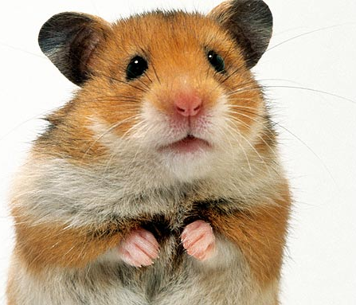
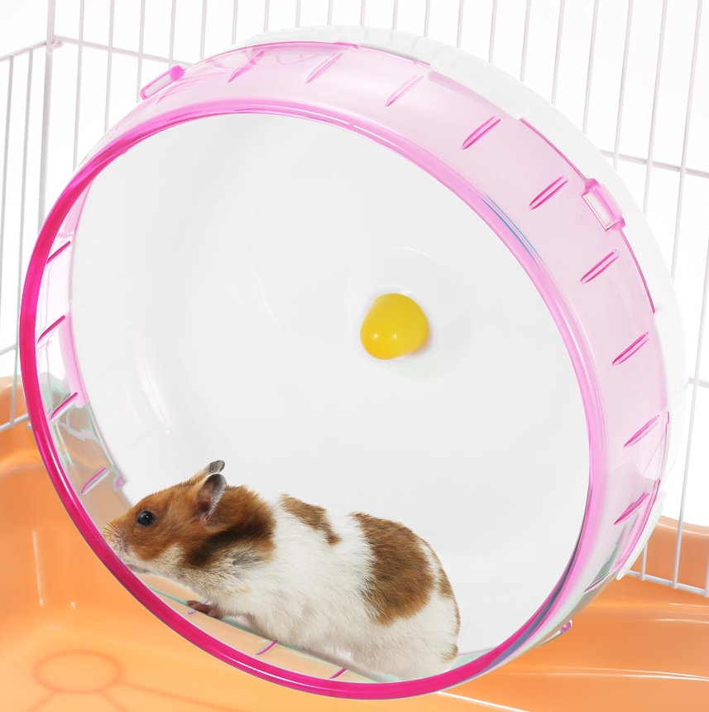
Make a new story
Your students are going to write a story about an animal. They can choose any animal, or even their pet.
Press space to start and read the task. Then press space and get everyone to read the questions.
Again, read the first question together as a class – help out with sounds, vocabulary and intonation.
Next, press space and read the example – you can say this is your pet!
Write a story
[ Press space bar to continue ]
Think of an animal. It can be any animal or even your pet. It is a girl.
An example:
a hamster
What is her name?
What does she do every day?
What does she eat?
What can’t she do well?
What can she do well?
What does she look like?
Suzie.
sleeps and runs.
seeds and apples.
climb.
run fast in her wheel.
fat and cute.
SAMPLE FOR EVALUATION
Join ESL KidStuff
to view without watermark.
[ Press space bar for next sentence ]

Slide 8

Write a story
Make sure everyone has a piece of paper and a pen or pencil. Even better is a dedicated writing notebook or folder so students can keep all their stories in one place.
Press space to start. The example story will appear, with some parts underlined. Explain that they can use this story as a model and replace the underlined words with their own answers. They should also draw pictures!
Have students write their stories. Circulate and help out with their writing as well as the vocabulary and spelling of new words.
Finally, have a couple of students stand up and read their stories to the class.
Write a story
This is Suzie. She is a hamster.
Every day she sleeps and runs.
She eats seeds and apples. She loves apples.
She can’t climb well.
But she can run fast in her wheel.
She is fat and cute.
Write your story.
SAMPLE FOR EVALUATION
Join ESL KidStuff
to view without watermark.
Press space to start.
[ Press space bar for next sentence ]

Slide 9
SAMPLE FOR EVALUATION
Join ESL KidStuff
to view without watermark.

