Slide 1
I’m Tom
1
Read, understand and write a simple text.
None
None
Paper and pens/pencils for each student.
Use this mini-lesson within your main lesson for reading and writing practice.

Slide 2
I’m Tom
- Lesson 1 -

Slide 3
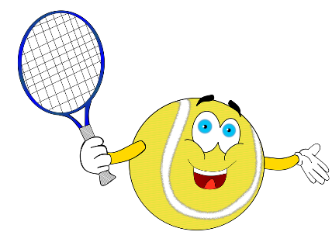

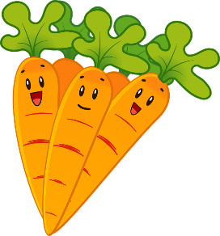
Read the story
We are going to read a short story together line-by-line.
Press space to start.
Bring everyone's attention to the first sentence. Read together as a class – help out with sounds and vocabulary.
Press space for each new sentence – there are also some pictures.
When finished, have everyone do a final read through at a faster pace.
Read the story
Hello, I’m Tom.
I’m 7-years old.
Can you read this story?
Press space bar
to start.
I like playing tennis.
SAMPLE FOR EVALUATION
Join ESL KidStuff
to view without watermark.
I love eating popcorn.
But I don’t like carrots.
[ Press space bar for next sentence ]

Slide 4
Answer questions about the story
Let’s read the questions about the story and answer them.
Bring everyone's attention to the first question. Read together as a class – help out with sounds, vocabulary and intonation.
Then ask a student for the answer. Encourage full sentence answers, not just a single word.
Give lots of praise for a correct answer and give help where needed.
Press space for each new question and get different students to answer.
Answer the questions
What is the boy’s name?
How old is he?
What sport does he like?
SAMPLE FOR EVALUATION
Join ESL KidStuff
to view without watermark.
What food does he love?
What food doesn’t he like?
[ Press space bar for next sentence ]

Slide 5
Answer student questions
Now we’ll ask the same questions but personalize them to your students.
Again, read the first question together as a class – help out with sounds, vocabulary and intonation.
Then ask a student for the answer. Encourage full sentence answers, not just a single word.
Give lots of praise for a correct answer and give help where needed.
Press space for each new question and get different students to answer.
Answer the questions
What’s your name?
How old are you?
What sport do you like?
SAMPLE FOR EVALUATION
Join ESL KidStuff
to view without watermark.
What food do you love?
What food don’t you like?
[ Press space bar for next sentence ]

Slide 6

Write a story
Students can now practice writing. Make sure everyone has a piece of paper and a pen or pencil. Even better is a dedicated writing notebook or folder so students can keep all their stories in one place.
Press space to start.
The original story will appear, with some parts underlined. Explain that they can use this story as a model and replace the underlined words with their own answers.
Have students write their stories. Circulate and help out with their writing as well as the vocabulary and spelling of new words.
Finally, have a couple of students stand up and read their stories to the class.
Write a story
Hello, I’m Tom.
I’m 7-years old.
I like playing tennis.
I love eating popcorn.
But I don’t like carrots.
Write your story.
SAMPLE FOR EVALUATION
Join ESL KidStuff
to view without watermark.
Press space to start.
[ Press space bar for next sentence ]

Slide 7
SAMPLE FOR EVALUATION
Join ESL KidStuff
to view without watermark.

