Slide 1
Hello!
1
Introductions and classroom objects

Slide 2
a pen
a notebook
coloured pencils

Slide 3
1
Say hello to Peter the puffin
Talk and write about you
Say hello and greet everyone
2
3
4
Say and write the names of classroom objects
SAMPLE FOR EVALUATION
Join ESL KidStuff
to view without watermark.
[ Press space bar or left-mouse to continue ]

Slide 4



Introductions (1)
Write your name on the card.
Take a card.
Emi
SAMPLE FOR EVALUATION
Join ESL KidStuff
to view without watermark.
Fold your card.
Use big letters!
Take a pencil.

Slide 5

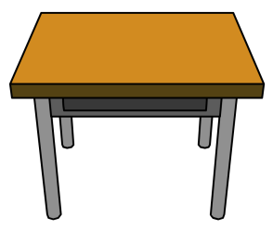


Introductions (2)
Read the classmates saying hello.
Put your card on your desk.
Hello there. I’m David.
Emi
SAMPLE FOR EVALUATION
Join ESL KidStuff
to view without watermark.
Hi Peter. My name’s Emi.
Hello Emi. I’m Kate
Nice to meet you, Kate.

Slide 6
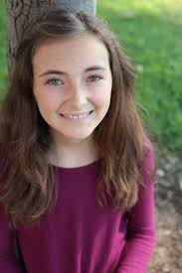
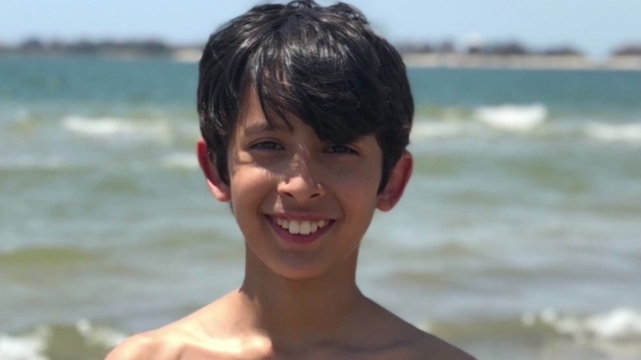
Introductions (3)
Read what the people say.
Say the words.
Hello. My name’s Adinda.
SAMPLE FOR EVALUATION
Join ESL KidStuff
to view without watermark.
Hi there. I’m Jennifer.
Say hello and tell the class your name.
Hello. My name’s _______.

Slide 7


Nice to meet you
Stand up.
Greet each other.
Hello. My name’s Mohammed. Nice to meet you.
SAMPLE FOR EVALUATION
Join ESL KidStuff
to view without watermark.
Hi there, Mohammed. I’m Choi.
Nice to meet you too.
Hello there. My name’s Lisa. Nice to meet you.

Slide 8
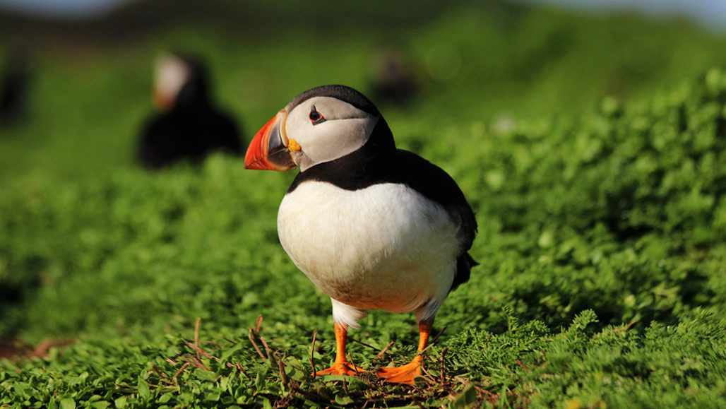
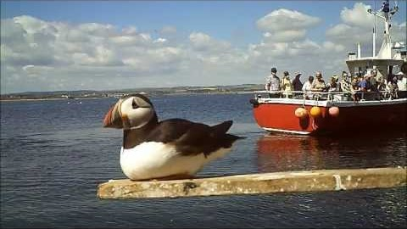

Greet Peter
Peter the Puffin
SAMPLE FOR EVALUATION
Join ESL KidStuff
to view without watermark.
Peter
Hello there.
Nice to meet you!
i
Notes:
An internet connection is required to view this YouTube video. The video is a short YouTube clip of Peter the Puffin. It is not necessary for the lesson, but is a nice feature to show if possible.

Slide 9
About Peter
His first name is Peter.
His surname is Puffin.
Peter is two years old.
He lives on an island.
His favourite colour is blue.
Blue is the colour of the sea.
Peter likes the sea.
SAMPLE FOR EVALUATION
Join ESL KidStuff
to view without watermark.
Hello Peter.
Nice to meet you.

Slide 10


Take some notes
Copy the text into your notebooks.
Hello. My name’s ___________.
I live in ________ near __________.
I’m _____ years old and my birthday is on ______ of ______.
I like _________ and __________.
My favourite colour is _________.
Write words that your teacher says in each space in the text.
SAMPLE FOR EVALUATION
Join ESL KidStuff
to view without watermark.
i
Notes:
Note: Read this text to the class giving information about you for the missing parts.

Slide 11
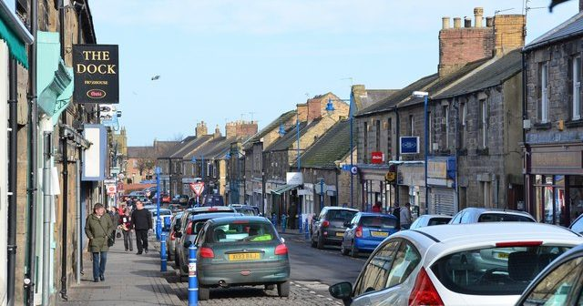
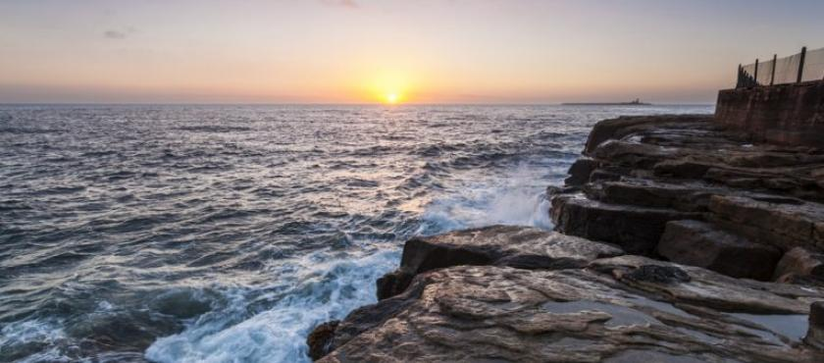

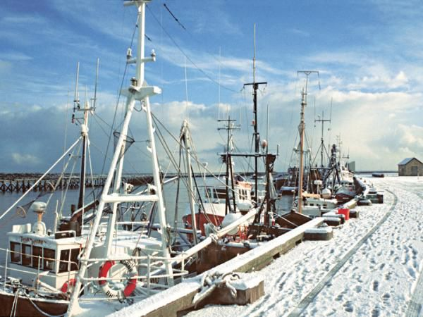
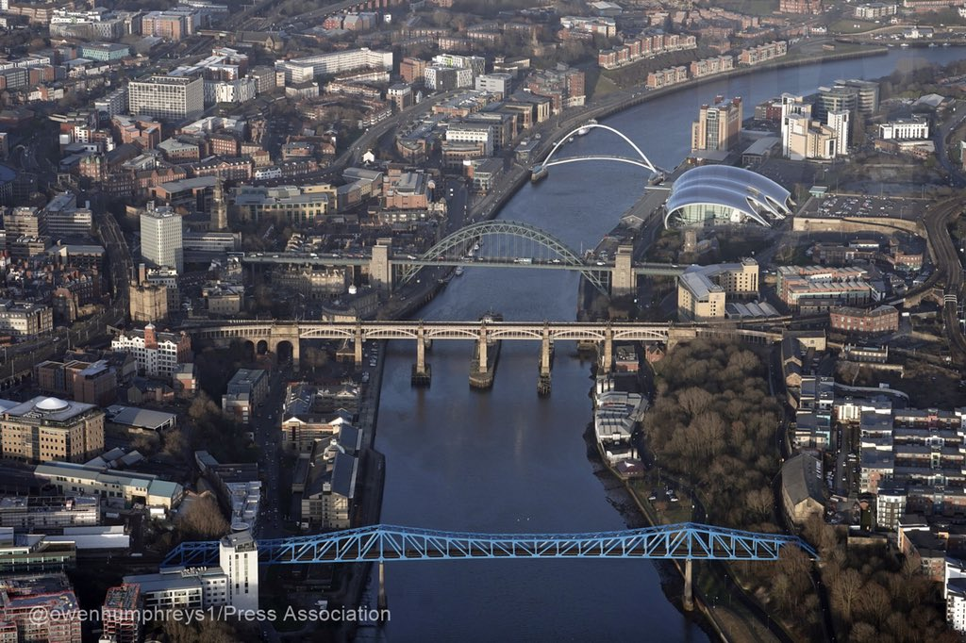
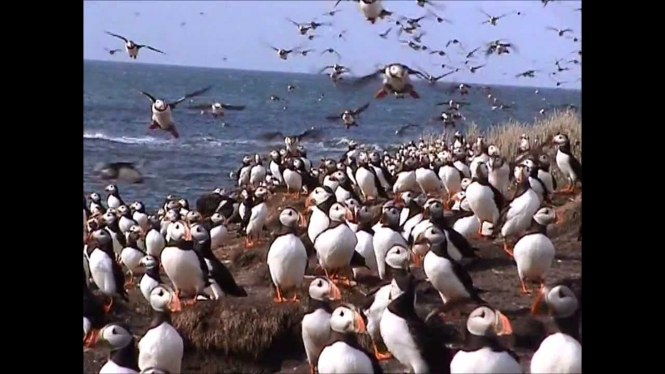
About Freddy
My mother lives in England in small town called Amble.
Read about an English teacher. He lives and works in Italy.
Amble is near the sea too.
My name’s Frederick. Freddy for short.
It’s very beautiful but it is very cold in the winter.
SAMPLE FOR EVALUATION
Join ESL KidStuff
to view without watermark.
I’m from Newcastle, a city in England, but I live in Pomezia near Rome in Italy.
Pomezia is near the sea and I love the sea.
Every March something amazing happens in Amble. The puffins arrive!
There are 40,000 of these incredible birds.

Slide 12
Questions about Freddy
Answer these questions about Freddy.
What is his name?
Where is he from?
Where does he live?
What does he love?
Does his mother live in a big city?
Is Amble warm in winter?
What arrives in Amble every March?
SAMPLE FOR EVALUATION
Join ESL KidStuff
to view without watermark.

Slide 13
About you
Answer these questions about yourself.
What is your first name?
Which name can we call you?
What is your last name?
How old are you?
Where do you live?
What’s your favourite colour?
What do you like?
i
SAMPLE FOR EVALUATION
Join ESL KidStuff
to view without watermark.
Now write about yourself.
Notes:
Notes: Ask students orally before the doing the writing exercise.

Slide 14
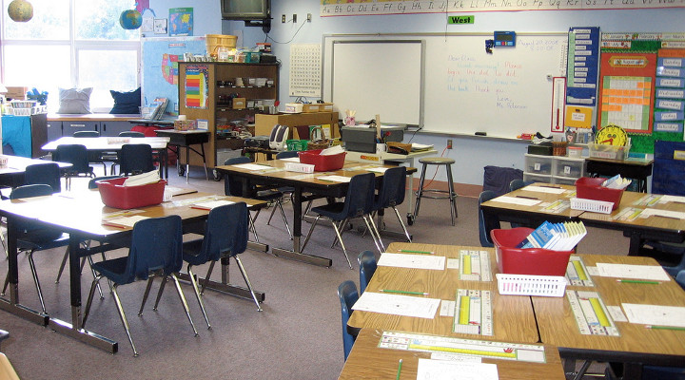
Things in the classroom
Vocabulary development
SAMPLE FOR EVALUATION
Join ESL KidStuff
to view without watermark.
Notes:
The video is a short YouTube clip of Peter the Puffin. It is not necessary for the lesson, but is a nice feature to show if possible.

Slide 15





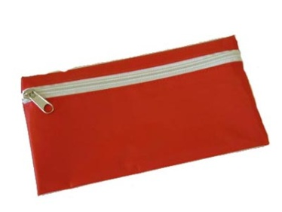


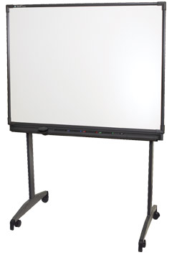
Classroom vocabulary (1)
Can you say the names of more things in the classroom?
Match each phrase with a picture.
a desk
a rubber
a waste bin
a pen
a chair
a teacher
a notebook
a whiteboard
a pencil case
SAMPLE FOR EVALUATION
Join ESL KidStuff
to view without watermark.
A ruler
Listen to your teacher say the words and phrases and repeat.
Try to remember the names of things in the classroom.

Slide 16



Classroom vocabulary (2)
Repeat these words after your teacher.
Look at this classroom.
a wall
a wall
a blackboard
What’s this in English?
SAMPLE FOR EVALUATION
Join ESL KidStuff
to view without watermark.
a bookcase
Peter the Puffin
It’s a pencil sharpener.
a door
How do you spell that?
books
a desk
a desk
P-E-N-C-I-L-new word-S-H-A-R-P-E-N-E-R.
a chair
a chair
the floor
a pencil sharpener.
paper
a desk
Now ask and answer questions with a partner.

Slide 17
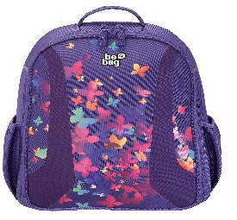


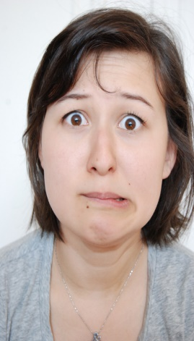

Reading
Where’s my phone?
What do these pictures show?
Listen as your teachers reads.
Mm …Where’s my mobile phone? OK. I have my pencil case, my notebook and a pen on my desk! OK. I have coloured pencils, a rubber, a ruler and a pencil sharpener in my pencil case. I have a dictionary and some books in my bag … so where’s my phone? Oh NOOOO!!!
a desk
a pencil case
a bag
SAMPLE FOR EVALUATION
Join ESL KidStuff
to view without watermark.
on your desk
in your bag
in your pencil case
in your coat
Listen.
a coat
What’s the problem?
Where’s your mobile phone?

Slide 18
1
Say hello to Peter the puffin
Talk and write about you
Say hello and greet everyone
2
3
4
Say and write the names of classroom objects
SAMPLE FOR EVALUATION
Join ESL KidStuff
to view without watermark.

Slide 19
Thank you!
SAMPLE FOR EVALUATION
Join ESL KidStuff
to view without watermark.
Do you have any questions?

