Slide 1
Days of the week
9
Saying the days of the week, describing weekly routines.
“What day is it (today)?”, Today is (Thursday)”, “What is [ he / she ] doing?”
Monday ~ Sunday, play [basketball], practice [piano], go to [the movie theater], have [computer] class, watch a DVD, do [ballet], sleep in late, walk my dog, enjoy a big dinner.
Weather and clothes vocabulary from previous lessons.
Days of the week song (audio & video)
Days of the week reader (video)
Days of the week order worksheet
Days calendar worksheet
Days of the week reader worksheet
name tags for each student
board with markers / chalk
empty plastic bottle (for the spin the bottle game)
weather board (from previous class)
7 colored rectangles of card with a day of week written on each card (one set for each pair of students)
black marker pen
Blu-Tack
In this lesson students learn to say and read the days of the week. They discuss what they do on a regular basis each week and read a story about two students’ weekly routine.

Slide 2
What day is it?
- Days of the week -

Slide 3
Warm up and maintenance
Greetings and name tags
Play “Spin the bottle”
Homework check
Talk about the weather using the "Weather board"
Review clothes
SAMPLE FOR EVALUATION
Join ESL KidStuff
to view without watermark.
2 | © ESLKidStuff.com
[ Press space bar or left-mouse click to move through the slides ]

Slide 4
1
Teacher’s notes are here on every lesson slide.
Greetings and name tags
Greet the students as they enter the classroom and gesture for them to sit down.
Before class prepare some blank name tags (stickers or pin-on tags).
Give the tags out and have everyone write their names and put their tags on. If you use pin-on tags, you can keep and give out every class.
SAMPLE FOR EVALUATION
Join ESL KidStuff
to view without watermark.
Name tags
[ Press space bar or left-mouse click to move to the next slide ]

Slide 5
2
Play “Spin the bottle”
Let’s review previous lessons with this fun game. Sit everyone in a circle with a bottle in the middle. Teacher spins the bottle. When it stops spinning the student it is pointing to has to answer a question. If the answer is correct, then that student can spin the bottle. Either the teacher or the student spinning the bottle can ask the questions.
Round 1:
Numbers 1-10 and classroom objects / stationery - “How many tables are there?”, “There are 6 tables”.
Round 2:
Likes & dislikes for food and drink – “Do you like milk?”, “Yes, I do / No, I don’t”.
… click panel for more »
Round 3:
Clothes - “What are you wearing?”, “I’m wearing a t-shirt and jeans”.
Round 4:
Clothes and weather – “What do you wear on rainy days?”, “I wear a coat and boots”.
… click panel to go back »
SAMPLE FOR EVALUATION
Join ESL KidStuff
to view without watermark.
Spin the bottle
[ Press space bar or left-mouse click to move to the next slide ]

Slide 6
3
Homework check
Check each student's homework that you set in the last lesson.
Ask each student some questions about their homework worksheet (e.g. “What is this?”, “What are these?”), give lots of praise, and then put some kind of mark on the homework sheet (e.g. a sticker, a stamp or draw a smiley face).
Finally, tell your students to put their homework back into their bags.
SAMPLE FOR EVALUATION
Join ESL KidStuff
to view without watermark.
`
Homework check
5 | © ESLKidStuff.com
[ Press space bar or left-mouse click to move to the next slide ]

Slide 7
4
Talk about the weather using the "Weather board"
Use the weather board that you created in the previous class.
Ask, “How’s the weather today?” and have students put up their hands. Allow one weather condition per student (e.g. It’s rainy) and have each student come up and put a weather picture on the weather board.
Depending on weather conditions, you can introduce more weather words (with pictures … you can get students to draw them), such as:
stormy
misty
showery
freezing
humid
frosty
icy
drizzly
SAMPLE FOR EVALUATION
Join ESL KidStuff
to view without watermark.
Weather board
[ Press space bar or left-mouse click to move to the next slide ]

Slide 8

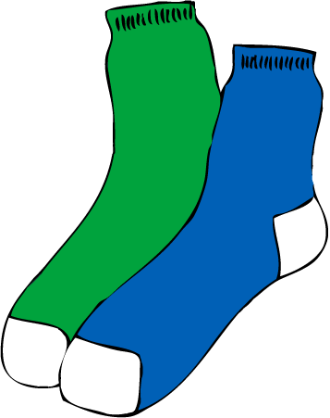
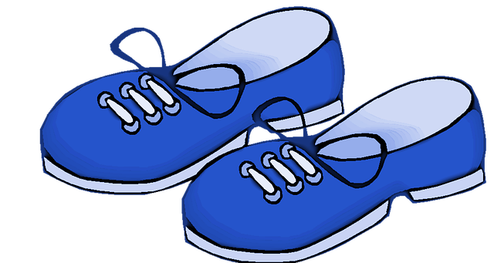


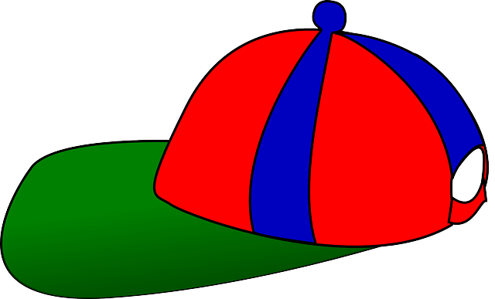
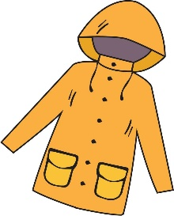




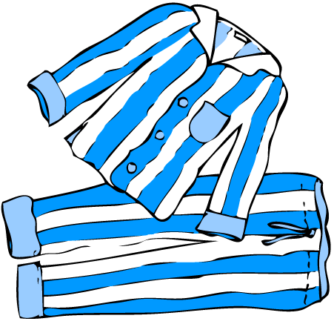


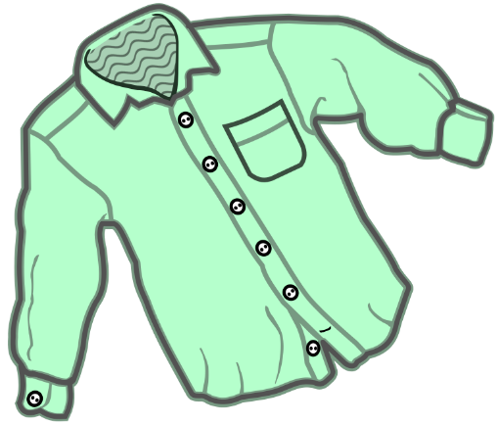


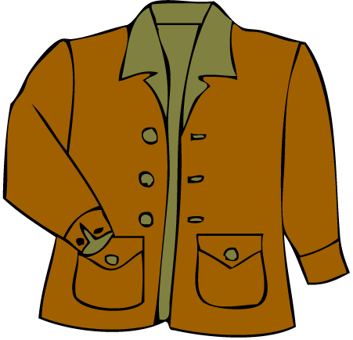
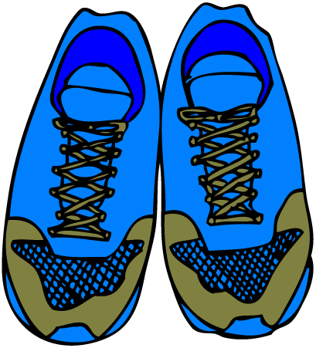


5
Review clothes
Bring everyone’s attention to this slide. Press space to start – the first item (a coat) will appear. Point at it and ask, “What is it?”. Elicit “It’s a coat”. Make sure the correct singular or plural form is used.
For the next clothing items, award points for correct items and usage of singular / plural forms – you can also put students in teams if it is too difficult for individual students to compete.
It’s a scarf.
They’re shoes.
They’re socks.
It’s a blouse.
What is it?
It’s a skirt.
It’s a cap.
Good job!
Press space or left click mouse to move to next slide.
Press left arrow key (◄ ) to go back.
What are they?
Say sentences about clothes, showing if they are singular or plural.
Press space to start.
It’s a dress.
It’s a t-shirt.
It’s a coat.
SAMPLE FOR EVALUATION
Join ESL KidStuff
to view without watermark.
They’re gloves.
They’re pants.
It’s a/an …
They’re …
They’re short pants.
They’re pajamas.
It’s a sweater.
It’s a shirt.
They’re boots.
It’s a hat.
It’s a jacket.
They’re sneakers.
It’s an umbrella.
It’s a belt.
Clothes review
[ Press space bar or left-mouse click to move to the next slide ]

Slide 9
New learning and practice
Introduce the days of the week vocabulary
Play “Put the days in order”
Play the “Days of the week song”
Play “Wall touch”
Do “Days of the week order” worksheet
Read and write time
Read classroom reader “Days of the week“
Talk about your week
SAMPLE FOR EVALUATION
Join ESL KidStuff
to view without watermark.
8 | © ESLKidStuff.com
[ Press space bar or left-mouse click to move through the slides ]

Slide 10
1
Introduce the days of the week vocabulary
Start off by looking at a calendar with everyone (an English one, if possible).
Have some fun with the calendar first: ask students to point at days such as Christmas and to point out their birthdays. Ask what day their birthdays are on this year and point to the days row at the top of each month.
Start to teach / elicit the English words for the days as you discuss their birthdays.
Finally, ask, “What day is it is today?”
SAMPLE FOR EVALUATION
Join ESL KidStuff
to view without watermark.
Calendar days
[ Press space bar or left-mouse click to move to the next slide ]

Slide 11
2
Play “Put the days in order”
Before class, prepare some colored rectangles of card and write the days of the week in thick marker pen on each rectangle of card. You’ll be putting students into pairs so make enough sets for each pair. Also, if each day can be written on a different colored card it will help the students to quickly identify each day.
Put your students in pairs and give each pair a set of mixed up cards. By referring to the calendar, have the pairs put the days in order on the floor or table. Then get everyone to touch each card and repeat after you as you chorus the days of the week paying special attention to the first letter of each word (e.g. "Th" for "Thursday").
… click panel for more »
Run through a few times, getting faster and faster. Finally, get the pairs to mix up the cards and tell them they are going to race to see which pair can put their cards in order first.
Say "Ready, steady, go!" and let the students put the cards in order. The pair that finishes first with the correct order is the winner.
… click panel to go back »
SAMPLE FOR EVALUATION
Join ESL KidStuff
to view without watermark.
Put the days in order
[ Press space bar or left-mouse click to move to the next slide ]

Slide 12


3
Play the “Days of the week song”
Take one set of day cards from a group and stick the cards around the walls of your classroom, in weekday order, starting with Monday. Students are going to point to these cards in time with the song.
Play the song and have students point to each day as it is sung.
Play the song once again, this time encourage everyone to sing along as they point to the cards.
Lyrics for "The days of the week song"
Monday, Tuesday, Wednesday, Thursday, Friday, Saturday, Sunday.
What day is it today?
What day is it today?
Repeat x3
The days of the week song
Monday
Tuesday
Wednesday
Song audio and video
only available to ESL KidStuff members.
Click here to remove message.
Song audio and video
only available to ESL KidStuff members.
Click here to remove message.
Thursday
SAMPLE FOR EVALUATION
Join ESL KidStuff
to view without watermark.
Click to play song
Friday
Saturday
Play song audio
Sunday
Play song video
11 | © ESLKidStuff.com

Slide 13
4
Play “Wall touch”
Give each pair some Blu-Tack or something to stick the cards on the wall with.
Ask everyone to randomly stick the cards all over the walls around the room. Then bring everyone into the middle of the room.
Shout out "Monday" - everyone has to race over to a Monday card and touch it.
Then "Tuesday" and so on (in the correct order) until you make it through all the days.
Play another round, this time faster!
SAMPLE FOR EVALUATION
Join ESL KidStuff
to view without watermark.
Wall touch
[ Press space bar or left-mouse click to move to the next slide ]

Slide 14
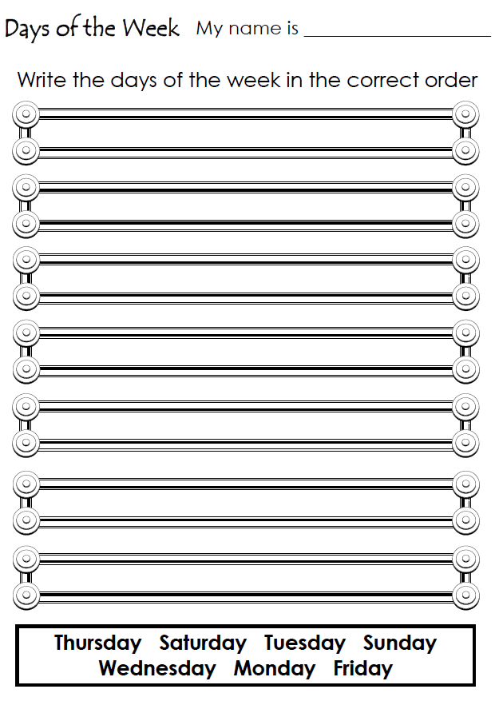
5
Do “Days of the week order” worksheet
Give out a worksheet to each student and tell them to take out their pencils/pens.
Model writing the days of the week in the correct order – do a couple of days. Then have students complete their worksheets.
Circulate as everyone is doing their worksheets. Help with vocabulary and spelling, and also give lots of praise and encouragement!
At the end, ask some students to read out the days from their worksheets.
SAMPLE FOR EVALUATION
Join ESL KidStuff
to view without watermark.
Click to see
Days of the week order
13 | © ESLKidStuff.com
[ Press space bar or left-mouse click to move to the next slide ]

Slide 15
6
Read and write time
This segment can be part of all your lessons. Spend 10 to 15 minutes building up your students’ writing and reading skills.
You’ll need to assess your students’ reading/writing level and then start at one of the following stages:
1. Beginners: students cannot read or write the alphabet
Each lesson introduce 3 lower-case letters of the alphabet. Use flashcards or our alphabet mini-lesson slides. Play alphabet games and do printing worksheets.
» See our ‘Alphabet’ mini-lesson slides for full details.
2. Early starters: Students have experience with the alphabet but need phonics practice.
… click panel for more »
Each lesson introduce 5 lower-case letters of the alphabet. Use flashcards or our alphabet mini-lesson slides. Start by working on the sounds of the letters and then move onto letter clusters (e.g. sh, ee, etc). » See our ‘Alphabet’ and ‘Letter clusters’ mini-lesson slides for full details.
3. Early readers:
Work on reading and writing simple sentences with lots of practice activities. » See our ‘Early reading’ mini-lesson slides for full details.
4. Elementary readers: Students can read and write simple sentences well.
Work on reading and writing short texts and stories. » See our ‘Reading short texts’ mini-lesson slides for full details.
… click panel to go back »
Read
and
write!
SAMPLE FOR EVALUATION
Join ESL KidStuff
to view without watermark.
Read and write
14 | © ESLKidStuff.com
[ Press space bar or left-mouse click to move to the next slide ]

Slide 16
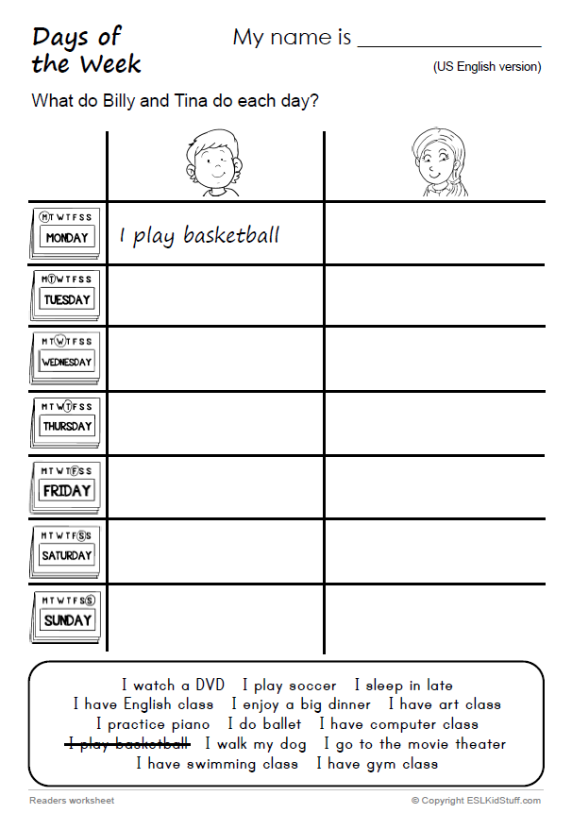
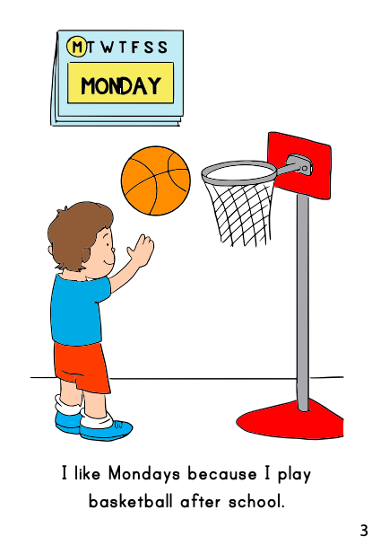
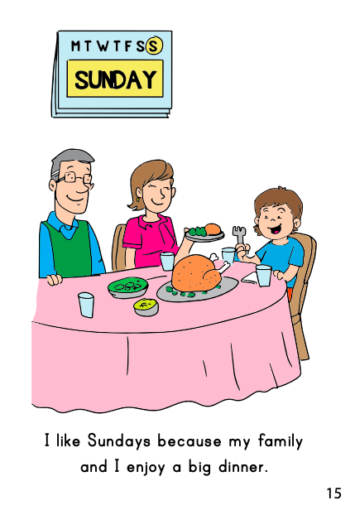
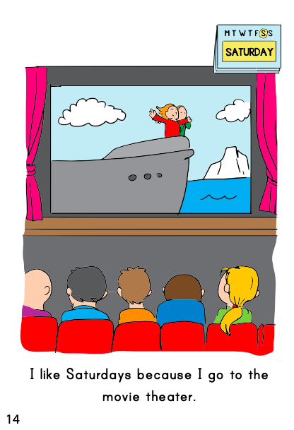
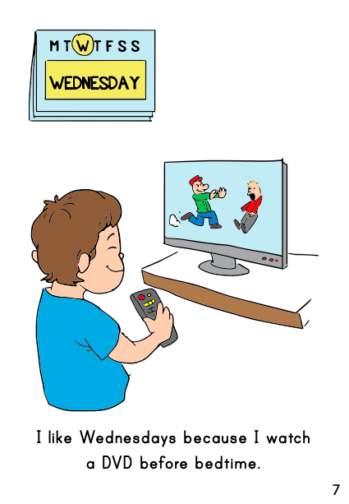
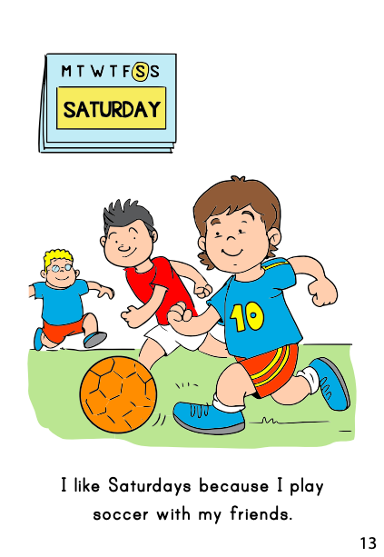
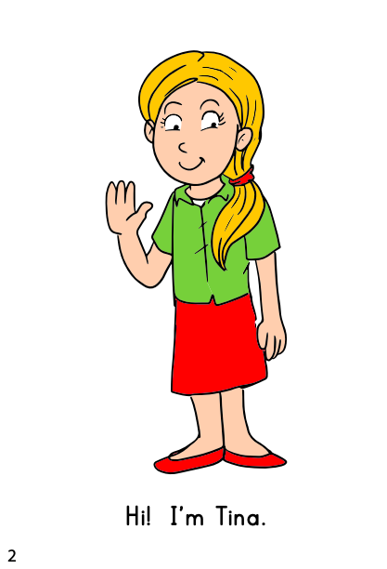
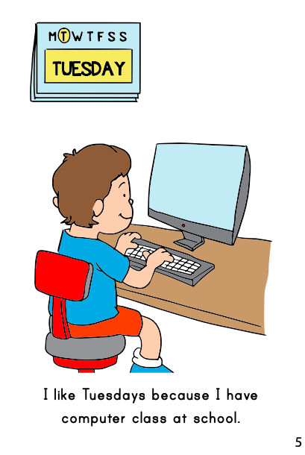
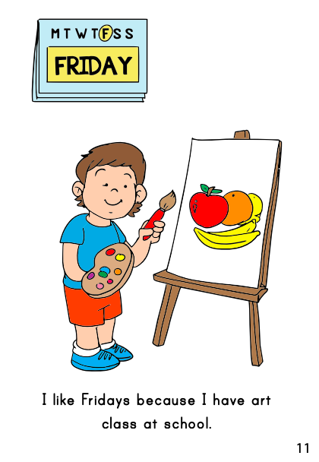
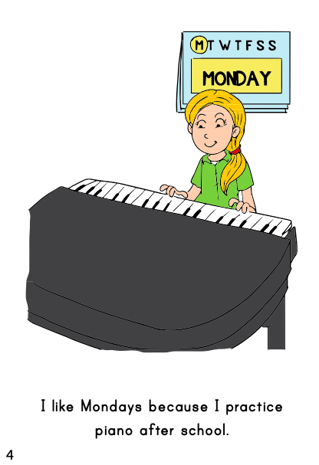
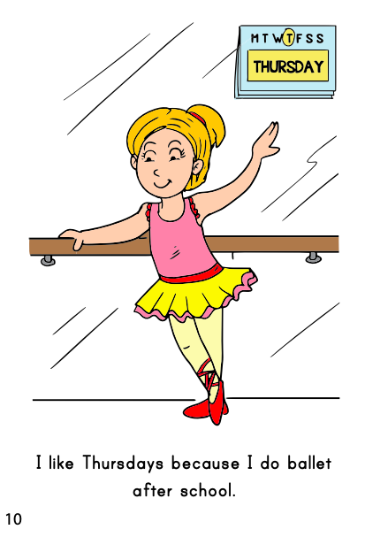
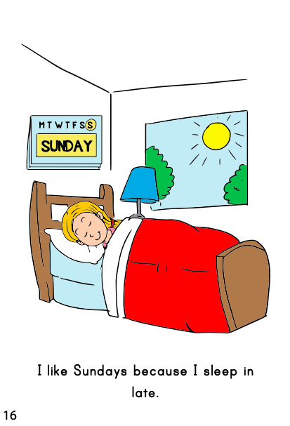
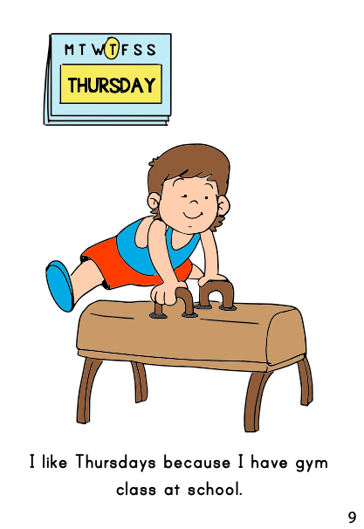
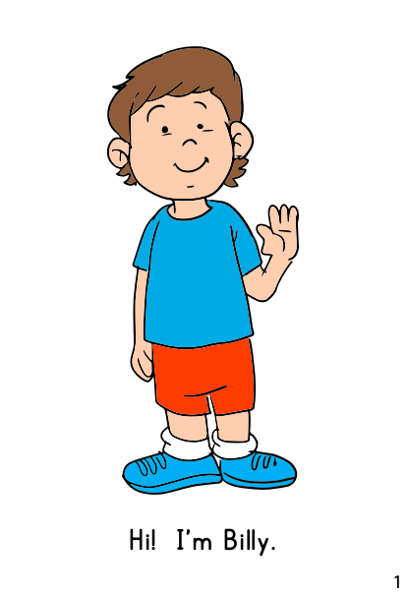
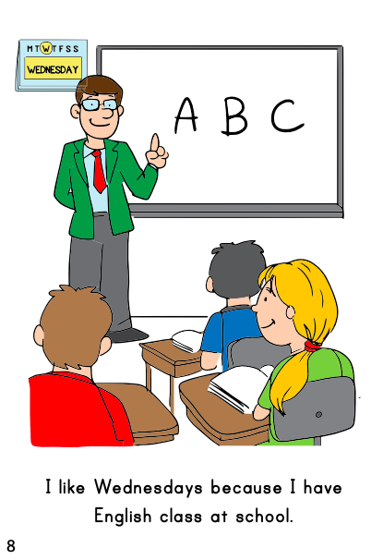
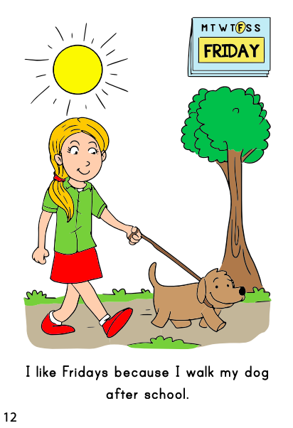
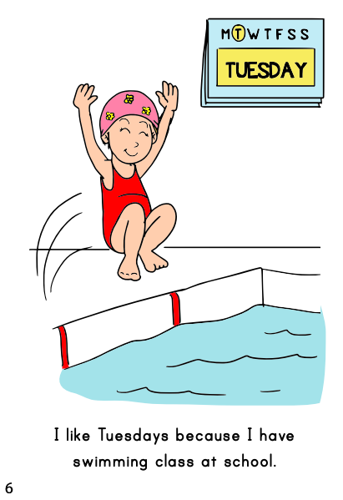
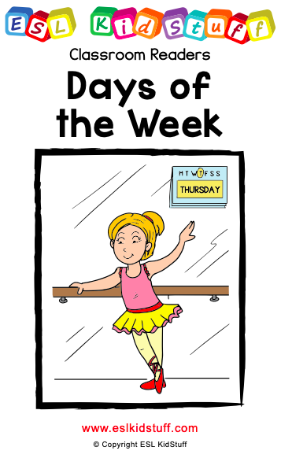

7
Read classroom reader “Days of the week"
Use either these slides or print out the reader booklet. As you go through each page, point to the different activities and ask questions to see if any of your students do these activities on the same day, for example:
Teacher: (pointing on page 3) Look, what is Billy doing?
Students: Playing basketball!
T: Yes, that's right! (reading) "I like Mondays because I play basketball after school". How about you, Kazu, do you play basketball?
S (Kazu): No.
T: Ok, Kazu doesn’t play basketball, does anyone play basketball? ... (some students put hands up) ...
Mari, do you play basketball?
… click panel for more »
S (Mari): Yes.
T: Great? Do you play basketball on Mondays?
S(Mari): No ... Wednesdays.
T: Good! Mari plays basketball on Wednesdays.
Continue through the reader, eliciting the activities the characters do each day – each time write the phrases on the board (e.g. “I play basketball on Mondays”). Have discussions with your students about who does what on different days.
After reading the story, give out a reader worksheet to each student and read through the story one more time (without stopping for questions, etc.) as students complete the table. Then go through the answers as a class.
… click panel to go back »
THE END
Press space or left click mouse to move to next slide.
Press left arrow key (◄ ) to go back through the book pages.
Reader video
only available to ESL KidStuff members.
Click here to remove message.
SAMPLE FOR EVALUATION
Join ESL KidStuff
to view without watermark.
To skip reader and jump to next slide, click here
Play reader video
Reader worksheet
Reader time
[ Press space bar or left-mouse turn pages ]
© ESLKidStuff.com

Slide 17
8
Talk about your week
Bring everyone’s attention to this slide. Read each phrase in the blue boxes to the class and elicit other ideas, for example:
“I play (basketball / soccer / tennis / etc.)” – what other ball sports can you think of?”
Students are going to say what they do on different days, using the phrases as prompts. Model with a student first, for example:
Teacher: On Saturdays, I sleep in late.
Student: On Fridays, I have English class. etc.
Then have students in pairs take turns in saying sentences. Circulate as they do so, checking and helping with mistakes.
Do a final check by asking students to say one sentence each.
On Mondays
On Tuesdays
On Wednesdays
On Thursdays
On Fridays
On Saturdays
On Sundays
I play (basketball / soccer / tennis / etc.).
I sleep in late.
Good job!
Press space or left click mouse to move to next slide.
Press left arrow key (◄ ) to go back.
Tell your partner about what you do on different days.
Use the phrases to help you.
Press space to start.
I practice (piano / guitar / etc. ).
I walk my dog.
SAMPLE FOR EVALUATION
Join ESL KidStuff
to view without watermark.
I go to (the movie theater / the shopping mall / etc.).
I enjoy a big dinner.
I have (computer / swimming / English / gym / art) class.
I watch a DVD.
I do (ballet / judo / etc.).
On Mondays, I …
[ Press space bar or left-mouse click to move to the next slide ]

Slide 18
Wrap up
Assign homework: “Days calendar”
Do “Quick check” and say goodbye
SAMPLE FOR EVALUATION
Join ESL KidStuff
to view without watermark.
17 | © ESLKidStuff.com
[ Press space bar or left-mouse click to move through the slides ]

Slide 19
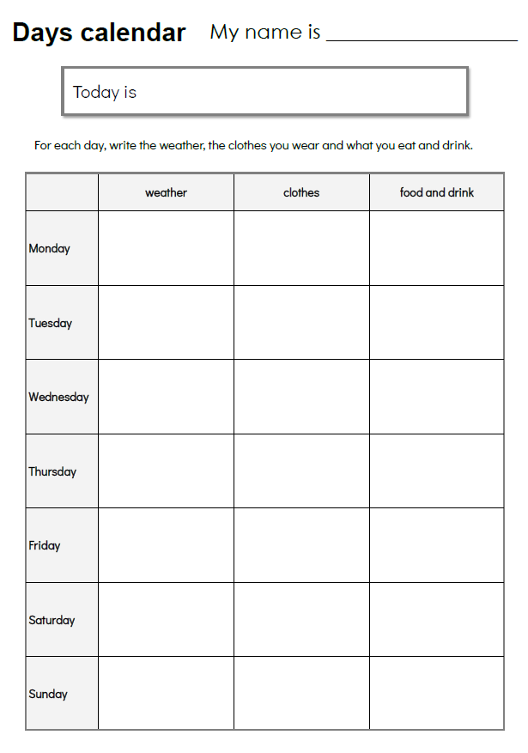
1
Assign homework: “Days calendar”
You’ll need to spend a few minutes explaining how to do this lesson’s homework.
Give out the worksheet to everyone. Hold it up and elicit what day it is for the “Today is” box. Get everyone to write the day.
Next, work with your class to fill in the details for today on the table – find the day and elicit what the weather is like and have everyone write the weather into that cell (e.g. hot, sunny, windy, etc.).
Move onto the clothes column and help everyone write some clothes they are wearing into the cell (e.g. a red t-shirt, blue short pants, etc.).
… click panel for more »
Finally, move onto the food and drink column. Say what you have eaten/drunk today (e.g. a sandwich and tea) and write it into the cell. Have everyone write what they have eaten today onto their worksheets.
Check that everyone has completed today’s information correctly.
Explain that for homework everyone has to write each day about the weather, their clothes and the food and drink they’ve had. By next week’s lesson, their tables should be complete.
Have everyone put their homework into their bags.
… click panel to go back »
SAMPLE FOR EVALUATION
Join ESL KidStuff
to view without watermark.
Click to see
Homework
18 | © ESLKidStuff.com
[ Press space bar or left-mouse click to move to the next slide ]

Slide 20
2
Do "Quick check" and say goodbye
Time to leave the class. Make sure everything is put away and the students have gathered their belongings.
Have them line up at the door and place yourself between the door and the students.
For each student check a day word by holding up a day card (e.g. Tuesday) and asking, “What day is this?”. Then ask a yes/no question, such as, “Do you do ballet on Tuesdays?” – make sure a full answer is given (e.g. “Yes, I do / No, I don’t.”).
When they give you the correct answer say goodbye and let them leave. If their answer is wrong, have them go back to the end of the line - they will have to try again once they reach the front!
SAMPLE FOR EVALUATION
Join ESL KidStuff
to view without watermark.
Goodbye and quick check
19 | © ESLKidStuff.com
[ Press space bar or left-mouse click to move to the next slide ]

Slide 21

The end
Thank you!
SAMPLE FOR EVALUATION
Join ESL KidStuff
to view without watermark.

