Slide 1
Days of the week
9
Saying the days of the week, describing weekly routines.
“What day is it (today)?”, Today is (Thursday)”, “What is [ he / she ] doing?”
Monday ~ Sunday, play [basketball], practice [piano], go to [the cinema], have [computer] class, watch a DVD, do [ballet], sleep in late, walk my dog, enjoy a big dinner.
Weather and clothes vocabulary from previous lessons.
Days of the week song (audio & video)
Days of the week reader (video)
Days of the week order worksheet
Days calendar worksheet
Days of the week reader worksheet
name tags for each student
board with markers / chalk
empty plastic bottle (for the spin the bottle game)
weather board (from previous class)
7 coloured rectangles of card with a day of week written on each card (one set for each pair of students)
black marker pen
Blu-Tack
In this lesson students learn to say and read the days of the week. They discuss what they do on a regular basis each week and read a story about two students’ weekly routine.

Slide 2
Media in these slides
Interactive activities
Vocabulary
Readers / Songs
Printables
Play games and activities on these slides with your class
View lesson vocabulary images on screen
Read stories and play songs on these slides
View worksheets and other printables on these slides
Review clothes
Talk about your week
Days of the week vocab: Monday ~ Sunday
Days of the week song
Days of the week reader
Days calendar worksheet
Days of the week reader worksheet

Slide 3
What day is it?
- Days of the week -

Slide 4

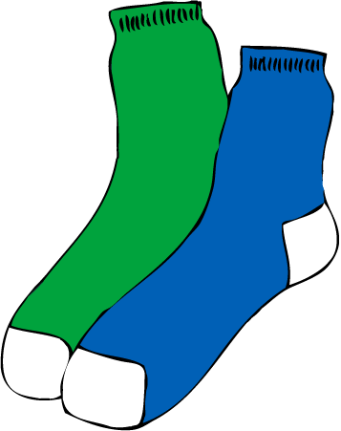
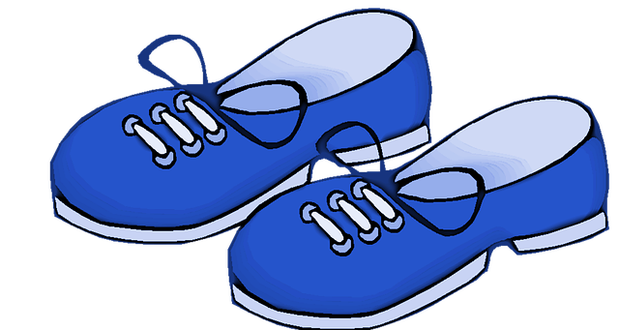
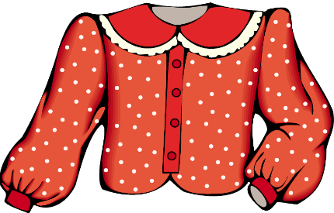

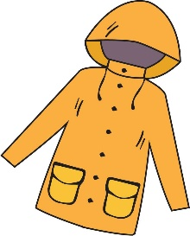





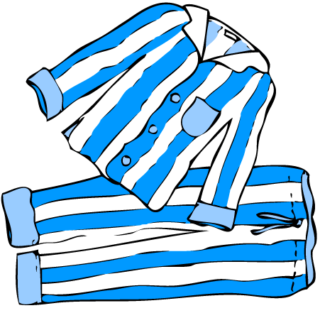


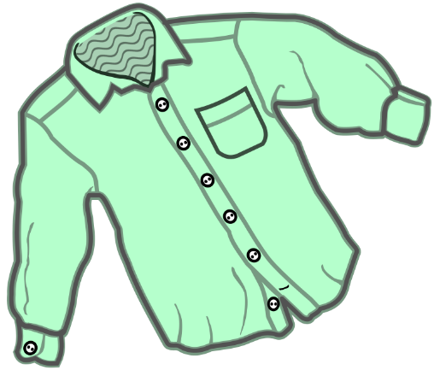


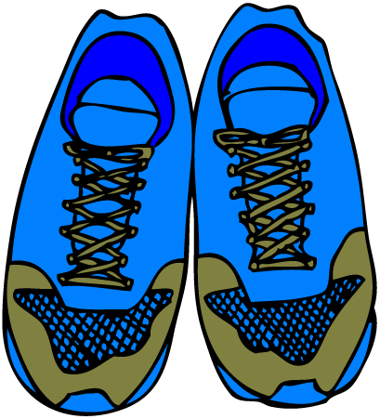



It’s a scarf.
To skip activity and jump to next slide, click here
They’re shoes.
They’re socks.
It’s a blouse.
Good job!
Press space or left click mouse to move to next slide.
Press left arrow key (◄ ) to go back.
What is it?
It’s a skirt.
What are they?
Say sentences about clothes, showing if they are singular or plural.
Press space to start.
It’s a cap.
It’s a dress.
It’s a coat.
It’s a t-shirt.
SAMPLE FOR EVALUATION
Join ESL KidStuff
to view without watermark.
They’re trousers.
It’s a/an …
They’re gloves.
They’re …
They’re pyjamas.
It’s a sweater.
They’re shorts.
It’s a shirt.
They’re boots.
It’s a hat.
They’re trainers.
It’s a jacket.
It’s an umbrella.
It’s a belt.
Clothes review

Slide 5


Click to hear the words
Monday
Tuesday
Wednesday
Thursday
SAMPLE FOR EVALUATION
Join ESL KidStuff
to view without watermark.
Friday
Saturday
Sunday
Days of the week vocab

Slide 6


The days of the week song
Monday
Tuesday
Song audio and video
only available to ESL KidStuff members.
Click here to remove message.
Song audio and video
only available to ESL KidStuff members.
Click here to remove message.
Wednesday
Thursday
SAMPLE FOR EVALUATION
Join ESL KidStuff
to view without watermark.
Click to play song
Friday
Saturday
Play song audio
Sunday
Play song video
5 | © ESLKidStuff.com

Slide 7
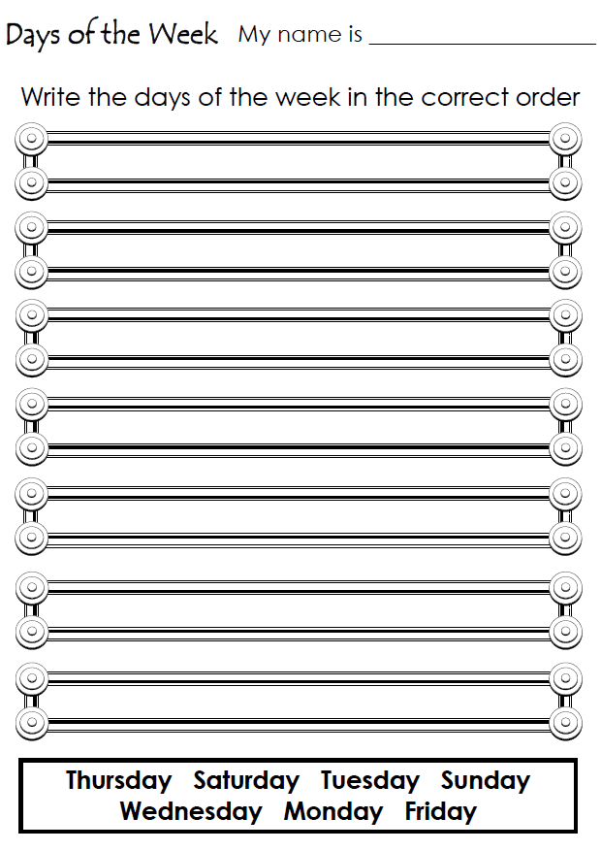
SAMPLE FOR EVALUATION
Join ESL KidStuff
to view without watermark.
Days of the week order

Slide 8
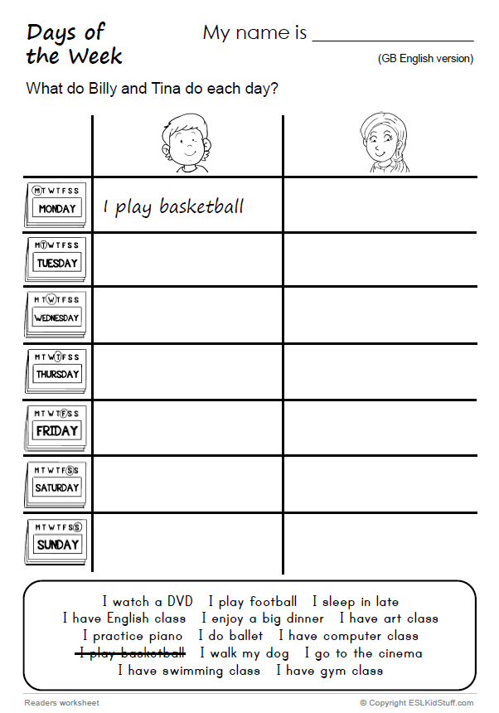
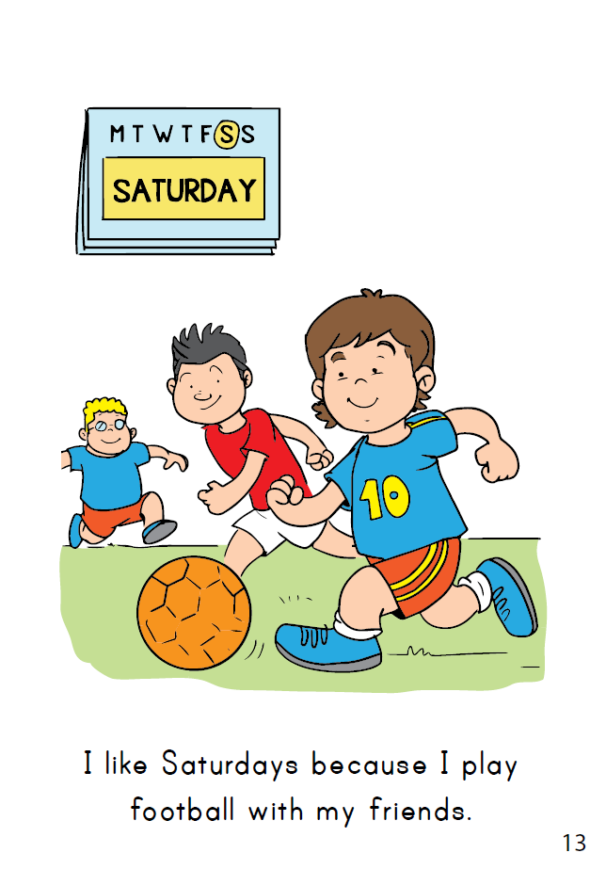
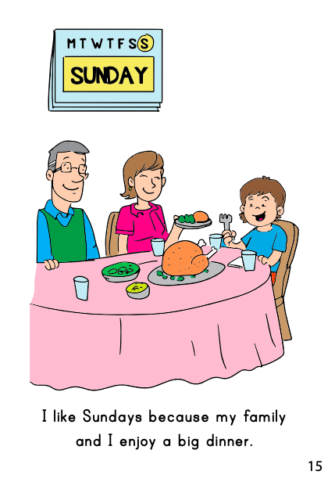
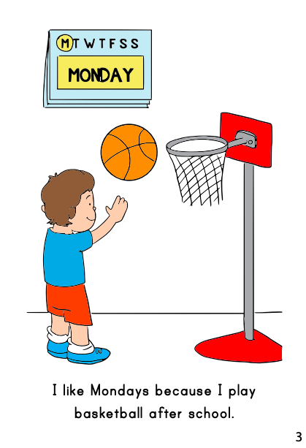
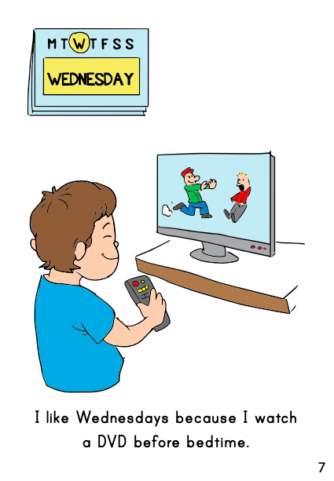
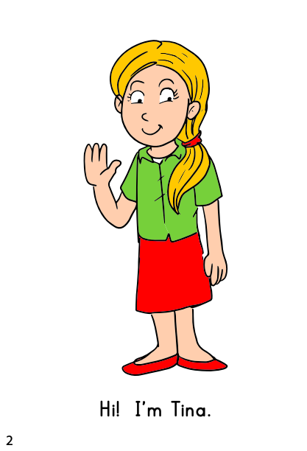
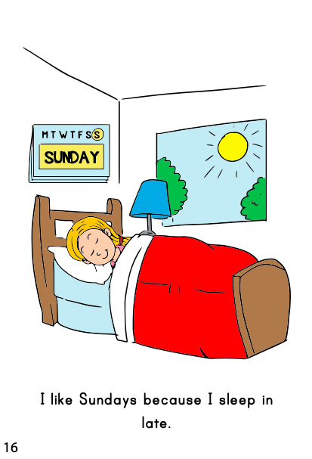
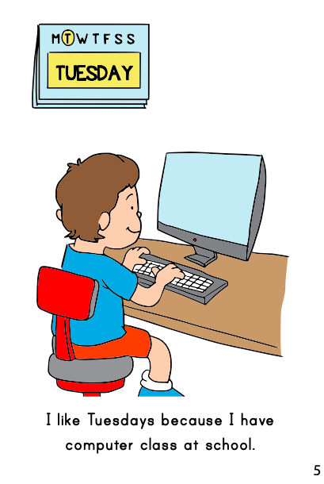
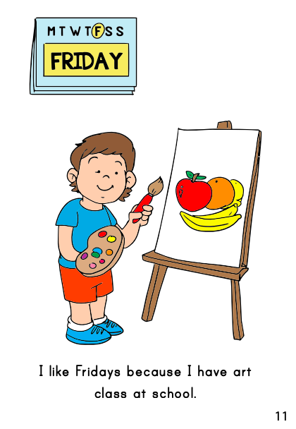
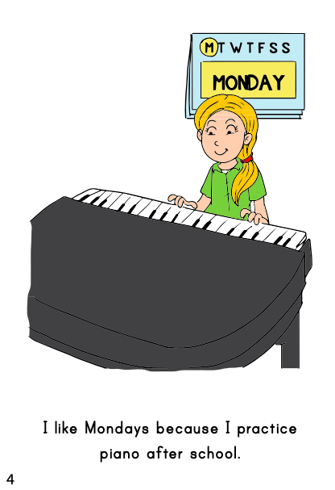
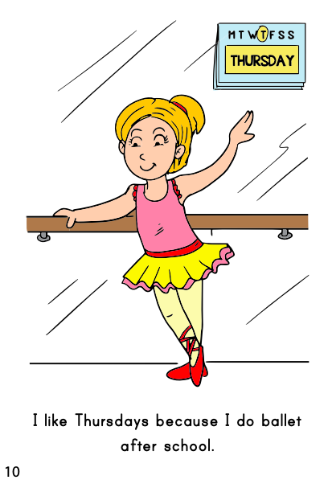
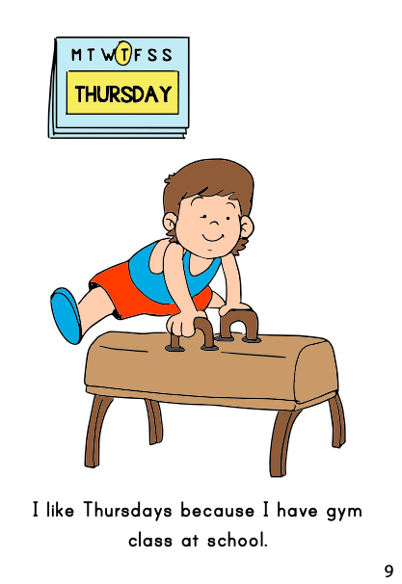
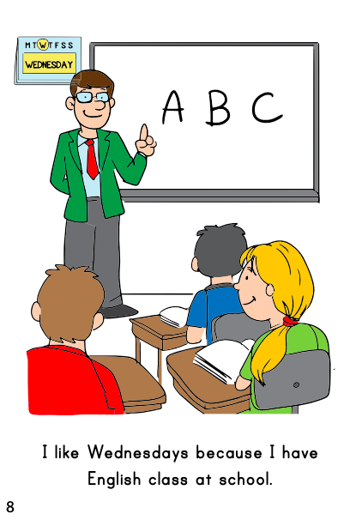
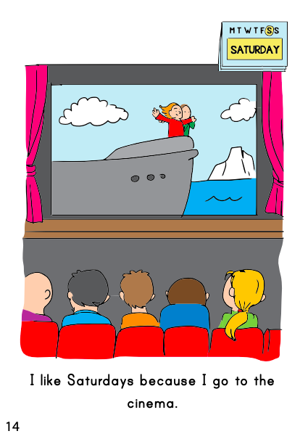
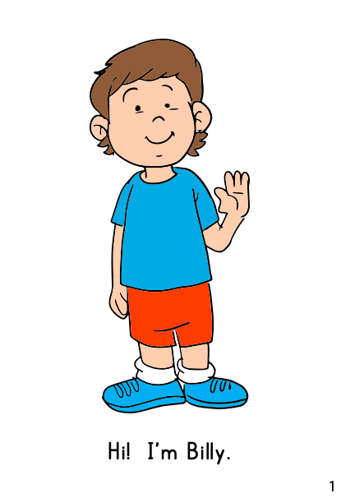
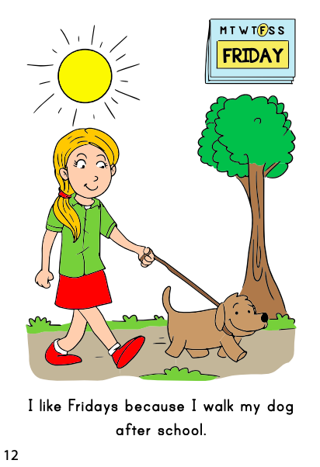
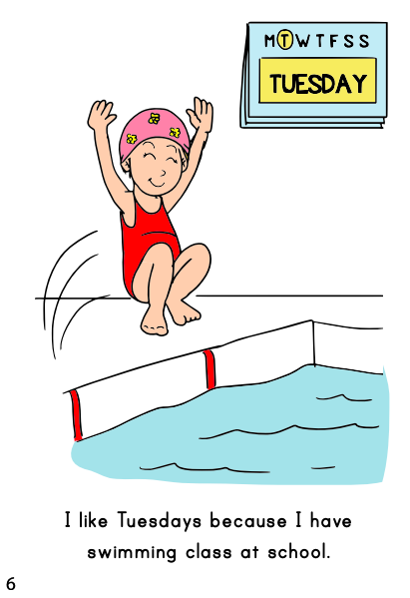
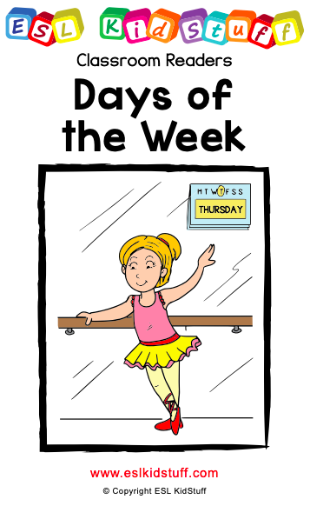

THE END
Press space or left click mouse to move to next slide.
Press left arrow key (◄ ) to go back through the book pages.
Reader video
only available to ESL KidStuff members.
Click here to remove message.
SAMPLE FOR EVALUATION
Join ESL KidStuff
to view without watermark.
To skip reader and jump to next slide, click here
Play reader video
Reader worksheet
Reader time
[ Press space bar or left-mouse turn pages ]
© ESLKidStuff.com

Slide 9
On Mondays
On Tuesdays
On Wednesdays
On Thursdays
On Fridays
On Saturdays
On Sundays
Good job!
Press space or left click mouse to move to next slide.
Press left arrow key (◄ ) to go back.
Tell your partner about what you do on different days.
Use the phrases to help you.
Press space to start.
I play (basketball / football / tennis / etc.).
I sleep in late.
SAMPLE FOR EVALUATION
Join ESL KidStuff
to view without watermark.
I walk my dog.
I practice (piano / guitar / etc.).
I go to (the cinema / the shopping centre / etc.).
I enjoy a big dinner.
I have (computer / swimming / English / gym / art) class.
I watch a DVD.
I do (ballet / judo / etc.).
On Mondays, I …

Slide 10
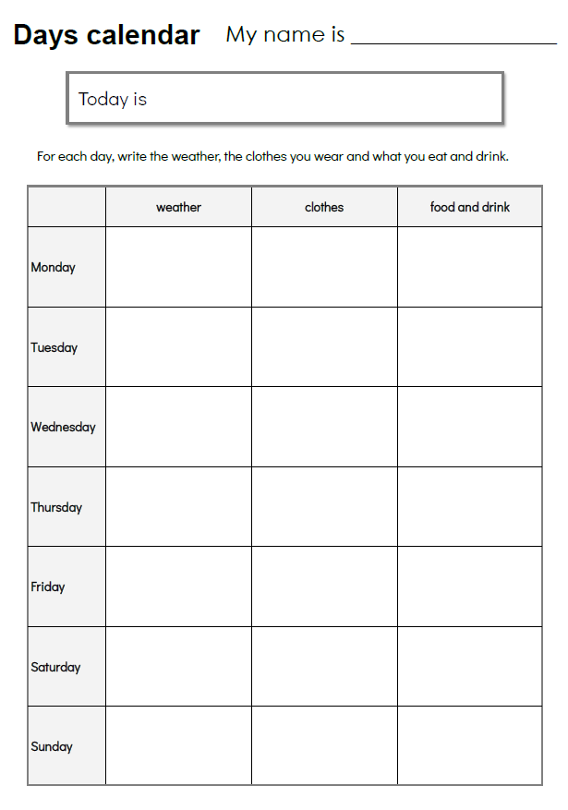
SAMPLE FOR EVALUATION
Join ESL KidStuff
to view without watermark.
Homework
9 | © ESLKidStuff.com

Slide 11

The end
Thank you!
SAMPLE FOR EVALUATION
Join ESL KidStuff
to view without watermark.

