Slide 1
Introduction lesson
1
Greetings, ask & answer personal questions, use modal verbs for rules, identify different classroom stationery.
"What's your name", "My name is...", " Where are you from?", "What pet do you have?", "What is your favorite food/drink/color?"
pet, food, drink, color, brother, sister, can, can't, must, mustn’t, bag, pen, pencil, eraser, crayon, ruler, stapler, glue, marker, scissors.
None for this lesson
Class survey intros worksheet
Classroom objects worksheet
name tags for each student
a small ball
poster paper (one sheet per group of 4-6)
colored marker pens
classroom stationery: pen, pencil, eraser, crayon, ruler, stapler, glue, marker, scissors
board with markers / chalk
This lesson provides a good platform to begin the course with your 7-9 year olds as it provides an opportunity for everyone to get to know each other and also sets the ground rules for behavior within the classroom. 'Wh’ question forms, modal verbs for rules and stationery vocabulary will also be practiced.

Slide 2
Hello!
- Introduction lesson -

Slide 3
Warm up and maintenance
Greetings and names
Name tags
SAMPLE FOR EVALUATION
Join ESL KidStuff
to view without watermark.
2 | © ESLKidStuff.com
[ Press space bar or left-mouse click to move through the slides ]

Slide 4
1
Teacher’s notes are here on every lesson slide.
Greetings and names
Greet the students as they enter the classroom and gesture for them to sit down.
When everyone has sat down and is ready, say,
"My name is ...“
and give your name.
Then tell everyone to stand up. If there is room, have everyone form a circle. Take a ball and hold it and say your name. Then throw the ball to one student and they say their name. Students throw the ball around randomly, saying their name each time they catch the ball.
… click panel for more »
Then, play the same throwing game, but instead of saying your name, say the name of the person who threw the ball to you - start by asking one student to throw the ball to you and as you catch it say their name. Then throw to another student and they should say your name as they catch it.
If anyone gets a name wrong (or can’t remember) they have to sit down for 3 throws.
By the end of the activity everyone should have a good idea of everyone else's names!
… click panel to go back »
SAMPLE FOR EVALUATION
Join ESL KidStuff
to view without watermark.
My name is …
[ Press space bar or left-mouse click to move to the next slide ]

Slide 5
2
Name tags
Before class prepare some blank name tags (stickers or pin-on tags).
Give the tags out and have everyone write their names and put their tags on. If you use pin-on tags, you can keep and give out every class.
For students who use a non-roman alphabet (e.g. Japanese), they should write they name in English letters - if they have never done this before you may have to help (possibly prepare their names on paper to copy).
SAMPLE FOR EVALUATION
Join ESL KidStuff
to view without watermark.
Name tags
[ Press space bar or left-mouse click to move to the next slide ]

Slide 6
New learning and practice
Do the "Ask me" activity
Write about yourself
Practice asking and answering questions
Do a class survey
Set classroom rules
Create a classroom rules poster
Agree to the classroom rules
Play "Classroom stationery quiz"
Play "What's missing?"
SAMPLE FOR EVALUATION
Join ESL KidStuff
to view without watermark.
5 | © ESLKidStuff.com
[ Press space bar or left-mouse click to move through the slides ]

Slide 7
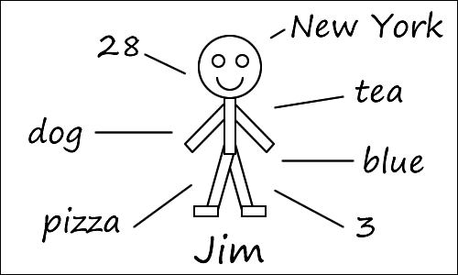
1
Do the "Ask me" activity
On the board, draw a little stick person and write your name under it.
Then write the answers to the following questions (just the answers) about you around the board:
• Age: How old are you?
• Hometown: Where are you from?
• Pets: What pet do you have?
• Food: What is your favorite food?
• Drink: What is your favorite drink?
• Color: What is your favorite color?
• Brothers / Sisters: How many brothers and sisters do you have?
For example:
… click panel for more »
The idea is to try and have your students guess what the answers relate to and the what the question is for each answer. Start by either clicking the” Name” box on this slide or writing on the board:
Name: What is your name?
Then point to your name on the board. Chorus the question x3.
Next, point to your hometown on the board and try to elicit the question "Where are you from?". Again, chorus x3.
As you elicit and help, reveal the questions on this slide or write the questions on the board until all the questions are there, chorusing the questions each time.
… click panel to go back »
Where are you from?
Click to see
Hometown
How old are you?
Click to see
Age
What is your favorite drink?
Click to see
Have you finished this activity? If so, press space.
To go back to the activity, press left arrow key (◄ ).
Drink
What pets do you have?
Click to see
SAMPLE FOR EVALUATION
Join ESL KidStuff
to view without watermark.
Pets
What is your favorite color?
Click to see
Color
What is your favorite food?
Click to see
How many brothers and sisters do you have?
Food
Click to see
Brothers / Sisters
What is your name?
Click to see
Click to reset
Name
Ask me
[ Press space bar or left-mouse click to move to the next slide ]

Slide 8

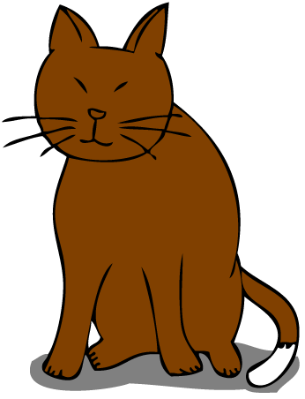










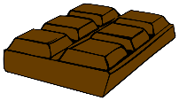















2
Ideas
Write about yourself
Have your students draw a stick person (or a drawing of themselves) on a piece of paper with their name underneath.
They should write down their own answers to the questions on this slide / the board - basically doing the same thing as you just did.
Students can use the ideas on this slide as example answers.
As students are writing their answers, circulate and help with mistakes, pronunciation and vocabulary.
Pets
dog
cat
bird
fish
hamster
guinea pig
mouse
rabbit
turtle
Food
SAMPLE FOR EVALUATION
Join ESL KidStuff
to view without watermark.
hotdog
hamburger
pizza
chicken
chocolate
egg
pasta
cake
sushi
ice-cream
Drink
juice
water
milk
soda
milkshake
tea
coffee
ice tea
ice coffee
Colors
red
yellow
pink
green
purple
orange
blue
brown
black
white
Write about yourself
[ Press space bar or left-mouse click to move to the next slide ]

Slide 9
3
Practice asking and answering questions
Put students in pairs and have them practice asking and answering the questions from their stick person sheets.
As they do this circulate and monitor, helping out with mistakes and pronunciation - and always give lots of praise.
SAMPLE FOR EVALUATION
Join ESL KidStuff
to view without watermark.
Questions
[ Press space bar or left-mouse click to move to the next slide ]

Slide 10
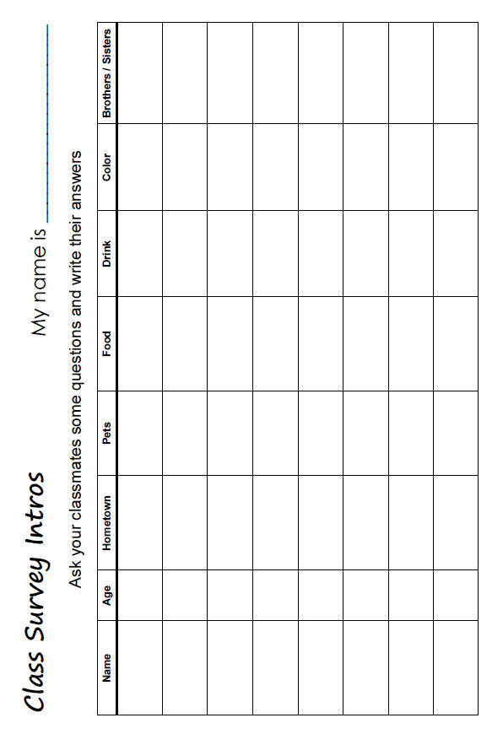
4
Do a class survey
Give out the survey sheets to each student.
Go through the column headers and make sure everyone understands that they have to ask questions to 8 other students to complete their survey. If you have less than 9 students in your class, each student will need to interview everyone in the class.
Just to make sure, model the activity with a student, asking the questions and showing writing the answers onto the sheet.
Then allow everyone to get up and mix around as they complete their surveys.
SAMPLE FOR EVALUATION
Join ESL KidStuff
to view without watermark.
Click to see
Class survey
[ Press space bar or left-mouse click to move to the next slide ]

Slide 11




5
Set classroom rules
Setting rules and boundaries is extremely important in your kids lessons - kids will feel comfortable knowing what is and isn't accepted and having this clearly stated at the beginning of the course will really help with classroom management.
This part of the lesson is a lot of fun and is a good way to practice modals "can", "can't", "must", "mustn’t”.
Firstly, bring everyone’s attention to the classroom rules poster on this slide. For each column explain and elicit the below. Press space to show examples.
We can = it is ok for us to do. E.g. "We can ask our teacher questions"
… click panel for more »
We can't = it is not ok for us to do. E.g. "We can't talk while our teacher is talking“
We must = very strong - things we have to do. E.g. "We must do our homework“
We mustn't = very strong - things we never do. E.g. "We mustn't take things without asking“
… click panel to go back »
Our classroom rules
We can
We can’t
We must
We mustn’t
ask our teacher questions.
talk while our teacher is talking.
do our homework.
take things without asking.
SAMPLE FOR EVALUATION
Join ESL KidStuff
to view without watermark.
[ Press space to see example ideas ]
Rules poster
[ Press space bar or left-mouse click to move to the next slide ]

Slide 12
6
Create a classroom rules poster
Put your students into groups of 4-6.
Give each group a large sheet of paper and colored marker pens to create their rules poster.
Have them copy the poster on the last slide.
Then explain that they must write down as many ideas as they can on their rules poster - they can even include some strange rules if they wish!
NOTE: If your students’ level is too low to write sentences, they can draw their ideas instead.
As the groups are making their posters, circulate and help with grammar, vocab, spelling. Allow students to use different colors and draw pictures - the posters should be attractive and fun.
SAMPLE FOR EVALUATION
Join ESL KidStuff
to view without watermark.
Make a poster
[ Press space bar or left-mouse click to move to the next slide ]

Slide 13
7
Agree to the classroom rules
When everyone has finished their posters, compare all the posters. Encourage the adding of any ideas from other groups that are worthy of adding to the posters.
Then show the example ideas on this slide [ click space for each idea ]. Again, students can add ideas to their posters.
To finish, have everyone in the group to sign their poster. This helps to reinforce the rules as a kind of “classroom contract“ - if any rules are broken in future lessons you can point to the rule which the offending student has signed.
Finally, have students pin their posters to the wall.
Our classroom rules
We can
We can’t
We must
We mustn’t
ask our teacher questions.
talk while our teacher is talking.
do our homework.
take things without asking.
respect each other.
fight, hit or kick anyone.
use my language when talking to the teacher.
turn off our phones.
SAMPLE FOR EVALUATION
Join ESL KidStuff
to view without watermark.
bring any electronic devices to class (e.g. games).
talk to others in English.
bring our books, folders, pens, etc. to every class.
bring food or drinks into class.
stay in our seat.
treat others badly.
raise our hand to answer questions.
start packing up before the teacher tells us to.
help other students.
be rude to anyone.
be in the classroom on time.
[ Press space to see more example ideas ]
[ Press space bar or left-mouse click to move to the next slide ]

Slide 14
8
Play “Classroom stationery quiz”
We’ll finish the lesson with a fun activity based around the vocabulary of classroom stationery.
Before class, prepare a bag of the following items of classroom stationery: pen, pencil, eraser, crayon, ruler, stapler, glue, marker, scissors.
Put students into teams (of 3-6) and tell them that you are going to show them some objects that they must write down on a piece of paper. Points will be given for each correct answer as follows:
• perfect answers (correct word and spelling): 3 points
• nearly perfect answers (correct word but incorrect spelling): 2
… click panel for more »
• slightly correct (e.g. “sisor" instead of “scissors"): 1 point
Explain that the winning team will win a prize (prepare some stickers or candy)!
Take out each object and teams work together to write down the answers - some they will probably know and some not. Include the bag you were keeping items in as well.
At the end, get each team to swap papers and go through the answers as teams mark the answer sheets. Present the prize to the winning team.
… click panel to go back »
SAMPLE FOR EVALUATION
Join ESL KidStuff
to view without watermark.
Stationery quiz
[ Press space bar or left-mouse click to move to the next slide ]

Slide 15
9
Play "What's missing?"
Line up all of the stationery items so that everyone can see.
Tell everyone to close their eyes - then remove one item. Say "Open your eyes" and everyone must shout out the missing item. Do this for all the items.
SAMPLE FOR EVALUATION
Join ESL KidStuff
to view without watermark.
What’s missing?
[ Press space bar or left-mouse click to move to the next slide ]

Slide 16
Wrap up
Assign homework: “Classroom objects”
Do “Quick check” and say goodbye
SAMPLE FOR EVALUATION
Join ESL KidStuff
to view without watermark.
15 | © ESLKidStuff.com
[ Press space bar or left-mouse click to move through the slides ]

Slide 17
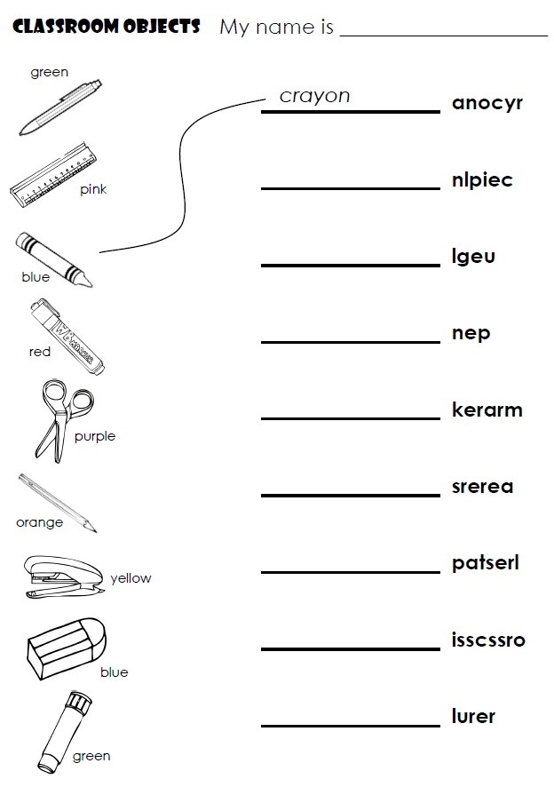
1
Assign homework: “Classroom objects”
Hold up the homework worksheet and model coloring the items of stationery, unscrambling the letters and matching the pictures to the words.
Give out the worksheets and say, "Put your homework in your bags”.
SAMPLE FOR EVALUATION
Join ESL KidStuff
to view without watermark.
Click to see
Homework
16 | © ESLKidStuff.com
[ Press space bar or left-mouse click to move to the next slide ]

Slide 18
2
Do "Quick check" and say goodbye
Time to leave the class.
Make sure everything is put away and the students have gathered their belongings.
Have them line up at the door and place yourself between the door and the students.
For each student check one new word (e.g. hold up a stationery item and ask, "What's this?").
When they give you the correct answer say goodbye and let them leave. If their answer is wrong, have them go back to the end of the line - they will have to try again once they reach the front!
SAMPLE FOR EVALUATION
Join ESL KidStuff
to view without watermark.
Goodbye and quick check
17 | © ESLKidStuff.com
[ Press space bar or left-mouse click to move to the next slide ]

Slide 19

The end
Thank you!
SAMPLE FOR EVALUATION
Join ESL KidStuff
to view without watermark.

