Slide 1
Body and shapes 3
9
Identify and recognize 9 body parts and 4 shapes.
“What is it?”, “Which part of the body is that?”, “Touch your ...”.
hair, rectangle, brown.
head, shoulders, knees, toes, eyes, ears, mouth, nose, square, circle, triangle, 8 colours.
Hello Song (audio & video)
Goodbye Song (audio & video)
Head, shoulders, knees and toes song (audio & video)
The rainbow song (audio & video)
Mr Shape Head song (audio & video)
Mr Shape Head reader (video)
Body flashcards (head, should, knees, toes, eyes, ears, mouth, nose, hair)
Mr Shape Head reader worksheet
Mr Shape Head craft sheet
Mr Shape Head’s body worksheet
name tags for each student
a glove puppet
coloured pencils
a large cloth bag
8 sheets of origami coloured paper (red, green, blue, purple, yellow, pink, orange, brown)
squares, circles, triangles and rectangles cut out of coloured card (4 of each)
scissors & glue for craft sheet activity
cushions (1 per student)
Students complete learning body and shape vocabulary and play lots of fun games. They are also introduced to a new character: Mr Shape Head – they sing a song about him, read a story about him and make a craft of his head.

Slide 2
Mr Shape Head
- Body and shapes 3 -

Slide 3
Warm up and maintenance
SAMPLE FOR EVALUATION
Join ESL KidStuff
to view without watermark.
Greetings
Name tags
Glove puppet greetings
Sing "The Hello Song"
Homework check
Do "Exercise routine" activity
Do the “What’s in the bag?” activity
Sing “Head, shoulders, knees and toes” song
[ Press space bar or left-mouse click to move through the slides ]

Slide 4
Teacher’s notes are here on every lesson slide.
Greetings
Greet the students by name as they enter the classroom and gesture for them to sit down (on cushions if you have them) in a fan-shape around you.
1
Hello!
SAMPLE FOR EVALUATION
Join ESL KidStuff
to view without watermark.
Let’s sit down
[ Press space bar or left-mouse click to move to the next slide ]

Slide 5
Name tags
If your students can not write their names well:
before class, prepare some blank name tags (stickers or pin-on tags) and some cards, each with a student’s name written on clearly – students will use them to copy their names onto their name tags.
Sit down with your students and lay out the name cards in front of you. Pick up each card and encourage each student to recognize his/her name.
Finally, everyone takes out a pencil to copy their names onto their tags and stick them on.
If your students can write their names well:
simply give a blank name tag to each student to write their name on in pencil and stick it on.
2
SAMPLE FOR EVALUATION
Join ESL KidStuff
to view without watermark.
Name tags
[ Press space bar or left-mouse click to move to the next slide ]

Slide 6
Glove puppet greetings
Bring out your glove puppet bag and have everyone shout "Hello!“ into the bag until he wakes up and jumps out of the bag.
Then model chatting with the glove puppet …
Puppet: "Hello", What's your name?"
Teacher: "My name is...".
Puppet: “How are you?”
Teacher: “I’m fine, thank you”.
… and then have the puppet say hello to each student and ask them the same questions.
Finally, go around saying "Goodbye" and "See you" before going back into the bag and back to sleep.
3
SAMPLE FOR EVALUATION
Join ESL KidStuff
to view without watermark.
Glove puppet
[ Press space bar or left-mouse click to move to the next slide ]

Slide 7


Sing "The Hello Song"
Sit in a circle and listen to the song (clap along or pat knees).
Gestures
Wave as you sing the "Hello, hello" parts.
Gesture to others as you sing "How are you today?“
Point to yourself as you sing "I’m fine, thank you“
Hand gesture towards another student as you sing "And how about you?".
The Hello Song
4
Song audio and video
only available to ESL KidStuff members.
Click here to remove message.
Song audio and video
only available to ESL KidStuff members.
Click here to remove message.
SAMPLE FOR EVALUATION
Join ESL KidStuff
to view without watermark.
Click to play song
Play song audio
Play song video

Slide 8
Homework check
Check each student's homework that you set in the last lesson.
Ask each student some questions about their homework worksheet (e.g. “What is this?, Is this an eye?”), give lots of praise, and then put some kind of mark on the homework sheet (e.g. a sticker, a stamp or draw a smiley face).
Finally, tell your students to put their homework back into their bags.
5
SAMPLE FOR EVALUATION
Join ESL KidStuff
to view without watermark.
`
Homework check
7 | © ESLKidStuff.com
[ Press space bar or left-mouse click to move to the next slide ]

Slide 9
Do "Exercise routine" activity
Say the following and have the students follow your lead:
"Stand up (T stands and so does everyone else)
"Hands up / hands down" (do 4 or 5 times)
"Jump" (4 or 5 times)
“Kick (4 or 5 times)
"Run! / Stop!" (4 or 5 times)
"Turn around! / Stop!" (4 or 5 times)
“Wiggle!” (a few seconds)
finally "Sit down".
hands up
6
hands down
stand up
jump
SAMPLE FOR EVALUATION
Join ESL KidStuff
to view without watermark.
kick
sit
down
wiggle
Press space or
left mouse click to see exercises
turn around
run
Exercises
8 | © ESLKidStuff.com
[ Press space bar or left-mouse click to move to the next slide ]
[ Press space bar or left-mouse click to move to the next slide ]

Slide 10
Do the “What’s in the bag?” activity
Time for the bag again.
Before class, put in a couple of new objects (e.g. a crayon, a plastic bottle, a sock, a paper cup, a leaf, a ball, a teddy, etc. - anything lying around (and safe!)) and take out the remaining plastic fruits.
Show the bag to your students, shake it to rattle the objects inside, and ask, “What’s in the bag?”.
Randomly pull out different objects and teach/elicit the words – in each case, have students hold and pass the objects around. You can even have students pull the objects out of the bag instead of you taking them out – with eyes closed to make it fun!
… click panel for more »
Finally, place/throw the objects around the classroom and have each student retrieve an object as you call out its name and put it back in the bag.
… click panel to go back »
7
SAMPLE FOR EVALUATION
Join ESL KidStuff
to view without watermark.
What’s in the bag?
9 | © ESLKidStuff.com
[ Press space bar or left-mouse click to move to the next slide ]

Slide 11
Sing “Head, shoulders, knees and toes” song
Everyone stand up. As the song plays everyone sings and does all the actions, touching each part of the body with two hands in time with the song. It’s easy and fun - your students will love doing this! Each verse gets faster so by the last verse it will be frantic but great fun.
Gestures
Doing the gestures with this song is a must! They are very simple and the kids will pick them up really quickly as they follow you.
Everyone needs to stand up. Simply touch the parts of your body with both hands in time with the song. The song starts off slowly with each verse getting progressively faster, making the gestures more frantic and therefore more fun!
8
Head, shoulders, knees and toes song
Song audio and video
only available to ESL KidStuff members.
Click here to remove message.
Song audio and video
only available to ESL KidStuff members.
Click here to remove message.
SAMPLE FOR EVALUATION
Join ESL KidStuff
to view without watermark.
Click to play song
Play song audio
Play song video
10 | © ESLKidStuff.com

Slide 12
New learning and practice
Teach/Review 9 body parts
Practice the body vocab
Play "Flashcard exercises”
Sing “The rainbow song”
Review colours and teach new colour: brown
Play “Colour touch” and Play "Colour hold up”
Read and write time
Teach/Review 4 shapes
Play “Missing shape” and “Shape touch”
Show Mr. Shape Head
SAMPLE FOR EVALUATION
Join ESL KidStuff
to view without watermark.
Sing the “Mr. Shape Head” song
Read classroom reader “Mr. Shape Head”
Do Mr. Shape Head craft
[ Press space bar or left-mouse click to move through the slides ]

Slide 13




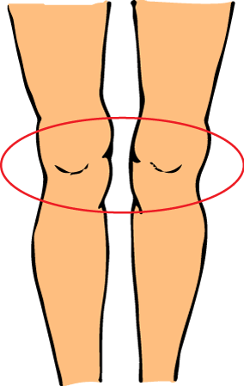




Teach/Review 9 body parts
This lesson we’ll learn 1 more body part: hair.
Either use this slide or prepare flashcards for the 9 body parts.
If using this slide: press space to start – as the picture slowly reveals itself, have students try to guess what it is. Press space to end each slow reveal.
If using flashcards: slowly reveal each flashcard card so students can guess what the picture is.
Then: have your students touch their part of the body (so, when you show the "head" picture get everyone to touch their heads). Chorus each word 3x and ask your students to individually say each word.
1
What is it?
Watch as the picture slowly reveals itself. Can you guess what it is?
Press space to start.
Good job!
The quiz is finished.
Press ◄ to go back.
Press space to continue to next slide.
SAMPLE FOR EVALUATION
Join ESL KidStuff
to view without watermark.
To skip to next slide, click here
Parts of the body
12 | © ESLKidStuff.com
[ Press space bar or left-mouse click to move to the next slide ]

Slide 14


Practice the body vocab
Use either this slide or the 9 body flashcards.
If using this slide: press space to start. Randomly touch or point to each picture and have your students touch that part of their body and say the word. Do a final, faster round.
If using flashcards: lay the flashcards that you have just used in front of you, facing your students (or lined up on the board). Randomly touch each card and have your students touch that part of their body and say the word. Do a final, faster round.
2
SAMPLE FOR EVALUATION
Join ESL KidStuff
to view without watermark.
Click to hear words
Say and touch
13 | © ESLKidStuff.com
[ Press space bar or left-mouse click to move to the next slide ]
[ Press space bar or left-mouse click to show pictures ]

Slide 15
Play "Flashcard exercises”
Get everyone sitting on the floor and facing the front of the class.
Give out body flashcards so that each student has at least one card (even better is for each student to have two cards).
Shout out a random flashcard word (e.g. "ears") with an action (e.g. "ears - hands up!").
All students with the ears flashcards have to do that action. Continue with other words and different actions (e.g. jump up and down, run on the spot, turn around, stand up / sit down, wiggle, touch your toes, etc.).
3
SAMPLE FOR EVALUATION
Join ESL KidStuff
to view without watermark.
Flashcard exercises
14 | © ESLKidStuff.com
[ Press space bar or left-mouse click to move to the next slide ]

Slide 16
Sing “The rainbow song”
Let’s review the colours with the rainbow song!
For this song you can either use the colours on this slide as you all sing along or have students touch the 7 colours (e.g. coloured paper, pencils, etc.) in front of him/her as they sing along.
… click panel for more »
Gestures
There are a number of activities you can do as you sing along to the song:
Give out the 7 colours to students (coloured paper, origami paper, coloured blocks, coloured pencils – anything will do) and have students touch the colours in time with the song.
Simply pat your knees or clap in time with the music as you sing the song
Give each student a print out of the Rainbow Song song poster. As they sing along, they touch each colour or picture.
Put coloured paper up around the walls of the classroom. Have all of your students point to each colour as it is sung.
… click panel to go back »
The rainbow song
4
Song audio and video
only available to ESL KidStuff members.
Click here to remove message.
Song audio and video
only available to ESL KidStuff members.
Click here to remove message.
SAMPLE FOR EVALUATION
Join ESL KidStuff
to view without watermark.
Click to play song
Play song audio
Play song video

Slide 17
Review colours: red, blue, green, purple, yellow, pink, orange
Teach new colour: brown
Use the coloured origami paper / card for the 8 colours.
Sit everyone in a circle and hold up the first coloured paper and elicit the colour (e.g. red). Chorus and practice saying the colour. Do this for the rest of the colours.
Finish with brown.
5
SAMPLE FOR EVALUATION
Join ESL KidStuff
to view without watermark.
Colours
16 | © ESLKidStuff.com
[ Press space bar or left-mouse click to move to the next slide ]

Slide 18
Play “Colour touch”
Next, lay the 8 colours in the middle of the circle. Say "Hands up". Students raise their hands. Then say "Touch.....red!" and the students should all try and touch the red coloured paper. Do for all of the colours.
Play "Colour hold up”
Finally, give each student one of the coloured papers. Say "Hold up....blue!" - the students holding the blue papers raise them into the air.
Optional activity:
Ask students what colour cloths they are wearing and the colour of their hair. Try and get the colour brown elicited.
6
SAMPLE FOR EVALUATION
Join ESL KidStuff
to view without watermark.
Play colour games
17 | © ESLKidStuff.com
[ Press space bar or left-mouse click to move to the next slide ]

Slide 19
Read and write time
This segment can be part of all your lessons. Spend 10 to 15 minutes building up your students’ writing and reading skills.
You’ll need to assess your students’ reading/writing level and then start at one of the following stages:
1. Beginners: students cannot read or write the alphabet
Each lesson introduce 3 lower-case letters of the alphabet. Use flashcards or our alphabet mini-lesson slides. Play alphabet games and do printing worksheets.
» See our ‘Alphabet’ mini-lesson slides for full details.
2. Early starters: Students have experience with the alphabet but need phonics practice.
… click panel for more »
Each lesson introduce 5 lower-case letters of the alphabet. Use flashcards or our alphabet mini-lesson slides. Start by working on the sounds of the letters and then move onto letter clusters (e.g. sh, ee, etc). » See our ‘Alphabet’ and ‘Letter clusters’ mini-lesson slides for full details.
3. Early readers:
Work on reading and writing simple sentences with lots of practice activities. » See our ‘Early reading’ mini-lesson slides for full details.
4. Elementary readers: Students can read and write simple sentences well.
Work on reading and writing short texts and stories. » See our ‘Reading short texts’ mini-lesson slides for full details.
… click panel to go back »
7
Read
and
write!
SAMPLE FOR EVALUATION
Join ESL KidStuff
to view without watermark.
Read and write
18 | © ESLKidStuff.com
[ Press space bar or left-mouse click to move to the next slide ]

Slide 20
Teach/Review 4 shapes
Use the shape cut-outs from your previous class
(4 squares, 4 circles and 4 triangles) and add 4 rectangle cut-outs on some coloured card.
Start off by showing the square and eliciting / chorusing "square".
Hand the square to a student who says "square" and passes it on to another, each student saying "square" as they pass it around.
Then do for the remaining 3 shapes. You can also elicit colours and sizes (e.g. a "big, yellow, square", "a small, blue circle", etc.).
8
SAMPLE FOR EVALUATION
Join ESL KidStuff
to view without watermark.
Click to hear words
4 shapes
19 | © ESLKidStuff.com
[ Press space bar or left-mouse click to move to the next slide ]

Slide 21
Play "Missing shape" and "Shape touch“
Put all the square, circle and triangle shapes on the floor and gather everyone around. Tell everyone to close their eyes. Take away one shape and say, “Open your eyes”. Everyone must guess which shape is missing.
With the shapes still on the floor, say "Hands up in the air" – once all hands are up say, “Touch a (green) circle” – and have everyone quickly touch (not slam!) a green circle.
Do this for all of the shapes.
9
SAMPLE FOR EVALUATION
Join ESL KidStuff
to view without watermark.
Play shape games
20 | © ESLKidStuff.com
[ Press space bar or left-mouse click to move to the next slide ]

Slide 22
Show Mr. Shape Head
We are going to introduce a character who we’ll sing and read about.
Bring everyone's attention to the board and draw a large square – this will be the head.
Make sure some of your cut-out shapes have some sticky tape or blue-tack on the back.
Hold up a triangle cut-out, elicit that shape and stick it to the nose position inside the square head.
Keep doing this with the shapes until you have a complete head/face. Everyone will enjoy watching a face grow out of the shapes they have been playing with.
Also make sure to elicit the face vocab for each face shape.
10
Click picture to see the completed face.
SAMPLE FOR EVALUATION
Join ESL KidStuff
to view without watermark.
Mr Shape Head
21 | © ESLKidStuff.com
[ Press space bar or left-mouse click to move to the next slide ]

Slide 23
Sing the “Mr. Shape Head” song
Keep Mr. Shape Head on the board and use it with the song (or use this slide).
Play the song through one time, pointing at the shapes on the board (or slide) as they are sung. Next, get everyone to stand up – teach the gestures (see below) and then play the song again and sing along doing all of the gestures.
Gestures
Some simple actions can be used with this song:
For the chorus, touch your head for the "Mr. Shape Head" parts and then do the question gesture (palms up, looking puzzled) for the "How are you?" parts.
… click panel for more »
For the verses, make shapes with your fingers for each shape and place on the part of the face as it is sung (e.g. "My eyes are square" – make two square shapes with your fingers and place over your eyes; for "My ears are circles" make two circle shapes with your fingers and place over your ears; etc.).
For the part of the verse "but I’m okay", do a thumbs up with both hands.
For the end of each verse "For I am Mr. Shape Head", move your already thumbs up gesture to point your thumbs inwards to your body.
… click panel to go back »
11
Mr. Shape Head song
Song audio and video
only available to ESL KidStuff members.
Click here to remove message.
Song audio and video
only available to ESL KidStuff members.
Click here to remove message.
SAMPLE FOR EVALUATION
Join ESL KidStuff
to view without watermark.
Click to play song
Play song audio
Play song video
22 | © ESLKidStuff.com

Slide 24
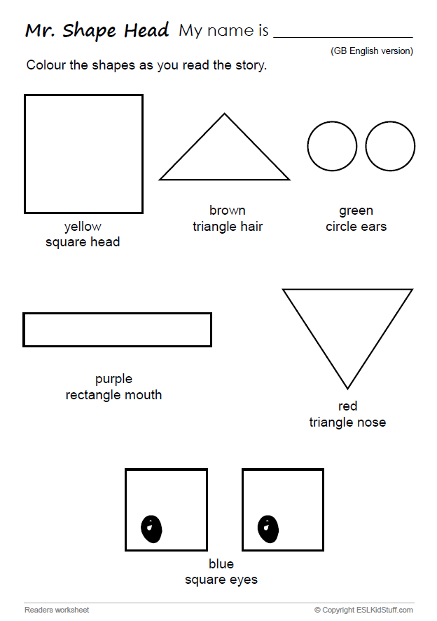
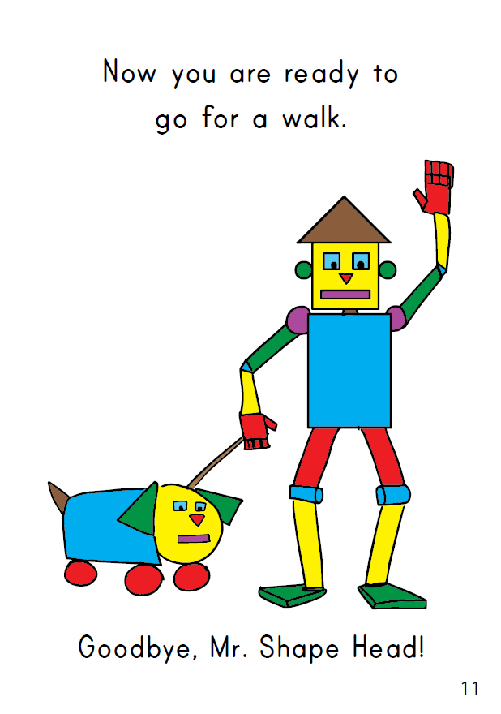
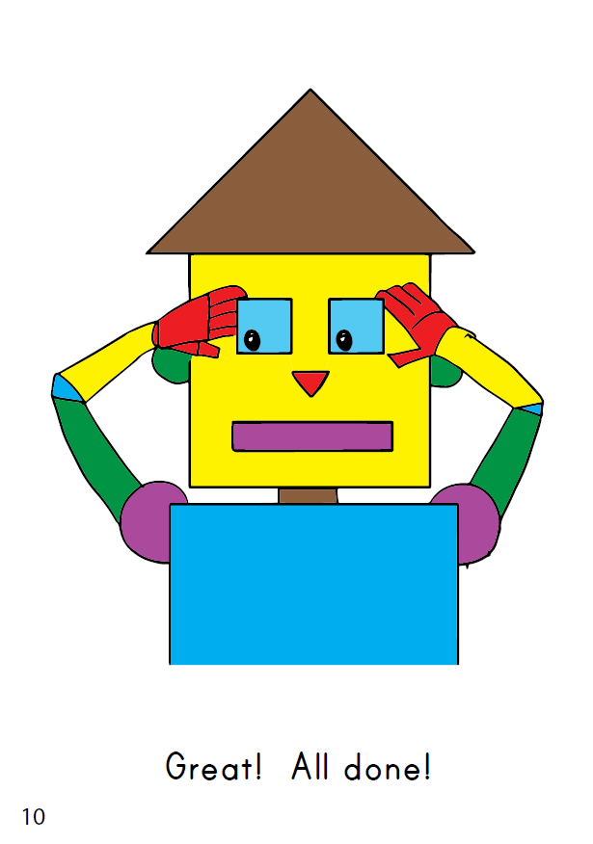
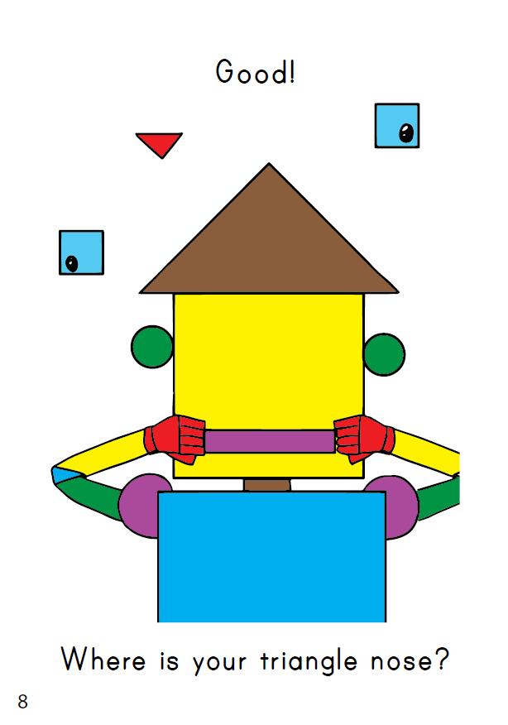
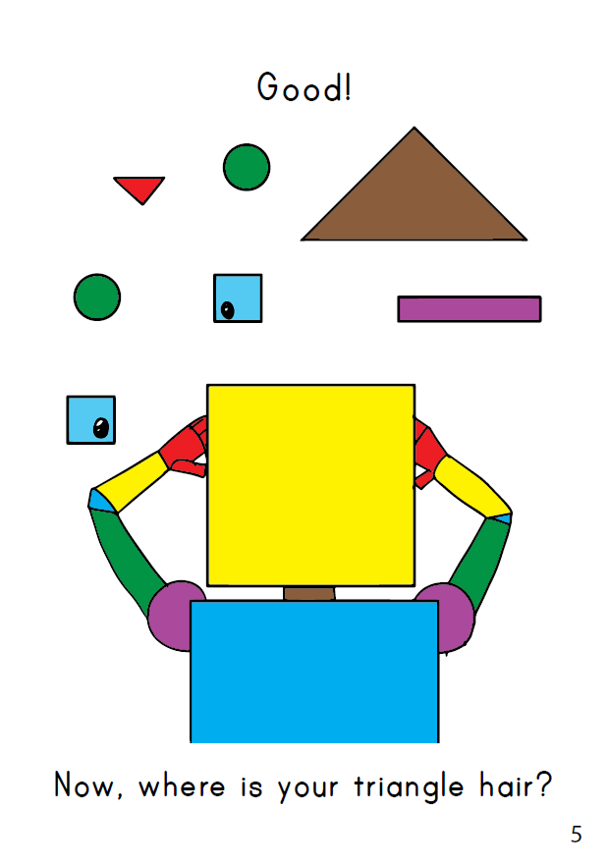
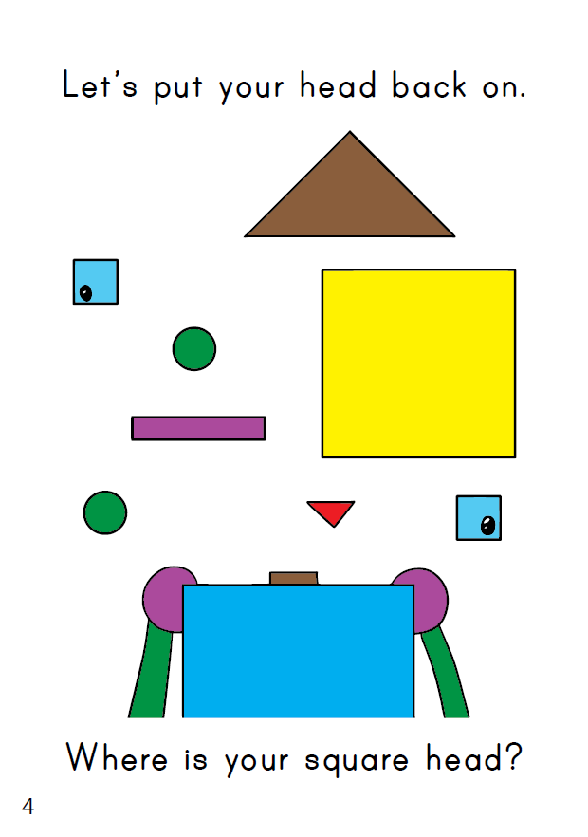
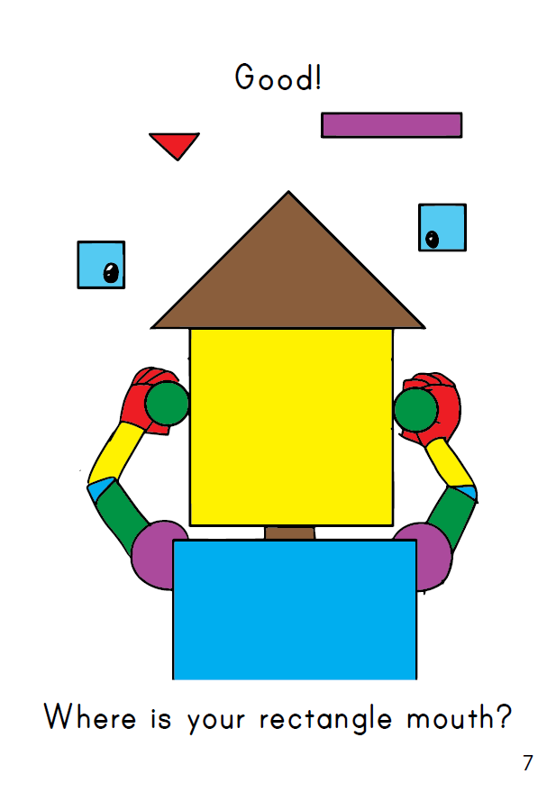
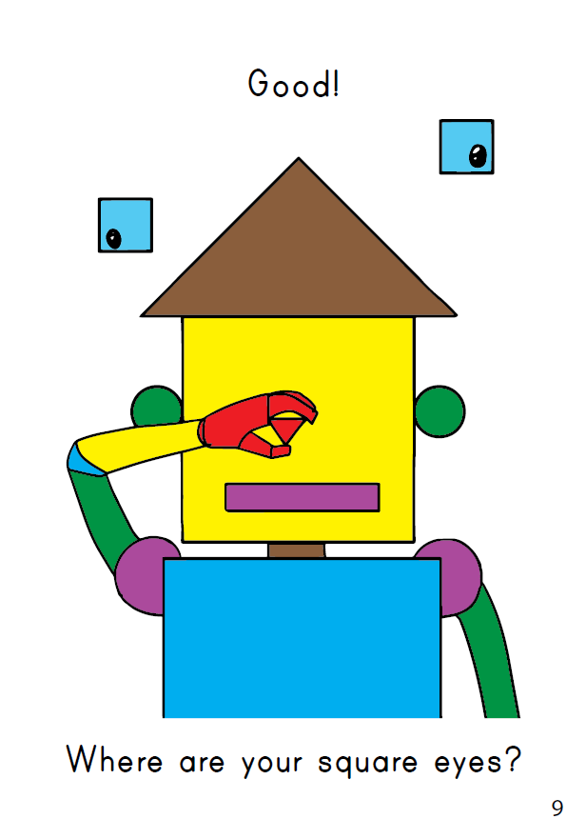
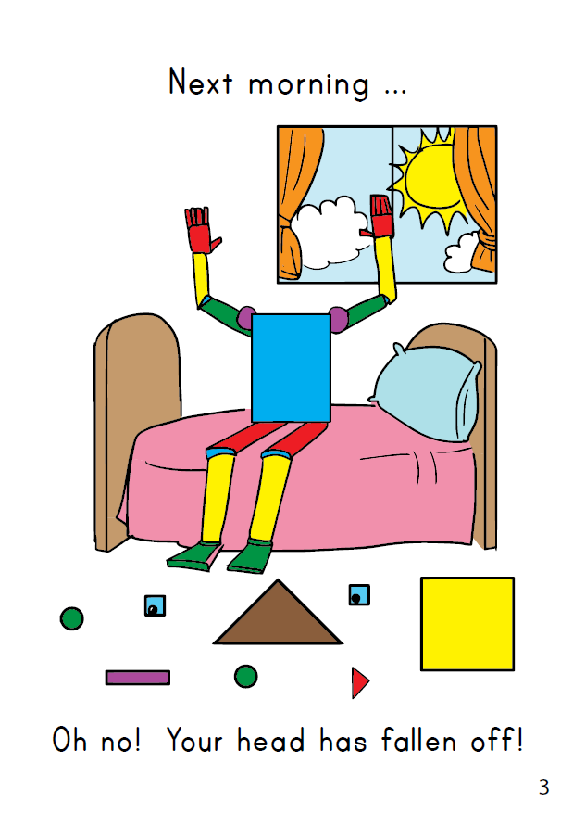
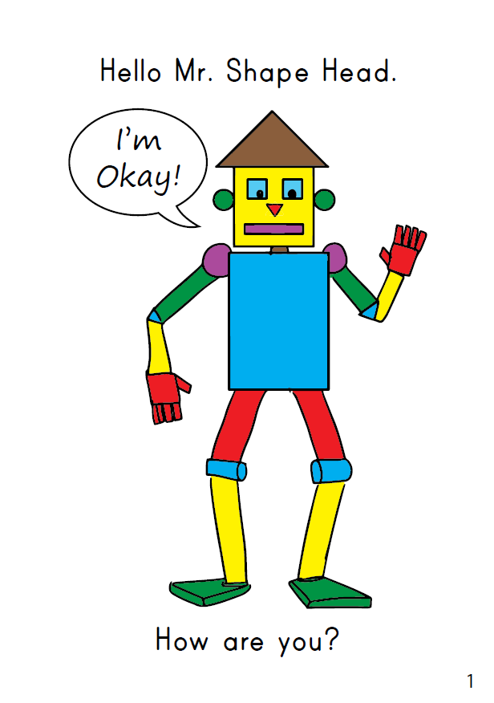
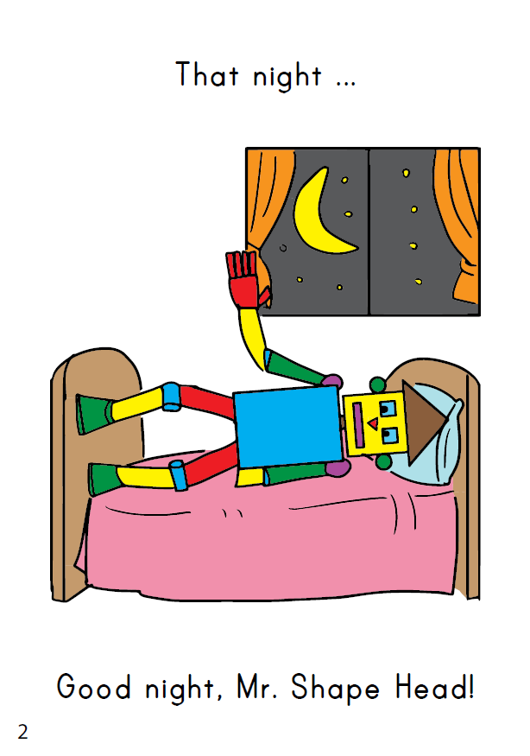
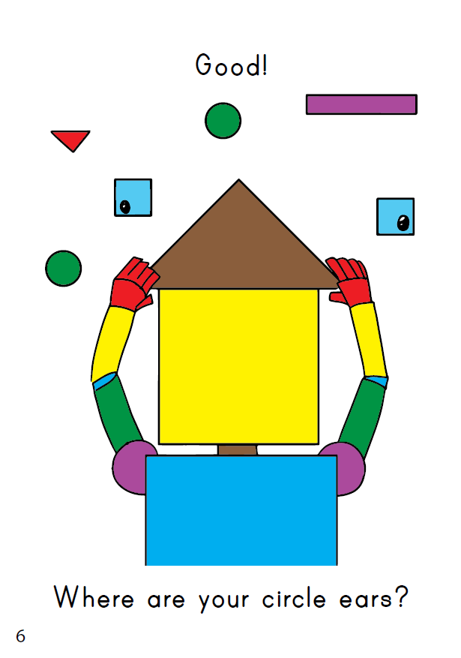
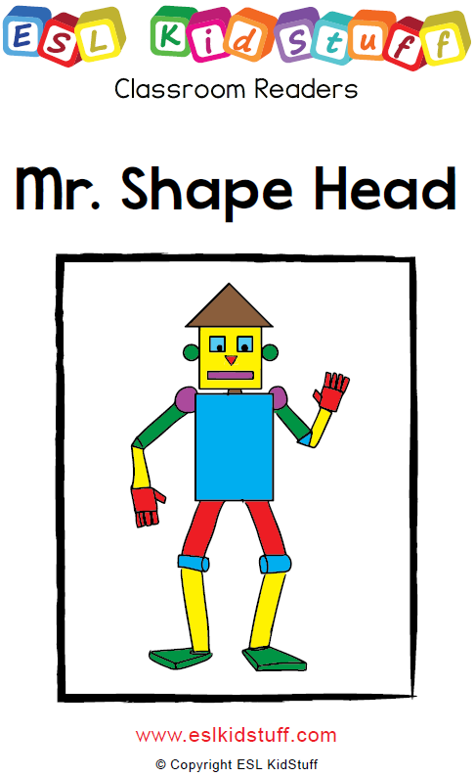

Read classroom reader “Mr. Shape Head”
Use either these slides or print out the reader booklet.
Let's follow the song with a reader which uses the structures from the song.
Before class, print off the reader worksheet. Give the worksheets to your students to colour as you read through the story.
As you go through each page, point to the shapes in each picture and elicit the shapes, colours and face parts, for example:
Teacher: (reading from page 4) "Let's put your head back on. Where is your square head?" ... Ok, what shape is his head?
Students: Square!
Teacher: (pointing at a square eye) ... Is this his head?
… click panel for more »
Students: No!
Teacher: (pointing at a circle) ... Is this his head?
Students: No!
Teacher: Where is his square head? (invite a student to touch the picture)
Student: Here.
Teacher: Ok, let's check (turns over to page 5) ... Yes, good job! What colour is his square head?
Students: Yellow!
Teacher: Yes, that's right! Ok, colour the yellow square on your worksheets.
etc.
Get the students really involved in the story by asking lots of questions and getting them to touch their face parts along with the story.
… click panel to go back »
12
THE END
Press space or left click mouse to move to next slide.
Press left arrow key (◄ ) to go back through the book pages.
Reader video
only available to ESL KidStuff members.
Click here to remove message.
SAMPLE FOR EVALUATION
Join ESL KidStuff
to view without watermark.
To skip reader and jump to next slide, click here
Play reader video
Reader worksheet
Story time
[ Press space bar or left-mouse turn pages ]
23 | © ESLKidStuff.com
[ Press space bar or left-mouse click to move to the next slide ]

Slide 25
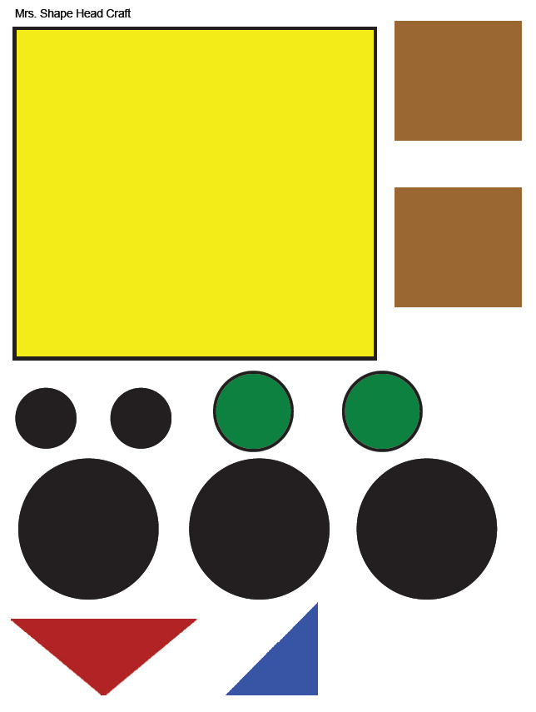
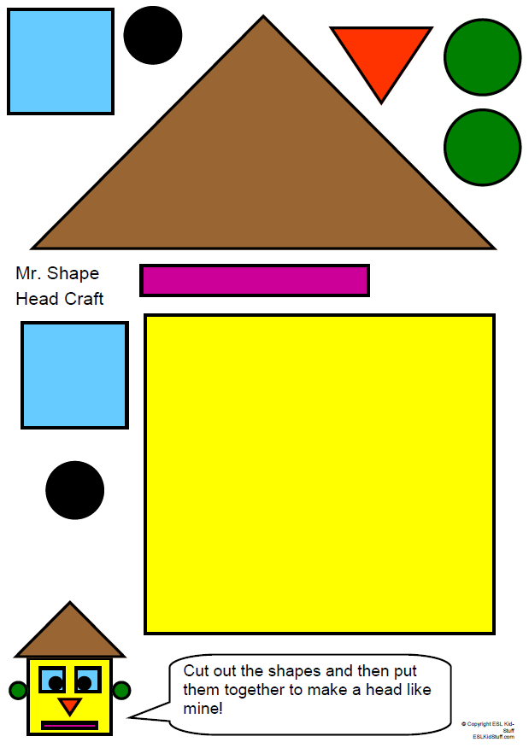
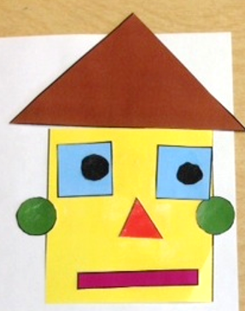
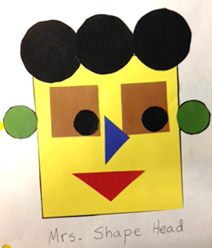
Do Mr. Shape Head craft
Before class, print out the Mr Shape Head craft sheet. You’ll also need scissors and glue.
Put students in pairs and give each pair the craft sheet. For little ones, you may want to cut out the shapes before class, otherwise help your students cut out the shapes.
Together each pair can then make Mr. Shape Head by gluing the shapes onto paper or card.
Circulate as everyone is doing the activity and ask questions (e.g. "What is this shape?“). You can play the Mr. Shape Head song in the background as everyone is doing this activity.
Optional extra: we also have a Mrs. Shape Head craft sheet!
13
Click picture to see the completed faces.
SAMPLE FOR EVALUATION
Join ESL KidStuff
to view without watermark.
Click to see
Click to see
Mr Shape Head craft
24 | © ESLKidStuff.com
[ Press space bar or left-mouse click to move to the next slide ]

Slide 26
Wrap up
SAMPLE FOR EVALUATION
Join ESL KidStuff
to view without watermark.
Assign homework: “Mr Shape Head’s body”
Say goodbye to glove puppet
Sing “The Goodbye Song”
Do “Quick check” and say goodbye
[ Press space bar or left-mouse click to move through the slides ]

Slide 27
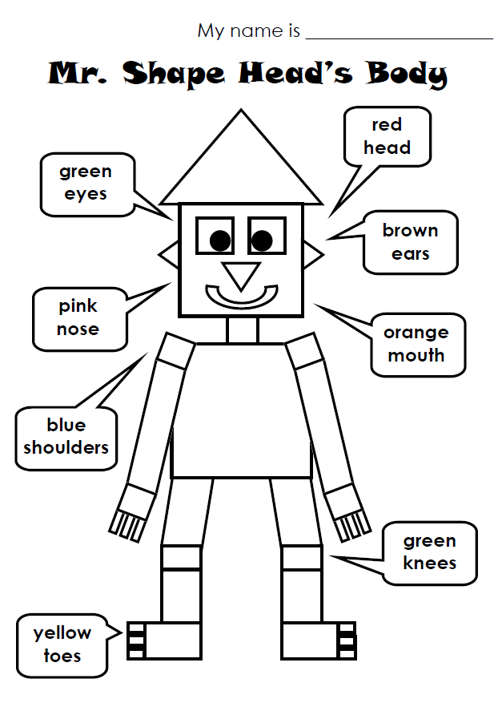
Assign homework: “Mr Shape Head’s body”
Hold up the homework worksheet and model colouring in the shapes.
Give out the worksheets and say, "Put your homework in your bags" and help them to do so - this is important as they will probably want to start colouring them right away.
1
SAMPLE FOR EVALUATION
Join ESL KidStuff
to view without watermark.
Click to see
Homework
26 | © ESLKidStuff.com
[ Press space bar or left-mouse click to move to the next slide ]

Slide 28
Say goodbye to glove puppet
Take out the bag again and get everyone to wake up the glove puppet by shouting its name into the bag (e.g. "Cookie Monster!").
Bring out the puppet and go through the same routine - go to each student and say hello, ask their name and how they are. Then say goodbye / see you.
Then put the puppet back in the bag (back to sleep).
2
SAMPLE FOR EVALUATION
Join ESL KidStuff
to view without watermark.
Goodbye glove puppet
27 | © ESLKidStuff.com
[ Press space bar or left-mouse click to move to the next slide ]

Slide 29
Sing The Goodbye Song
“The Goodbye Song" is a great way to sign off the class.
Sit together in a circle and sing and clap along.
Gestures
The first time you play the song do the gestures and encourage everyone to do them with you.
Wave as you sing the "Goodbye, goodbye" parts.
Hold your hand above your eyes (as you would when you are looking into the distance and keeping the sun out of your eyes) and look at another student as you sing "See you again".
Tap watch (or imaginary watch) and then point to the door as you sing "It’s time to go".
Point towards another student as you sing "See you next time".
The Goodbye Song
3
Song audio and video
only available to ESL KidStuff members.
Click here to remove message.
Song audio and video
only available to ESL KidStuff members.
Click here to remove message.
SAMPLE FOR EVALUATION
Join ESL KidStuff
to view without watermark.
Click to play song
Play song audio
Play song video

Slide 30
Do "Quick check" and say goodbye
Time to leave the class.
Make sure everything is put away and the students have gathered their belongings.
Have them line up at the door and place yourself between the door and the students.
For each student hold up either a body part flashcard or a shape and ask them to say what it is.
When they say the words correctly say goodbye and let them leave. If they make a mistake, have them go back to the end of the line - they will have to try again once they reach the front!
4
Goodbye!
SAMPLE FOR EVALUATION
Join ESL KidStuff
to view without watermark.
Goodbye and quick check
29 | © ESLKidStuff.com
[ Press space bar or left-mouse click to move to the next slide ]

Slide 31
SAMPLE FOR EVALUATION
Join ESL KidStuff
to view without watermark.

