Slide 1
Body and shapes 3
9
Identify and recognize 9 body parts and 4 shapes.
“What is it?”, “Which part of the body is that?”, “Touch your ...”.
hair, rectangle, brown.
head, shoulders, knees, toes, eyes, ears, mouth, nose, square, circle, triangle, 8 colors.
Hello Song (audio & video)
Goodbye Song (audio & video)
Head, shoulders, knees and toes song (audio & video)
The rainbow song (audio & video)
Mr Shape Head song (audio & video)
Mr Shape Head reader (video)
Body flashcards (head, should, knees, toes, eyes, ears, mouth, nose, hair)
Mr Shape Head reader worksheet
Mr Shape Head craft sheet
Mr Shape Head’s body worksheet
name tags for each student
a glove puppet
colored pencils
a large cloth bag
8 sheets of origami colored paper (red, green, blue, purple, yellow, pink, orange, brown)
squares, circles, triangles and rectangles cut out of colored card (4 of each)
scissors & glue for craft sheet activity
cushions (1 per student)
Students complete learning body and shape vocabulary and play lots of fun games. They are also introduced to a new character: Mr Shape Head – they sing a song about him, read a story about him and make a craft of his head.

Slide 2
Media in these slides
Songs
Interactive games
Readers
Printables
Vocabulary
Play audio or video directly from the slide
Play games and activities on the slide with your class
Read stories together on the slide or watch a video
View worksheets, craft sheets, etc. on screen
View lesson vocabulary images on screen
The hello song
Head, shoulders, knees and toes
The rainbow song
Mr Shape Head
The goodbye song
Parts of the body
Mr Shape Head
Mr Shape Head craft sheet
Mr Shape Head’s body worksheet
Body vocab: head, shoulders, knees, toes, eyes, ears, mouth, nose, hair
Colors vocab: red, blue, green, purple, yellow, pink, orange, brown
Shapes vocab: square, circle, triangle, rectangle

Slide 3
Mr Shape Head
- Body and shapes 3 -

Slide 4


The Hello Song
Song audio and video
only available to ESL KidStuff members.
Click here to remove message.
Song audio and video
only available to ESL KidStuff members.
Click here to remove message.
SAMPLE FOR EVALUATION
Join ESL KidStuff
to view without watermark.
Click to play song
Play song audio
Play song video

Slide 5
Head, shoulders, knees and toes song
Song audio and video
only available to ESL KidStuff members.
Click here to remove message.
Song audio and video
only available to ESL KidStuff members.
Click here to remove message.
SAMPLE FOR EVALUATION
Join ESL KidStuff
to view without watermark.
Click to play song
Play song audio
Play song video
4 | © ESLKidStuff.com

Slide 6




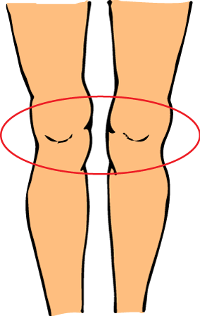




What is it?
Watch as the picture slowly reveals itself. Can you guess what it is?
Press space to start.
Good job!
The quiz is finished.
Press ◄ to go back.
Press space to continue to next slide.
SAMPLE FOR EVALUATION
Join ESL KidStuff
to view without watermark.
To skip to next slide, click here
Parts of the body

Slide 7


Click to hear words
SAMPLE FOR EVALUATION
Join ESL KidStuff
to view without watermark.
Body parts

Slide 8
The rainbow song
Song audio and video
only available to ESL KidStuff members.
Click here to remove message.
Song audio and video
only available to ESL KidStuff members.
Click here to remove message.
SAMPLE FOR EVALUATION
Join ESL KidStuff
to view without watermark.
Click to play song
Play song audio
Play song video

Slide 9
Click object to hear vocab
SAMPLE FOR EVALUATION
Join ESL KidStuff
to view without watermark.
Colors vocab
8 | © ESLKidStuff.com

Slide 10
Click to hear words
SAMPLE FOR EVALUATION
Join ESL KidStuff
to view without watermark.
Shapes vocab

Slide 11
Mr. Shape Head song
Song audio and video
only available to ESL KidStuff members.
Click here to remove message.
Song audio and video
only available to ESL KidStuff members.
Click here to remove message.
SAMPLE FOR EVALUATION
Join ESL KidStuff
to view without watermark.
Click to play song
Play song audio
Play song video
10 | © ESLKidStuff.com

Slide 12
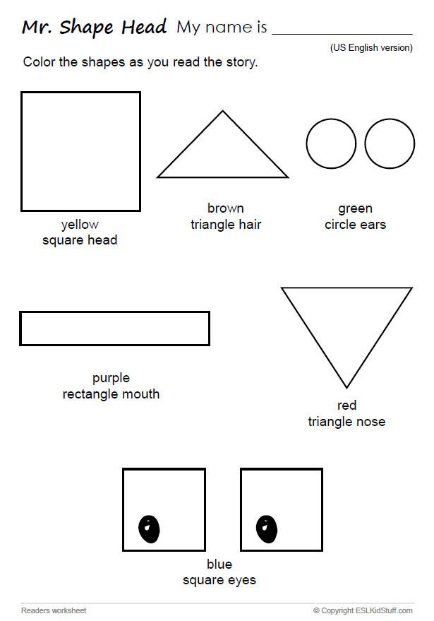
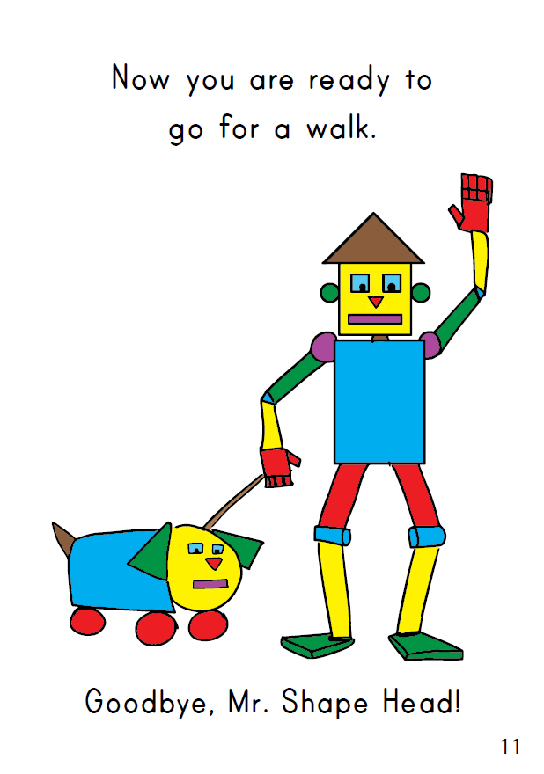

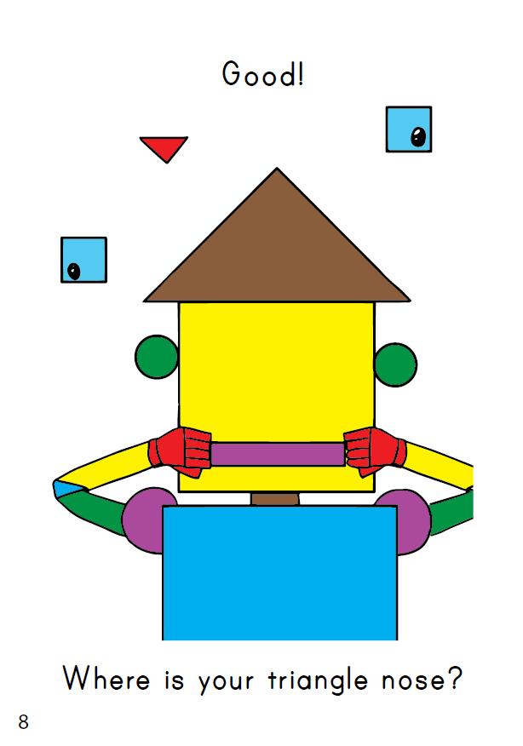
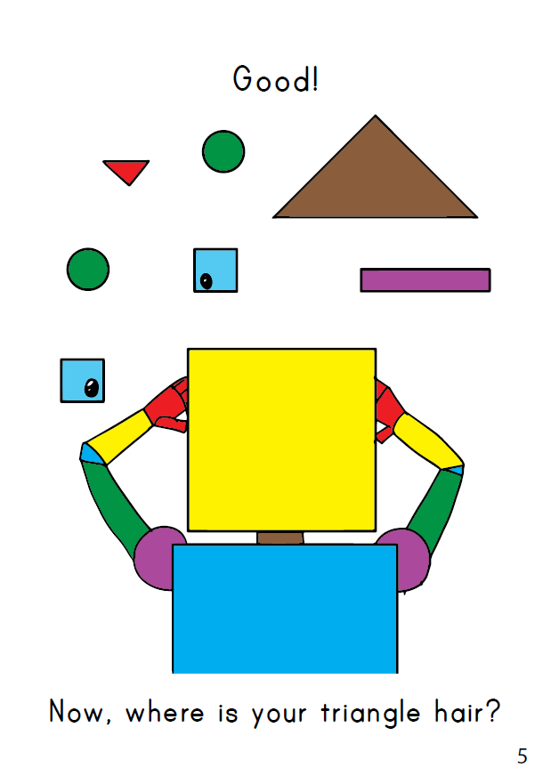
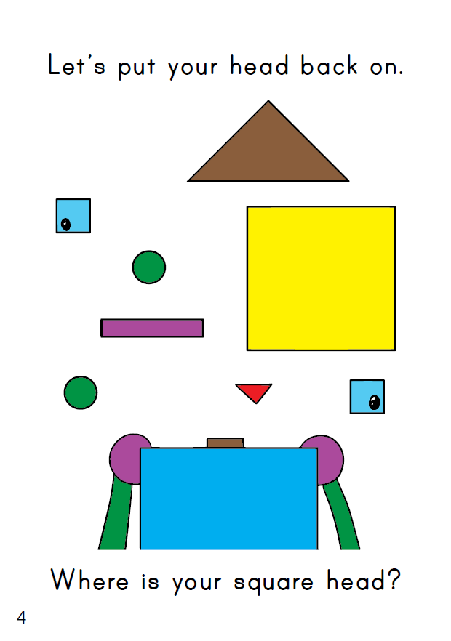
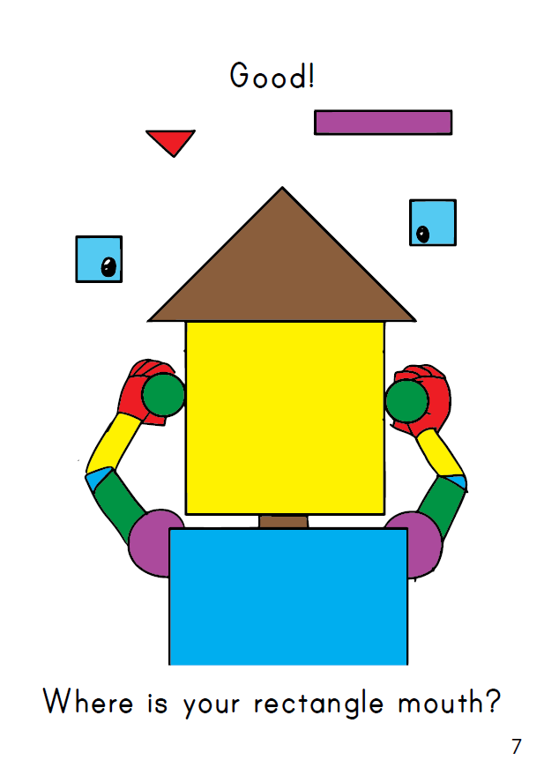
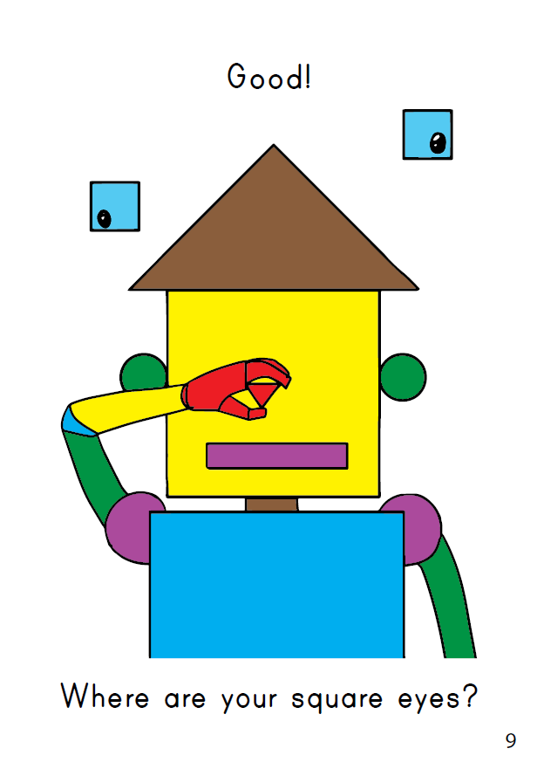
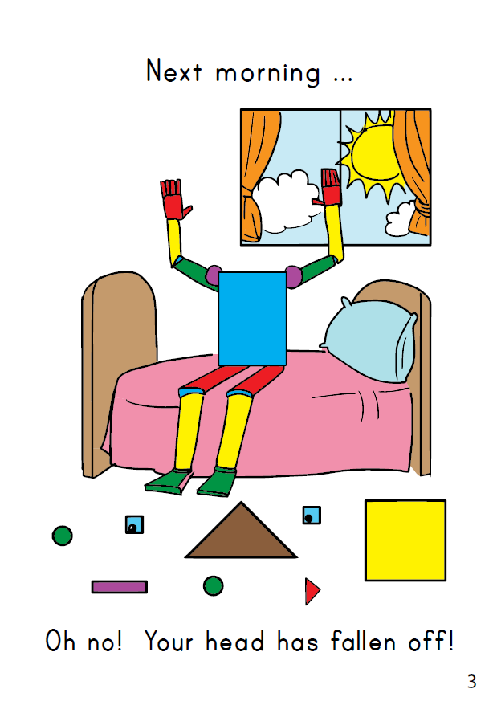
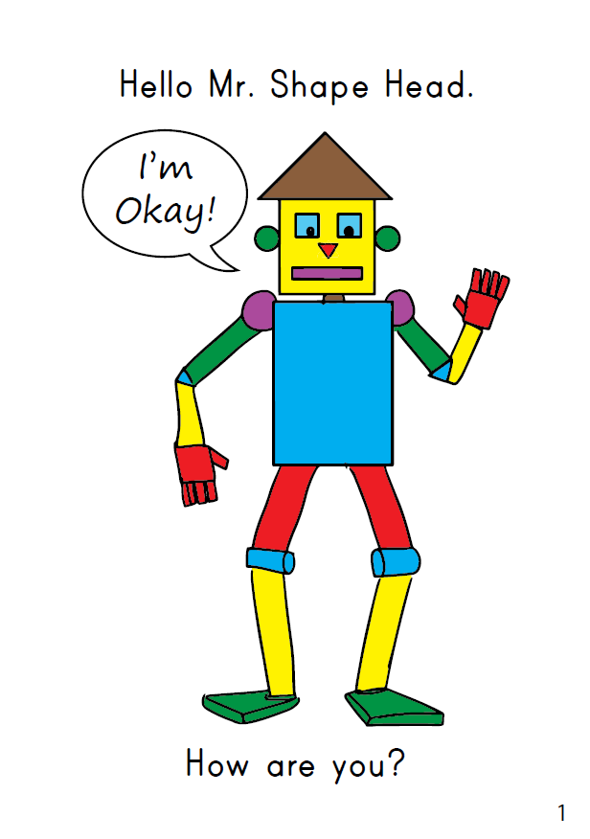
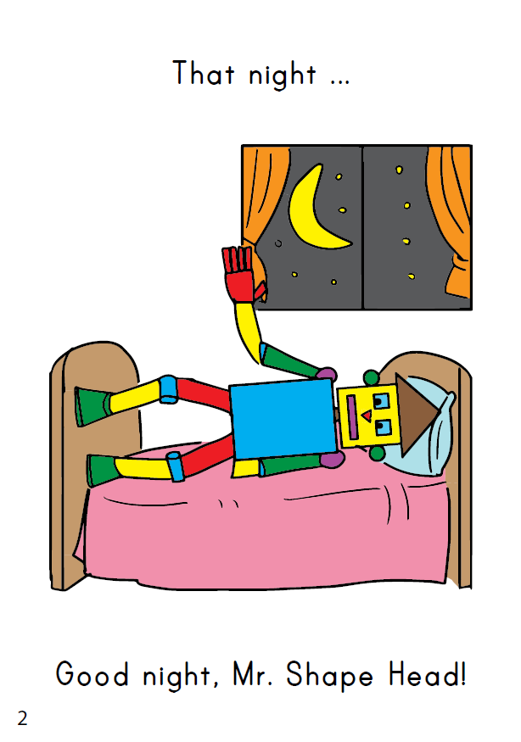
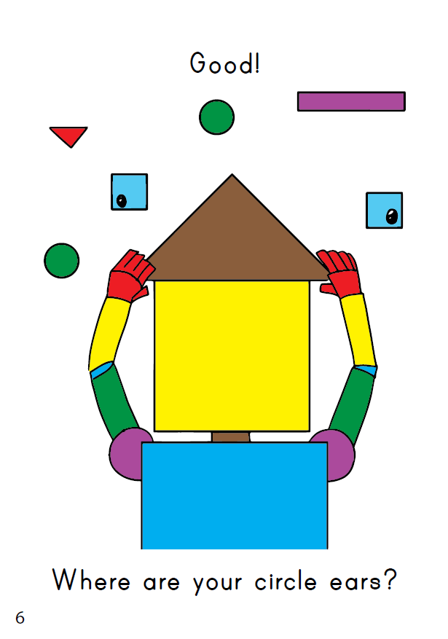


THE END
Press space or left click mouse to move to next slide.
Press left arrow key (◄ ) to go back through the book pages.
Reader video
only available to ESL KidStuff members.
Click here to remove message.
SAMPLE FOR EVALUATION
Join ESL KidStuff
to view without watermark.
To skip reader and jump to next slide, click here
Play reader video
Reader worksheet
Story time
11 | © ESLKidStuff.com

Slide 13
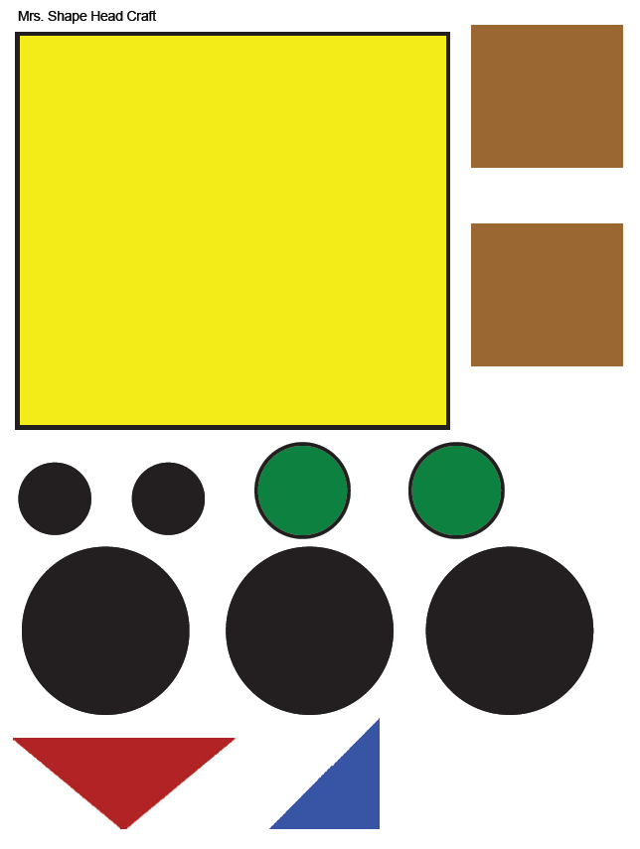
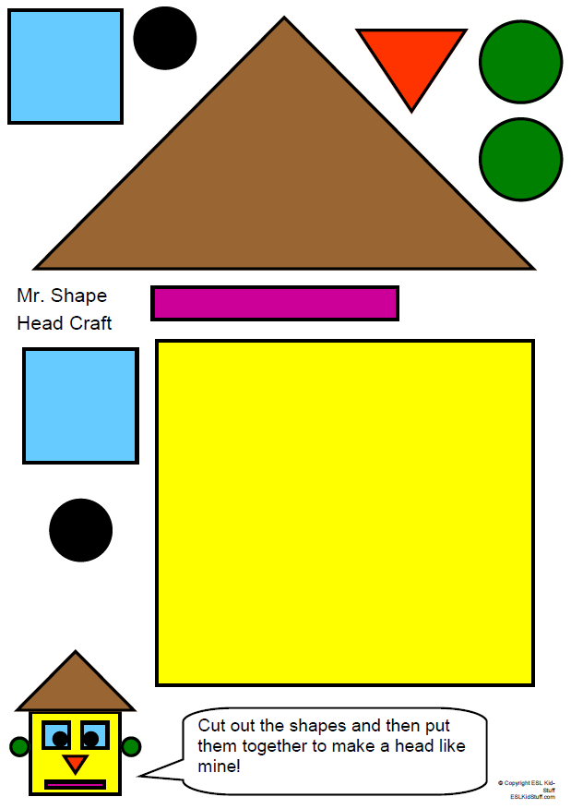
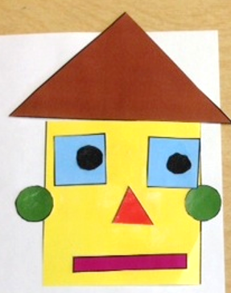
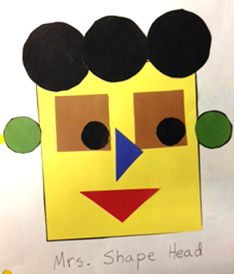
Click picture to see the completed faces.
SAMPLE FOR EVALUATION
Join ESL KidStuff
to view without watermark.
Click to see
Click to see
Mr Shape Head craft

Slide 14
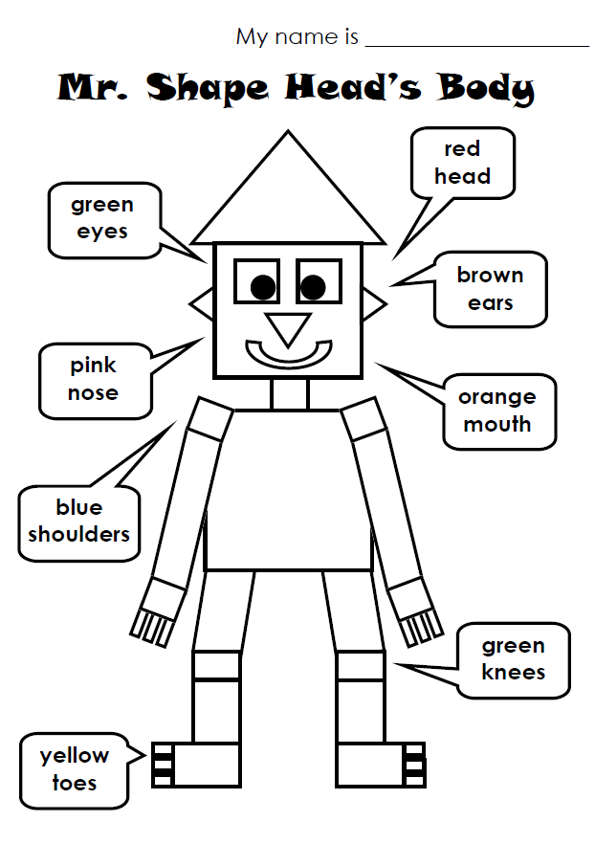
SAMPLE FOR EVALUATION
Join ESL KidStuff
to view without watermark.
Homework

Slide 15
The Goodbye Song
Song audio and video
only available to ESL KidStuff members.
Click here to remove message.
Song audio and video
only available to ESL KidStuff members.
Click here to remove message.
SAMPLE FOR EVALUATION
Join ESL KidStuff
to view without watermark.
Click to play song
Play song audio
Play song video

Slide 16
SAMPLE FOR EVALUATION
Join ESL KidStuff
to view without watermark.

