Slide 1
Intro lesson
1
Greetings, names, follow simple instructions, identify and recognize 5 colors.
"Hello", "What's your name", "My name is...", "How are you?", "I’m fine, thank you", "Goodbye", "Give me..."
red, blue, green, yellow, purple, favorite, color, stand up, sit down, hands up, hands down, jump, run, turn around, pass, touch.
The Hello Song (audio)
The Hello Song (video)
The Goodbye Song (audio)
The Goodbye Song (video)
All about me worksheet
Color the cute fish worksheet
name tracing sheets (one for each student with their name in dots) - optional
colored pencils
name tags for each student
a glove puppet
a small ball
5 sheets of origami colored paper (red, green, blue, yellow, purple)
cushions (1 per student)
This lesson provides a good platform to begin the course with your young learners as it introduces them to the key stages and routines you will use in every class. At this age some of your students may be a bit shy at first so make sure you smile a lot and make them feel really welcome - they will soon gain confidence as you run through all the fun activities in this lesson!

Slide 2
Hello!
- Introduction lesson -

Slide 3
Warm up and maintenance
SAMPLE FOR EVALUATION
Join ESL KidStuff
to view without watermark.
Greetings
Name tags
[ Press space bar or left-mouse click to move through the slides ]

Slide 4
Teacher’s notes are here on every lesson slide.
Greetings
Greet the students by name as they enter the classroom and gesture for them to sit down.
It's a good idea to have a cushion for each student as this makes sitting arrangements easy to organize.
Try and arrange the cushions beforehand spaced out in a fan-shape around you.
1
Hello!
SAMPLE FOR EVALUATION
Join ESL KidStuff
to view without watermark.
Let’s sit down
[ Press space bar or left-mouse click to move to the next slide ]

Slide 5
Greetings
Before class prepare some name tags (stickers or pin-on tags) with each student's name written on in lower-case letters.
Sit down with your students and lay out the name tags in front of you. Pick up each tag and call out the name.
Try and encourage each student to put their hand up and say "yes". Hand over the tags and help to pin / stick on.
In later lessons, if your students can write their name in English, you can have them write their names on their tags at the beginning of each lesson.
2
SAMPLE FOR EVALUATION
Join ESL KidStuff
to view without watermark.
Name tags
[ Press space bar or left-mouse click to move to the next slide ]

Slide 6
New learning and practice
SAMPLE FOR EVALUATION
Join ESL KidStuff
to view without watermark.
Play "Ball pass" and say names
Introduce glove puppet
Sing "The Hello Song"
Do "Exercise routine" activity
Name writing (optional - see slide notes)
Teach colors: red, blue, green, purple, yellow
Play color games
Do the “All about me” worksheet
[ Press space bar or left-mouse click to move through the slides ]

Slide 7
Play "Ball pass" and say names
Take a soft ball and pass it to your nearest student, saying "Pass". Have each student pass the ball around the circle.
Next, hold the ball and say:
“My name is (your name)”
Have each student say their name with the structure “My name is …” as they pass the ball to each other.
If a student doesn't pass, make sure s/he does it again until done properly.
Next do 2 more rounds – rolling the ball to each other and then throwing and catching the ball – each time saying their names as they receive the ball.
1
SAMPLE FOR EVALUATION
Join ESL KidStuff
to view without watermark.
Play "Ball pass"
[ Press space bar or left-mouse click to move to the next slide ]

Slide 8
Introduce glove puppet You need a glove puppet in a bag.
Bring out the bag, and shout into the bag "Hello!". Then move your ear to the opening to listen - nothing.
Then get all the students together to shout "Hello!" at the same time. This time the puppet wakes up and jumps out of the bag!
Then model talking to the glove puppet:
"Hello", What's your name?"
Puppet: "My name is...".
“How are you?”
Puppet: “I’m fine, thank you”.
Then move onto the first student and say "Hello“ and encourage him/her to say hello back.
… click panel for more »
Next, the puppet asks each student:
“What's your name?”,
and encourage the response:
"My name is...“
Then, the puppet asks each student:
“How are you?”
And elicit:
“I’m fine, thank you.
Finally, the puppet says "Goodbye" and "See you" before going back into the bag to sleep.
NOTE: even 7-year olds enjoy chatting with glove puppets so it shouldn’t be a problem for this age group! If you have a group of mature 7-year olds who are not being responsive to the puppet, use a ball to pass to each student and roleplay the greetings.
… click panel to go back »
2
SAMPLE FOR EVALUATION
Join ESL KidStuff
to view without watermark.
Glove puppet
[ Press space bar or left-mouse click to move to the next slide ]

Slide 9


Sing “The Hello Song“
Sit in a circle and listen to the song (clap along or pat knees).
Play it once more emphasizing "Hello". Your students will pick up the words surprisingly quickly.
Gestures
The first time you play the song do the gestures and encourage everyone to do them with you.
Wave as you sing the "Hello, hello" parts.
Gesture to others as you sing "How are you today?“
Point to yourself as you sing "I’m fine, thank you“
Hand gesture towards another student as you sing "And how about you?"
The Hello Song
3
Song audio and video
only available to ESL KidStuff members.
Click here to remove message.
Song audio and video
only available to ESL KidStuff members.
Click here to remove message.
SAMPLE FOR EVALUATION
Join ESL KidStuff
to view without watermark.
Click to play song
Play song audio
Play song video

Slide 10
Do "Exercise routine" activity
Time for some action. Say the following and have the students follow your lead:
"Stand up (T stands and so does everyone else)
"Hands up / hands down" (do 4 or 5 times)
"Jump" (4 or 5 times)
"Run! / Stop!" (4 or 5 times)
"Turn around! / Stop!" (4 or 5 times)
finally "Sit down".
4
hands up
hands down
jump
stand up
SAMPLE FOR EVALUATION
Join ESL KidStuff
to view without watermark.
sit
down
Press space or
left mouse click to see exercises
run
turn around
Exercises
9 | © ESLKidStuff.com
[ Press space bar or left-mouse click to move to the next slide ]

Slide 11
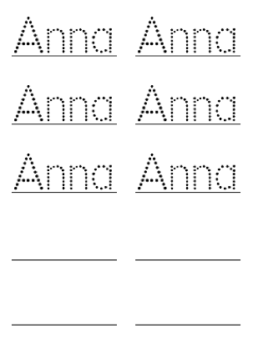
Name writing
This is an optional activity you can do if your students can’t write their names in English. If they can, skip this step.
Before class prepare a writing sheet for each student with their name written in dots for them to practice tracing (similar to the picture on this slide).
Everyone sits at a table with you. Give clear instructions: first, tell everyone to get their bags (you do the same so they can see what to do). Then say, "Take out your crayons".
Take the sheets of paper and read the names - encourage each student to put their hand up and say "Yes". Give out the sheets to each student and give one to yourself.
… click panel for more »
Next, say, "Take out a pencil" and have the students follow you as you take out your pencil. Any color will do. Model tracing your name, slowly and carefully, saying your name as you trace.
Have everyone trace the first name. Then put the pencil back into your pencil case and take out a different color and write the next name. As the students trace their names, circulate, help and give lots of praise.
When everyone has finished, get each student to hold up their sheet so you and everyone can see. Give lots of praise to each student - you can even put stickers on each student's sheet as a prize or even a simple drawing of a smiley face will do!
… click panel to go back »
5
SAMPLE FOR EVALUATION
Join ESL KidStuff
to view without watermark.
OPTIONAL ACTIVITY
If your students need to practice writing their names.
See teacher’s notes for details.
Name writing practice
10 | © ESLKidStuff.com
[ Press space bar or left-mouse click to move to the next slide ]

Slide 12


Teach colors: red, blue, green, purple, yellow
Over the next few lessons we’ll learn some colors. In this lesson we’ll start with the colors red, blue, green, purple and yellow.
Origami paper is great for this, or just some colored paper/card cut into squares.
Sit everyone in a circle and hold up the first colored paper and ask, “What color is it?” – even with young kids you may get the right answer! If not, teach the color (e.g. red) and chorus it 3 times. Do this for the rest of the colors.
6
SAMPLE FOR EVALUATION
Join ESL KidStuff
to view without watermark.
Click object to hear vocab
5 colors
11 | © ESLKidStuff.com
[ Press space bar or left-mouse click to move to the next slide ]

Slide 13
Play “Color pass”
Take each color card and pass it to your nearest student. Say "red" as you pass red, etc. The students pass the colors round the circle.
Play “Color touch”
Next, lay the 5 colors in the middle of the circle. Say "Hands up". Students raise their hands. Then say "Touch.....red!" and the students should all try and touch the red colored paper. Do for all of the colors.
Play “Color hold up”
Finally, give each student one of the colored papers. Say "Hold up....blue!" - the students holding the blue papers raise them into the air.
7
SAMPLE FOR EVALUATION
Join ESL KidStuff
to view without watermark.
Play color games
12 | © ESLKidStuff.com
[ Press space bar or left-mouse click to move to the next slide ]

Slide 14
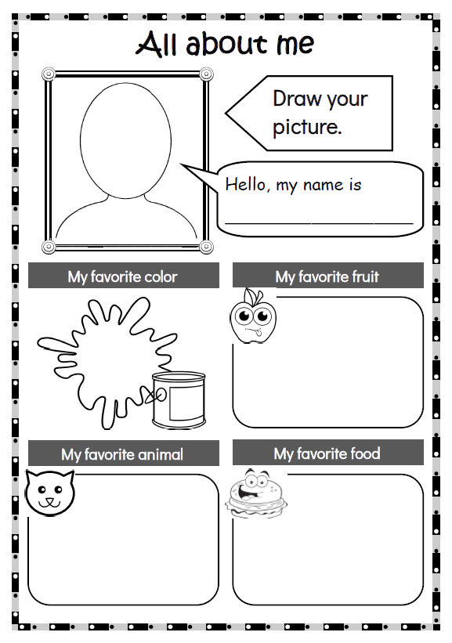
Do the “All about me” worksheet
Let’s find out a little about everybody. Hold up the worksheet and show drawing your face and writing your name – and make it lots of fun! Then complete the favorites sections, making it clear that these are your favorite things. Your students can also try to guess what your favorite things are.
Then give out the worksheets and have everyone complete them. Circulate, check and ask questions (What color is this?, What fruit is that?).
Finally, hold up each student’s work in turn and show to the class. Ask a question (e.g. What is your favorite animal?) and give lots of praise.
Tell your students to put their worksheets into their bags.
8
SAMPLE FOR EVALUATION
Join ESL KidStuff
to view without watermark.
Click to see
All about me
13 | © ESLKidStuff.com
[ Press space bar or left-mouse click to move to the next slide ]

Slide 15
Wrap up
SAMPLE FOR EVALUATION
Join ESL KidStuff
to view without watermark.
Assign homework: “Color the cute fish”
Say goodbye to glove puppet
Sing “The Goodbye Song”
Do “Quick check” and say goodbye
[ Press space bar or left-mouse click to move through the slides ]

Slide 16
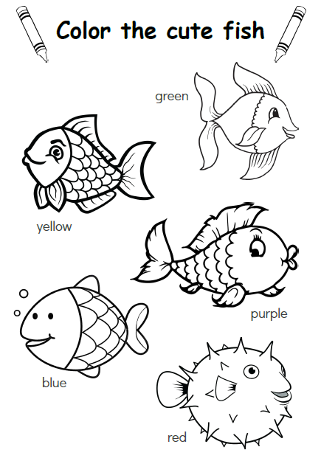
Assign homework: “Color the cute fish”
Hold up the homework worksheet and model coloring in the 5 fish pictures (with red, blue, green, yellow and purple pencils).
Elicit each color as you go.
Give out the worksheets and say, "Put your homework in your bags" and help them to do so - this is important as they will probably want to start coloring them right away.
1
SAMPLE FOR EVALUATION
Join ESL KidStuff
to view without watermark.
Click to see
Homework
15 | © ESLKidStuff.com
[ Press space bar or left-mouse click to move to the next slide ]

Slide 17
Say goodbye to glove puppet
Take out the bag again and get everyone to wake up the glove puppet by shouting its name into the bag (e.g. "Cookie Monster!").
Bring out the puppet and go through the same routine - go to each student and say hello, ask their name and how they are. Then say goodbye / see you.
Then put the puppet back in the bag (back to sleep).
2
SAMPLE FOR EVALUATION
Join ESL KidStuff
to view without watermark.
Goodbye glove puppet
16 | © ESLKidStuff.com
[ Press space bar or left-mouse click to move to the next slide ]

Slide 18
Sing The Goodbye Song
“The Goodbye Song" is a great way to sign off the class.
Sit together in a circle and sing and clap along.
Gestures
The first time you play the song do the gestures and encourage everyone to do them with you.
Wave as you sing the "Goodbye, goodbye" parts.
Hold your hand above your eyes (as you would when you are looking into the distance and keeping the sun out of your eyes) and look at another student as you sing "See you again".
Tap watch (or imaginary watch) and then point to the door as you sing "It’s time to go".
Point towards another student as you sing "See you next time".
The Goodbye Song
3
Song audio and video
only available to ESL KidStuff members.
Click here to remove message.
Song audio and video
only available to ESL KidStuff members.
Click here to remove message.
SAMPLE FOR EVALUATION
Join ESL KidStuff
to view without watermark.
Click to play song
Play song audio
Play song video

Slide 19
Do "Quick check" and say goodbye
Time to leave the class.
Make sure everything is put away and the students have gathered their belongings.
Have them line up at the door and place yourself between the door and the students.
For each student hold up a color and ask, "What color is this?".
When they give you the correct answer say goodbye and let them leave. If their answer is wrong, have them go back to the end of the line - they will have to try again once they reach the front!
4
Goodbye!
SAMPLE FOR EVALUATION
Join ESL KidStuff
to view without watermark.
Goodbye and quick check
18 | © ESLKidStuff.com
[ Press space bar or left-mouse click to move to the next slide ]

Slide 20
SAMPLE FOR EVALUATION
Join ESL KidStuff
to view without watermark.

