Slide 1
Colours and fruit 3
4
Identify and recognize 7 colours and 6 fruit.
"What colour is it?“, "What fruit is it?"
orange, melon, pineapple, balloon.
red, blue, green, purple, yellow, pink, orange, apple, banana, grapes.
Hello Song (audio & video)
Goodbye Song (audio & video)
The Rainbow Song (audio & video)
What colour am I? reader (video)
Fruit flashcards (apple, banana, grapes, orange, melon, pineapple)
Colour the 6 fruit worksheet
The Rainbow Song song sheet
What colour am I? classroom reader
What colour am I? reader worksheet
name tracing sheets (one for each student with their name in dots)
coloured crayons / pencils
name tags for each student
a glove puppet
7 sheets of origami coloured paper (red, green, blue, purple, yellow, pink, orange)
7 balloons of different colours (red, green, blue, purple, yellow, pink, orange)
plastic fruit (in a small box)
a length of rope
cushions (1 per student)
A fun lesson with lots of activities building on the previous lessons - and also your students’ first classroom reader!

Slide 2
Media in these slides
Songs
Interactive games
Readers
Printables
Vocabulary
Play audio or video directly from the slide
Play games and activities on the slide with your class
Read stories together on the slide or watch a video
View worksheets, craft sheets, etc. on screen
View lesson vocabulary images on screen
The hello song
The rainbow song
The goodbye song
Review quiz: colours and fruit
What colour am I?
Colour the 6 fruit worksheet
Practice colours: red, blue, green, purple, yellow, pink, orange
Practice fruit: apple, banana, grapes, orange, melon, pineapple.

Slide 3
What colour?
- Colours and fruit 3 -

Slide 4


The Hello Song
Song audio and video
only available to ESL KidStuff members.
Click here to remove message.
Song audio and video
only available to ESL KidStuff members.
Click here to remove message.
SAMPLE FOR EVALUATION
Join ESL KidStuff
to view without watermark.
Click to play song
Play song audio
Play song video

Slide 5
The Rainbow Song
Song audio and video
only available to ESL KidStuff members.
Click here to remove message.
Song audio and video
only available to ESL KidStuff members.
Click here to remove message.
SAMPLE FOR EVALUATION
Join ESL KidStuff
to view without watermark.
Click to play song
Play song audio
Play song video

Slide 6


Click object to hear vocab
SAMPLE FOR EVALUATION
Join ESL KidStuff
to view without watermark.
Practice colours

Slide 7



Click object to hear vocab
SAMPLE FOR EVALUATION
Join ESL KidStuff
to view without watermark.
Practice fruit

Slide 8
Click object to hear vocab
Quiz time!
Press ► to start and move through the images,
press ◄ to go back.
Ready? Let’s start! ►
Good job!
The quiz is finished.
Press ◄ to go back.
Press space to continue to next slide.
SAMPLE FOR EVALUATION
Join ESL KidStuff
to view without watermark.
Review quiz
[ Press space bar to start ]

Slide 9
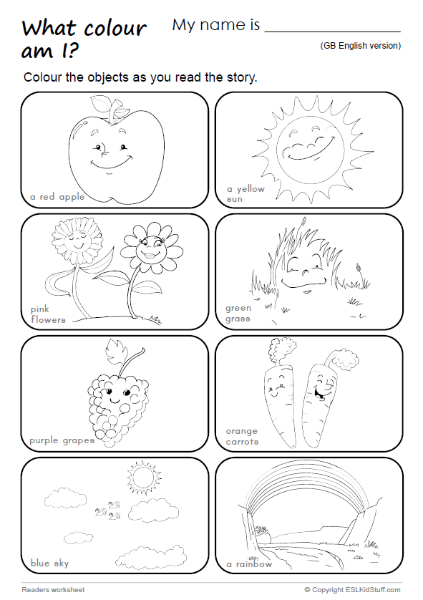
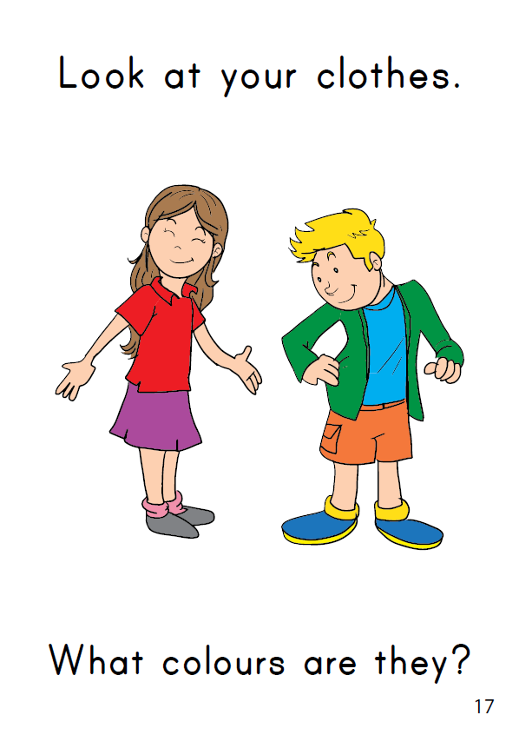
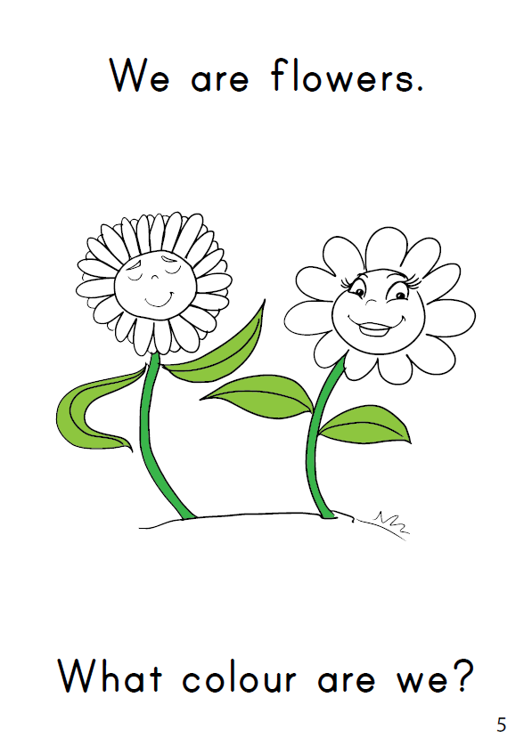
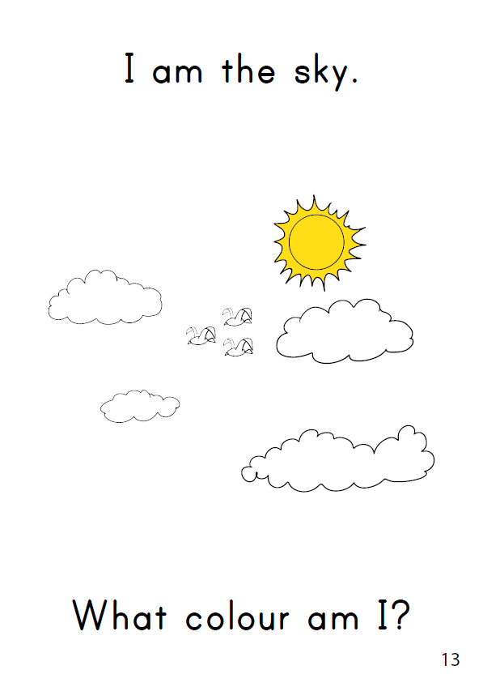
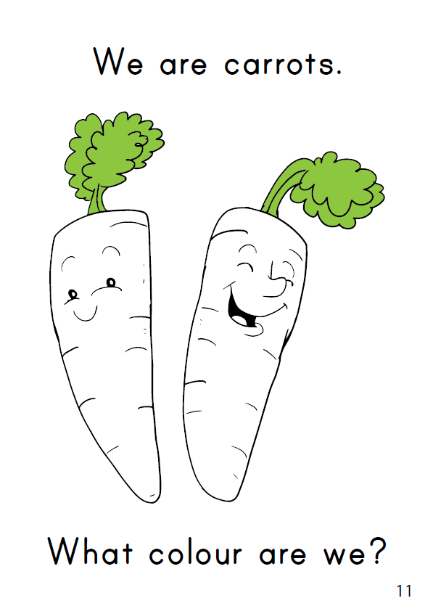
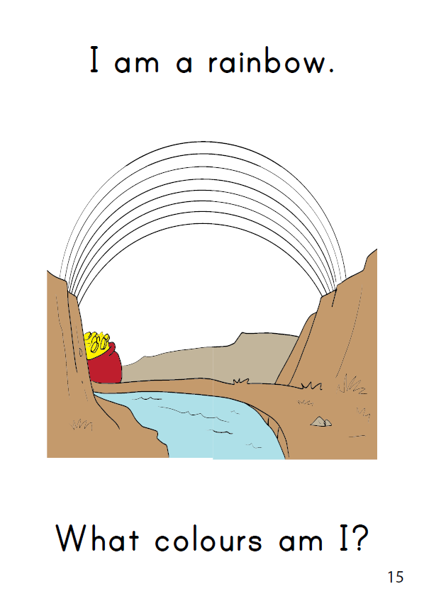
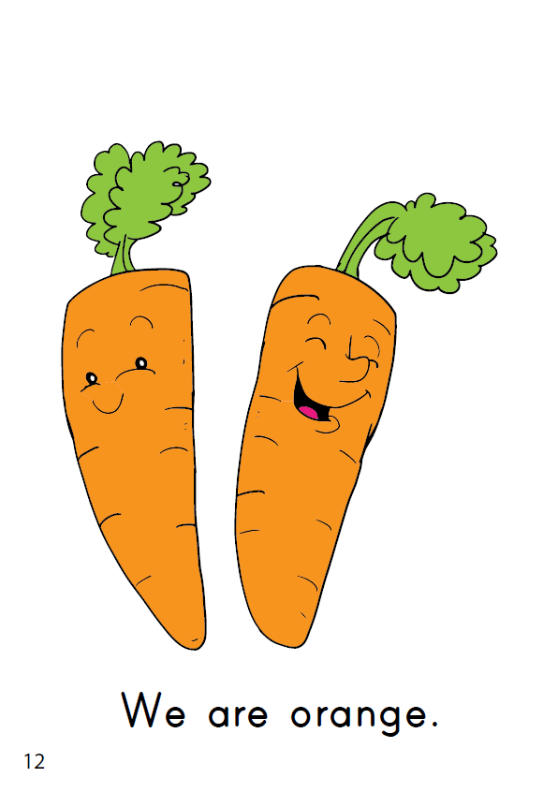
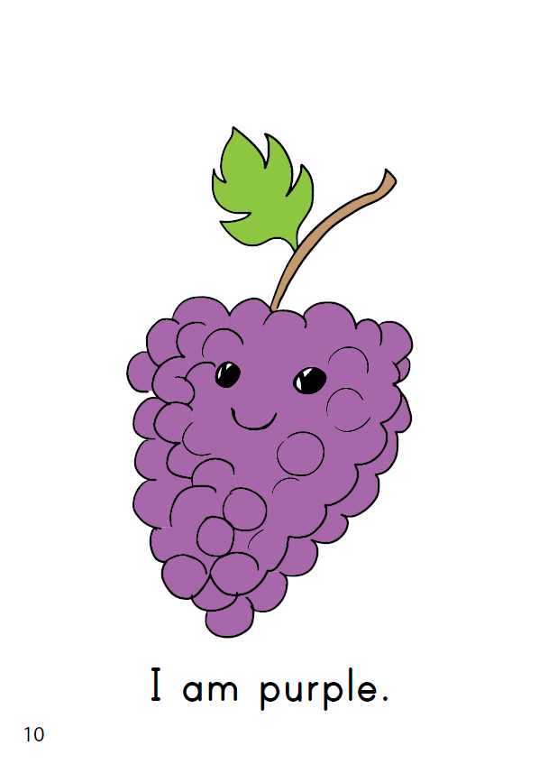
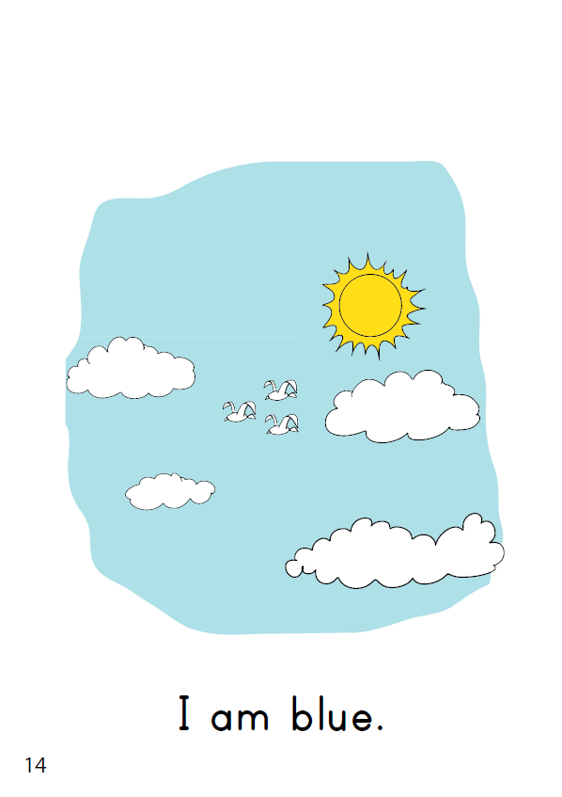
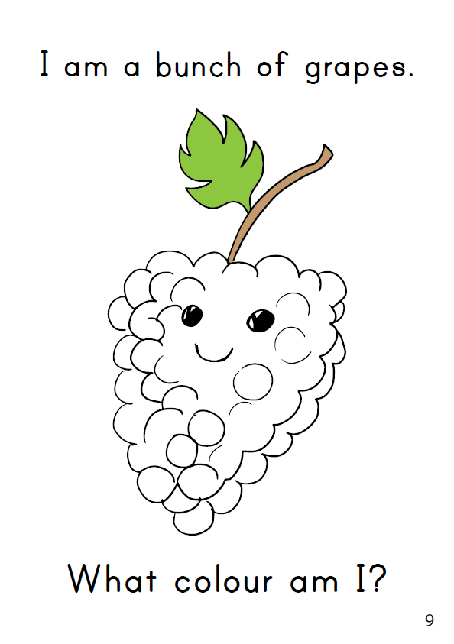
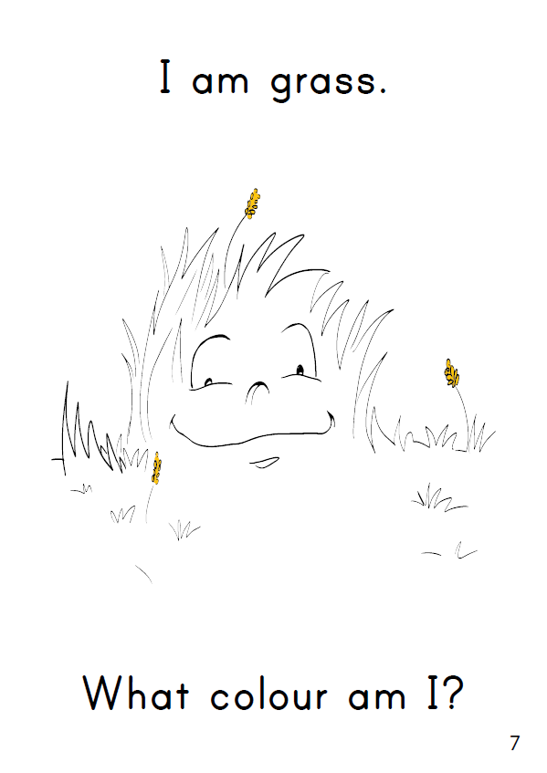
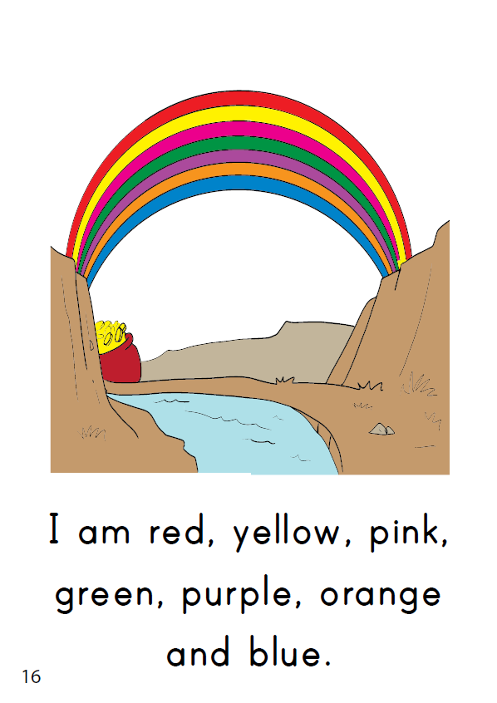
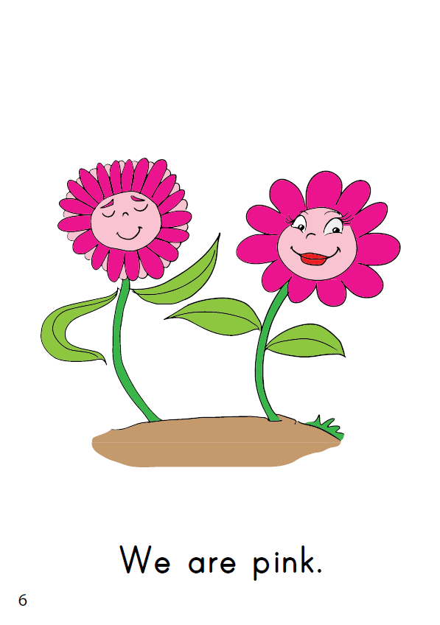
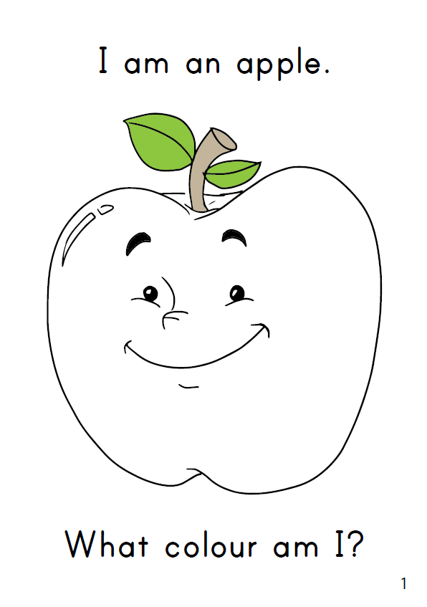
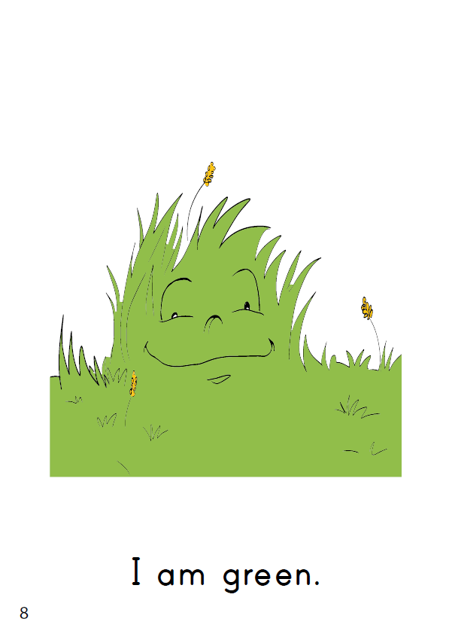
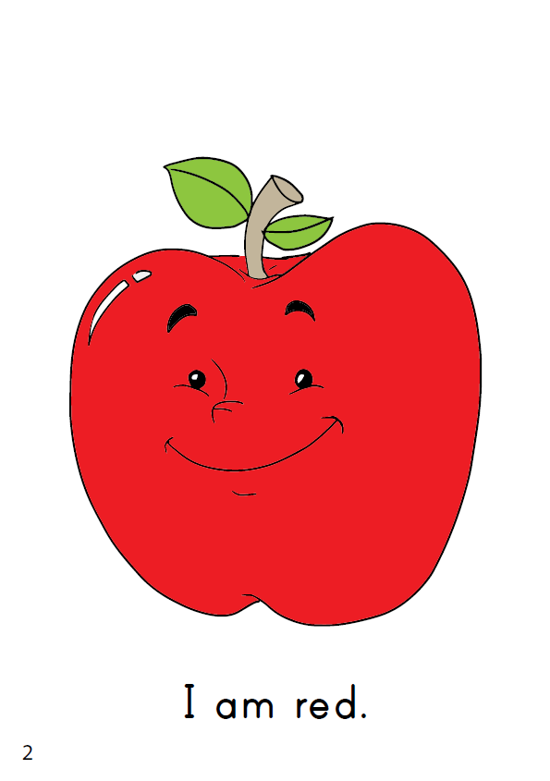

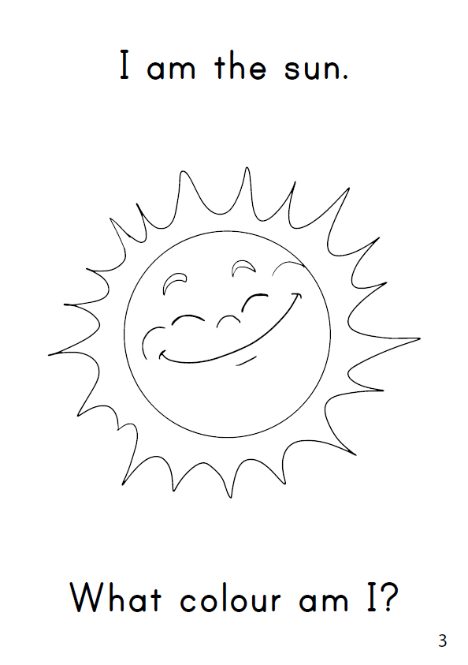
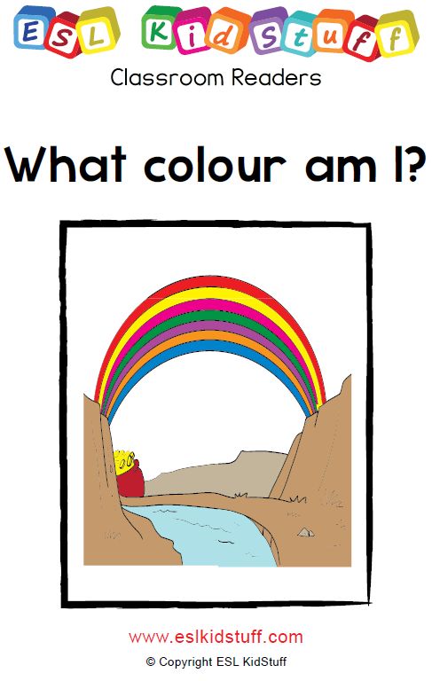

THE END
Press space or left click mouse to move to next slide.
Press left arrow key (◄ ) to go back through the book pages.
Song audio and video
only available to ESL KidStuff members.
Click here to remove message.
SAMPLE FOR EVALUATION
Join ESL KidStuff
to view without watermark.
To skip reader and jump to next slide, click here
Play reader video
Reader worksheet
Story time
[ Press space bar or left-mouse to turn pages ]
[ Press space bar or left-mouse click to move to the next slide ]

Slide 10
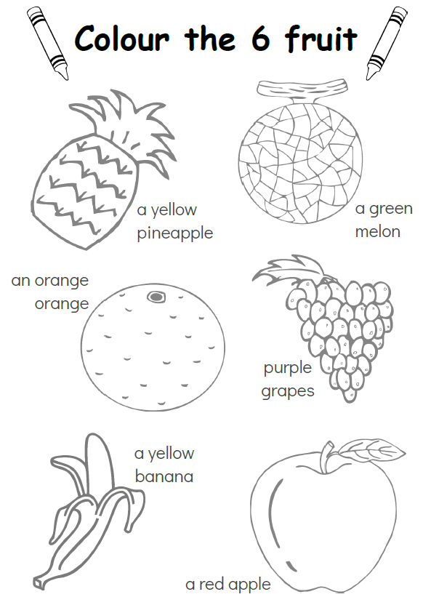
SAMPLE FOR EVALUATION
Join ESL KidStuff
to view without watermark.
Homework

Slide 11
The Goodbye Song
Song audio and video
only available to ESL KidStuff members.
Click here to remove message.
Song audio and video
only available to ESL KidStuff members.
Click here to remove message.
SAMPLE FOR EVALUATION
Join ESL KidStuff
to view without watermark.
Click to play song
Play song audio
Play song video

Slide 12

The end
Thank you!
SAMPLE FOR EVALUATION
Join ESL KidStuff
to view without watermark.
© Copyright ESL KidStuff
www.eslkidstuff.com

