Slide 1
Introduction Lesson
1
Greetings, names, follow simple instructions, identify and recognize 3 colours.
"Hello", "What's your name", "My name is...", "Goodbye", "Give me..."
red, blue, green, flower, stand up, sit down, hands up, hands down, jump, run, turn around, pass, touch.
Hello Song (audio)
Hello Song (video)
Goodbye Song (audio)
Goodbye Song (video)
Name flower craft sheet
Colour the balloons worksheet
name tracing sheets (one for each student with their name in dots)
coloured crayons / pencils
name tags for each student
a glove puppet
a small ball
3 sheets of origami coloured paper (red, green, blue)
cushions (1 per student)
This lesson provides a good platform to begin the course with your younger level learners as it introduces them to the key stages and routines you will use in every class. At this age some of your students may be a bit shy at first so make sure you smile a lot and make them feel really welcome - they will soon gain confidence as you run through all the fun activities in this lesson!

Slide 2
Hello!
- Introduction lesson -

Slide 3
Warm up and
Maintenance
SAMPLE FOR EVALUATION
Join ESL KidStuff
to view without watermark.
Greetings
Name tags
[ Press space bar or left-mouse click to move through the slides ]

Slide 4
Teacher’s notes are here on every lesson slide.
Greetings
Greet the students by name as they enter the classroom and gesture for them to sit down.
It's a good idea to have a cushion for each student (and parent if also taking part) as this makes sitting arrangements easy to organize.
Try and arrange the cushions beforehand spaced out in a fan-shape around you.
1
Hello!
SAMPLE FOR EVALUATION
Join ESL KidStuff
to view without watermark.
Let’s sit down
[ Press space bar or left-mouse click to move to the next slide ]

Slide 5
Name tags
Before class prepare some name tags (stickers or pin-on tags) with each student's name written on in lower case letters.
Sit down with your students and lay out the name tags in front of you. Pick up each tag and call out the name.
Try and encourage each student to put their hand up and say "yes". Hand over the tags and help to pin / stick on.
In later lessons, once your students can recognize their written name, you can have them pick out their own name tags.
2
SAMPLE FOR EVALUATION
Join ESL KidStuff
to view without watermark.
Name tags
[ Press space bar or left-mouse click to move to the next slide ]

Slide 6
New Learning and Practice
SAMPLE FOR EVALUATION
Join ESL KidStuff
to view without watermark.
Play "Ball pass" and say names
Introduce glove puppet - greetings and introductions activity
Sing “The Hello Song“
Do "Exercise routine" activity
Name writing practice
Do the Name flower craft activity
Introduce “5-minute play time”
Teach colours: red, blue, green
Play "Colour pass", "Colour touch" and "Colour hold up“
[ Press space bar or left-mouse click to move through the slides ]

Slide 7

Play "Ball pass" and say names
Take a soft ball and pass it to your nearest student, saying "Pass". Have each student pass the ball around the circle.
Next, hold the ball and say your name. Have each student say their name as they pass the ball to each other.
Make sure they pass, not throw, roll, etc.
If a student doesn't pass, make sure s/he does it again until done properly.
1
SAMPLE FOR EVALUATION
Join ESL KidStuff
to view without watermark.
Play "Ball pass"
[ Press space bar or left-mouse click to move to the next slide ]

Slide 8
Introduce glove puppet You need a glove puppet and put it in a bag before class.
Bring out the bag, and shout into the bag "Hello!". Then move your ear to the opening to listen - nothing.
Go to each student and encourage them to shout "Hello" into the bag - each time nothing happens.
Finally, get all the students together to shout "Hello!" at the same time. This time the puppet wakes up and jumps out of the bag!
Then model talking to the glove puppet:
"Hello", What's your name?"
Puppet: "My name is...".
… click panel for more »
Then move onto the first student and say "Hello“ and encourage him/her to say hello back.
Let the students touch, cuddle and stroke the puppet and the puppet can nibble their feet and arms.
Next, the puppet asks each student:
"What's your name?".
If they are old enough, try and encourage
"My name is...“
but for the really little ones (3 and under) just saying their name is fine.
Finally, go around saying "Goodbye" and "See you" before going back into the bag and back to sleep.
… click panel to go back »
2
SAMPLE FOR EVALUATION
Join ESL KidStuff
to view without watermark.
Glove puppet
[ Press space bar or left-mouse click to move to the next slide ]

Slide 9


Sing “The Hello Song“
Sit in a circle and listen to the song (clap along or pat knees).
Play it once more emphasizing "Hello". Your students will pick up the words surprisingly quickly.
Gestures
The first time you play the song do the gestures and encourage everyone to do them with you.
Wave as you sing the "Hello, hello" parts.
Gesture to others as you sing "How are you today?“
Point to yourself as you sing "I’m fine, thank you“
Hand gesture towards another student as you sing "And how about you?"
The Hello Song
3
Song audio and video
only available to ESL KidStuff members.
Click here to remove message.
Song audio and video
only available to ESL KidStuff members.
Click here to remove message.
SAMPLE FOR EVALUATION
Join ESL KidStuff
to view without watermark.
Click to play song
Play song audio
Play song video

Slide 10
Do "Exercise routine" activity
Time for some action. Say the following and have the students follow your lead:
"Stand up (T stands and so does everyone else)
"Hands up / hands down" (do 4 or 5 times)
"Jump" (4 or 5 times)
"Run! / Stop!" (4 or 5 times)
"Turn around! / Stop!" (4 or 5 times)
finally "Sit down".
4
hands up
hands down
jump
stand up
SAMPLE FOR EVALUATION
Join ESL KidStuff
to view without watermark.
sit
down
Press space or
left mouse click to see exercises
run
turn around
Exercises
[ Press space bar or left-mouse click to move to the next slide ]

Slide 11
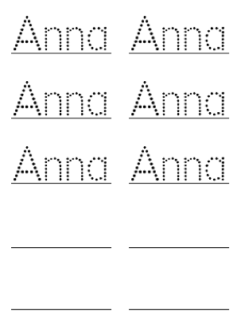
Name writing
Your students are going to practice writing their names.
Before class prepare a writing sheet for each student with their name written in dots for them to practice tracing (similar to the picture on this slide).
Everyone sits at a table with you. Give clear instructions: first, tell everyone to get their bags (you do the same so they can see what to do). Then say, "Take out your crayons".
Take the sheets of paper and read the names - encourage each student to put their hand up and say "Yes". Give out the sheets to each student and give one to yourself.
… click panel for more »
Next, say, "Take out a crayon" and have the students follow you as you take out your crayon. Any colour will do. Model tracing your name, slowly and carefully, saying your name as you trace.
Have everyone trace the first name. Then put the crayon back into your pencil case and take out a different colour and write the next name. As the students trace their names, circulate, help and give lots of praise.
When everyone has finished, get each student to hold up their sheet so you and everyone can see. Give lots of praise to each student - you can even put stickers on each student's sheet as a prize or even a simple drawing of a smiley face will do!
… click panel to go back »
5
SAMPLE FOR EVALUATION
Join ESL KidStuff
to view without watermark.
Name writing practice
[ Press space bar or left-mouse click to move to the next slide ]

Slide 12

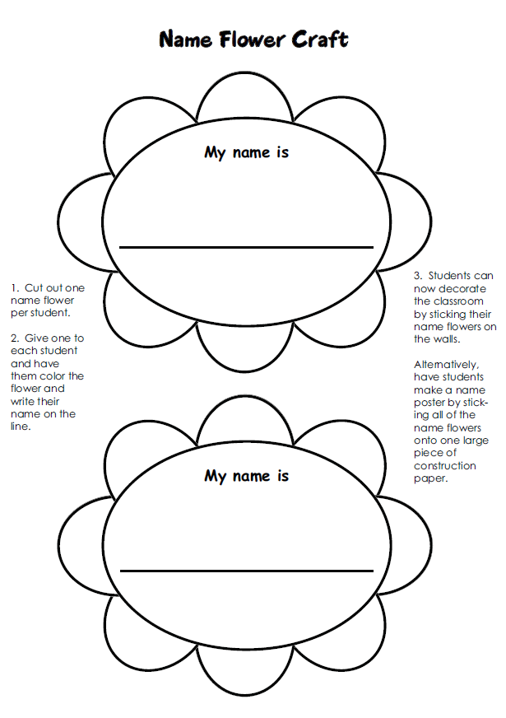
Do the “Name flower craft” activity
Now that everyone has had a chance to practice writing their name you can do this craft activity.
Before class, print out the "Name Flower Craft" sheet and copy / cut out the flower shapes so that there are enough to give one to each student.
Get each student to write their name on the line and then color in their flower. Students can now decorate the classroom by sticking their name flowers on the walls.
Alternatively, have students make a name poster by sticking all of the name flowers onto one large piece of construction paper (idea: make a tree shape out of brown card for students to stick their flowers on).
6
SAMPLE FOR EVALUATION
Join ESL KidStuff
to view without watermark.
Click to see
Flower craft
[ Press space bar or left-mouse click to move to the next slide ]

Slide 13

Introduce “5-minute play time”
This is an optional segment that can be part of all your lessons at this level. At this age, kids like a quick break and will be able to focus better on the rest of your lesson.
Allow your students to play with any games or toys you have. If possible, use large tubs or boxes to hold the toys and bring them out for a few minutes each lesson. Tubs filled with animals, plastic fruit, building blocks, kitchen sets, plastic food, cars & vehicles, Mr. Potato Head dolls and so on. Encourage your students to ask you for the toy they want to play with, circulate during the play time and ask students about their toys.
It’s also a good opportunity for a quick rest room break!
7
Play time!
SAMPLE FOR EVALUATION
Join ESL KidStuff
to view without watermark.
chat
games
rest room
toys
[ Press space bar or left-mouse click to move to the next slide ]

Slide 14


Teach colours: red, blue, green
Over the next few lessons we’ll learn some colours. In this lesson we’ll start with the colours red, blue and green.
Origami paper is great for this, or just some coloured paper/card cut into squares.
Sit everyone in a circle and hold up the first coloured paper and ask, “What colour is it?” – even with young kids you may get the right answer! If not, teach the colour (e.g. red) and chorus it 3 times. Do this for the rest of the colours.
8
SAMPLE FOR EVALUATION
Join ESL KidStuff
to view without watermark.
Colors
Click object to hear vocab
[ Press space bar or left-mouse click to move to the next slide ]

Slide 15
Play "Colour pass“
Take each colour card and pass it to your nearest student. Say "red" as you pass red, etc. The students pass the colours round the circle.
Play "Colour touch“
Next, lay the 3 colours in the middle of the circle. Say "Hands up". Students raise their hands. Then say "Touch.....red!" and the students should all try and touch the red coloured paper. Do for all of the colours.
Play "Colour hold up“
Finally, give each student one of the coloured papers. Say "Hold up....blue!" - the students holding the blue papers raise them into the air.
9
SAMPLE FOR EVALUATION
Join ESL KidStuff
to view without watermark.
Play colour games
[ Press space bar or left-mouse click to move to the next slide ]

Slide 16
Wrap up
SAMPLE FOR EVALUATION
Join ESL KidStuff
to view without watermark.
Assign homework: "Colour the balloons"
Say goodbye to glove puppet
Sing “The Goodbye Song"
Do "Quick check" and say goodbye
[ Press space bar or left-mouse click to move through the slides ]

Slide 17
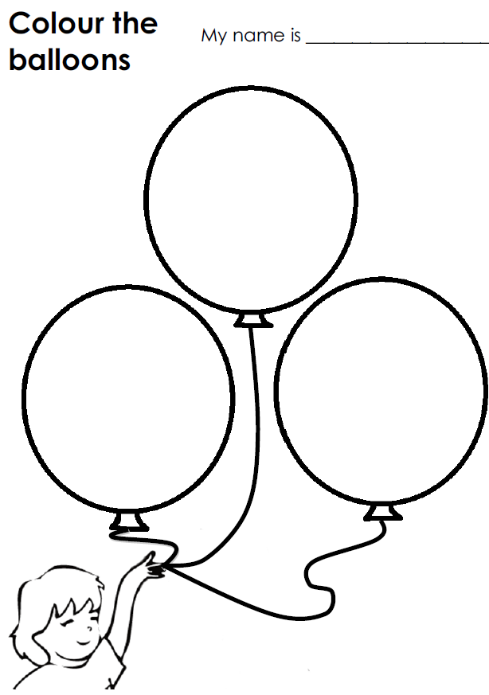
Assign homework: "Colour the balloons“
Hold up the homework worksheet and model colouring in the 3 balloon pictures (with red, blue and green crayons).
Elicit each colour as you go. Give out the worksheets and say, "Put your homework in your bags" and help them to do so - this is important as they will probably want to start colouring them right away.
1
SAMPLE FOR EVALUATION
Join ESL KidStuff
to view without watermark.
Click to see
Homework
[ Press space bar or left-mouse click to move to the next slide ]

Slide 18
Say goodbye to glove puppet
Take out the bag again and get everyone to wake up the glove puppet by shouting its name into the bag (e.g. "Cookie Monster!").
Bring out the puppet and go through the same routine - go to each student and say hello, ask their name and the say goodbye / see you.
Then put the puppet back in the bag (back to sleep).
2
SAMPLE FOR EVALUATION
Join ESL KidStuff
to view without watermark.
Goodbye glove puppet
[ Press space bar or left-mouse click to move to the next slide ]

Slide 19
Sing The Goodbye Song
“The Goodbye Song" is a great way to sign off the class.
Sit together in a circle and sing and clap along.
Gestures
The first time you play the song do the gestures and encourage everyone to do them with you.
Wave as you sing the "Goodbye, goodbye" parts.
Hold your hand above your eyes (as you would when you are looking into the distance and keeping the sun out of your eyes) and look at another student as you sing "See you again".
Tap watch (or imaginary watch) and then point to the door as you sing "It’s time to go".
Point towards another student as you sing "See you next time".
The Goodbye Song
3
Song audio and video
only available to ESL KidStuff members.
Click here to remove message.
Song audio and video
only available to ESL KidStuff members.
Click here to remove message.
SAMPLE FOR EVALUATION
Join ESL KidStuff
to view without watermark.
Click to play song
Play song audio
Play song video

Slide 20
Do "Quick check" and say goodbye
Time to leave the class.
Make sure everything is put away and the students have gathered their belongings.
Have them line up at the door and place yourself between the door and the students.
For each student hold up a colour and ask, "What colour is this?". For very young kids you can hold up the three coloured papers and have them touch one that you say (e.g. "Touch green").
When they give you the correct answer say goodbye and let them leave. If their answer is wrong, have them go back to the end of the line - they will have to try again once they reach the front!
4
Goodbye!
SAMPLE FOR EVALUATION
Join ESL KidStuff
to view without watermark.
Goodbye and quick check
[ Press space bar or left-mouse click to move to the next slide ]

Slide 21

The end
Thank you!
SAMPLE FOR EVALUATION
Join ESL KidStuff
to view without watermark.
© Copyright ESL KidStuff
www.eslkidstuff.com

