Slide 1
Introduction Lesson
1
Greetings, names, follow simple instructions, identify and recognize 3 colours.
"Hello", "What's your name", "My name is...", "Goodbye", "Give me..."
red, blue, green, flower, stand up, sit down, hands up, hands down, jump, run, turn around, pass, touch.
The Hello Song (audio)
The Hello Song (video)
The Goodbye Song (audio)
The Goodbye Song (video)
Name flower craft sheet
Colour the balloons worksheet
name tracing sheets (one for each student with their name in dots)
coloured crayons / pencils
name tags for each student
a glove puppet
a small ball
3 sheets of origami coloured paper (red, green, blue)
cushions (1 per student)
This lesson provides a good platform to begin the course with your younger level learners as it introduces them to the key stages and routines you will use in every class. At this age some of your students may be a bit shy at first so make sure you smile a lot and make them feel really welcome - they will soon gain confidence as you run through all the fun activities in this lesson!

Slide 2
Media in these slides
Songs
Interactive games
Readers
Printables
Vocabulary
Play audio or video directly from the slide
Play games and activities on the slide with your class
Read stories together on the slide or watch a video
View worksheets, craft sheets, etc. on screen
View lesson vocabulary images on screen
The hello song
The goodbye song
Name flower craft
Colour the balloons worksheet
Teach colours: red, blue, green

Slide 3
Hello!
- Introduction lesson -

Slide 4


The Hello Song
Song audio and video
only available to ESL KidStuff members.
Click here to remove message.
Song audio and video
only available to ESL KidStuff members.
Click here to remove message.
SAMPLE FOR EVALUATION
Join ESL KidStuff
to view without watermark.
Click to play song
Play song audio
Play song video

Slide 5
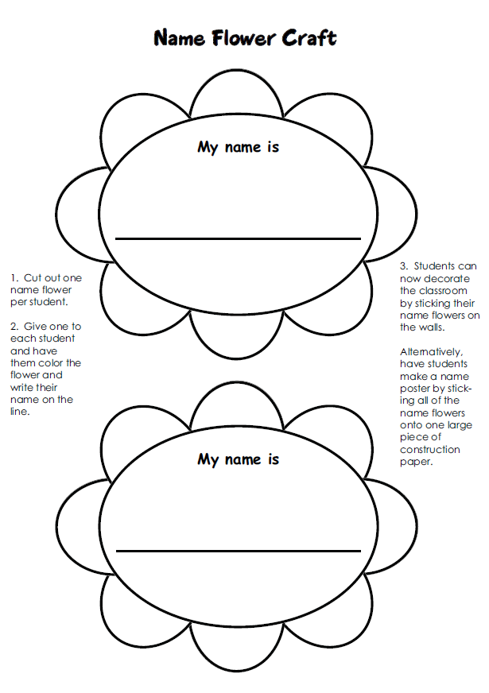
SAMPLE FOR EVALUATION
Join ESL KidStuff
to view without watermark.
Flower craft

Slide 6


Click object to hear vocab
SAMPLE FOR EVALUATION
Join ESL KidStuff
to view without watermark.
Colours

Slide 7
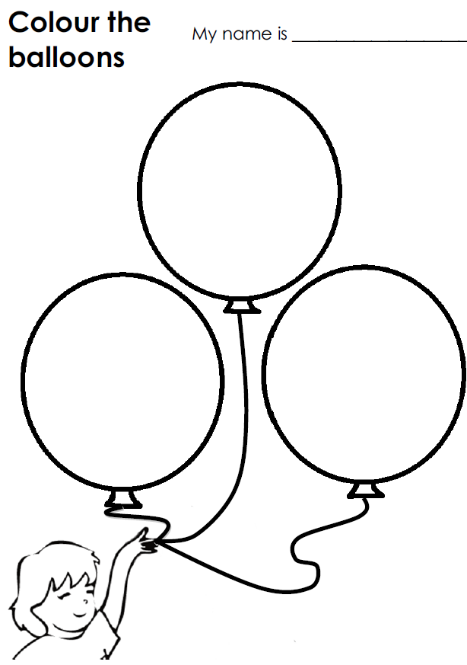
SAMPLE FOR EVALUATION
Join ESL KidStuff
to view without watermark.
Homework

Slide 8
The Goodbye Song
Song audio and video
only available to ESL KidStuff members.
Click here to remove message.
Song audio and video
only available to ESL KidStuff members.
Click here to remove message.
SAMPLE FOR EVALUATION
Join ESL KidStuff
to view without watermark.
Click to play song
Play song audio
Play song video

Slide 9

The end
Thank you!
SAMPLE FOR EVALUATION
Join ESL KidStuff
to view without watermark.
© Copyright ESL KidStuff
www.eslkidstuff.com

