Slide 1
Funny sentences 1
1
Read, understand and write some simple sentences.
None
Funny sentences 1 printing sheet
Blackboard / Whiteboard with chalk / markers
Use this mini-lesson within your main lesson for reading and writing practice.

Slide 2
Funny sentences 1
- Lesson 1 -

Slide 3

Read the sentence
(1 of 6)
1. Bring everyone's attention to the slide. Explain that they will read some funny sentences.
[ Press space to start ]
2. Get everyone to read out the words slowly together. Help with vowel sounds and clusters. When they have read the sentence chorus it 3x.
[ Press space ]
3. A funny picture representing the sentence appears!
A happy dog.
Can you read these sentences?
Press space bar
to start.
1
SAMPLE FOR EVALUATION
Join ESL KidStuff
to view without watermark.
[ Press space bar to see the answer ]
[ Press space bar for next sentence ]

Slide 4
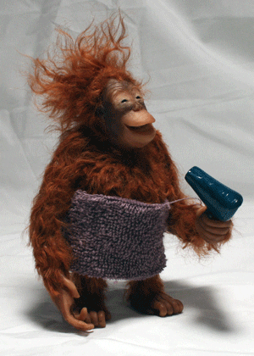
Read the sentence
(2 of 6)
1. Get everyone to read out the words slowly together. Help with vowel sounds and clusters. When they have read the sentence chorus it 3x.
[ Press space ]
2. A funny picture representing the sentence appears!
Dry my hair.
2
SAMPLE FOR EVALUATION
Join ESL KidStuff
to view without watermark.
[ Press space bar to see the answer ]
[ Press space bar for next sentence ]

Slide 5

Read the sentence
(3 of 6)
1. Get everyone to read out the words slowly together. Help with vowel sounds and clusters. When they have read the sentence chorus it 3x.
[ Press space ]
2. A funny picture representing the sentence appears!
A big nose.
3
SAMPLE FOR EVALUATION
Join ESL KidStuff
to view without watermark.
[ Press space bar to see the answer ]
[ Press space bar for next sentence ]

Slide 6

Read the sentence
(4 of 6)
1. Get everyone to read out the words slowly together. Help with vowel sounds and clusters. When they have read the sentence chorus it 3x.
[ Press space ]
2. A funny picture representing the sentence appears!
The pig dances.
4
SAMPLE FOR EVALUATION
Join ESL KidStuff
to view without watermark.
[ Press space bar to see the answer ]
[ Press space bar for next sentence ]

Slide 7
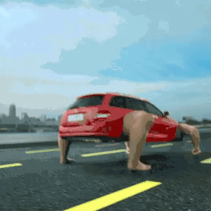
Read the sentence
(5 of 6)
1. Get everyone to read out the words slowly together. Help with vowel sounds and clusters. When they have read the sentence chorus it 3x.
[ Press space ]
2. A funny picture representing the sentence appears!
The car jumps.
5
SAMPLE FOR EVALUATION
Join ESL KidStuff
to view without watermark.
[ Press space bar to see the answer ]
[ Press space bar for next sentence ]

Slide 8
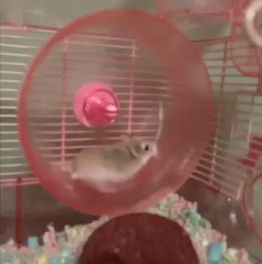
Read the sentence
(6 of 6)
1. Get everyone to read out the words slowly together. Help with vowel sounds and clusters. When they have read the sentence chorus it 3x.
[ Press space ]
2. A funny picture representing the sentence appears!
The hamster runs
fast.
6
SAMPLE FOR EVALUATION
Join ESL KidStuff
to view without watermark.
[ Press space bar to see the answer ]
[ Press space bar for next sentence ]

Slide 9
Write on the board
Give a marker / chalk to a student and have them come to the board.
Show him/her one sentence from the previous slides on a piece of paper, but don’t let the rest of the class see.
The student writes the sentence on the board and the rest of the students must shout out the sentence as it is written. Points can be awarded to the student who shouts out the sentence first.
Repeat for the other sentences with different students.
Write on the board
SAMPLE FOR EVALUATION
Join ESL KidStuff
to view without watermark.
[ Press space bar or left-mouse click to move to the next slide ]

Slide 10
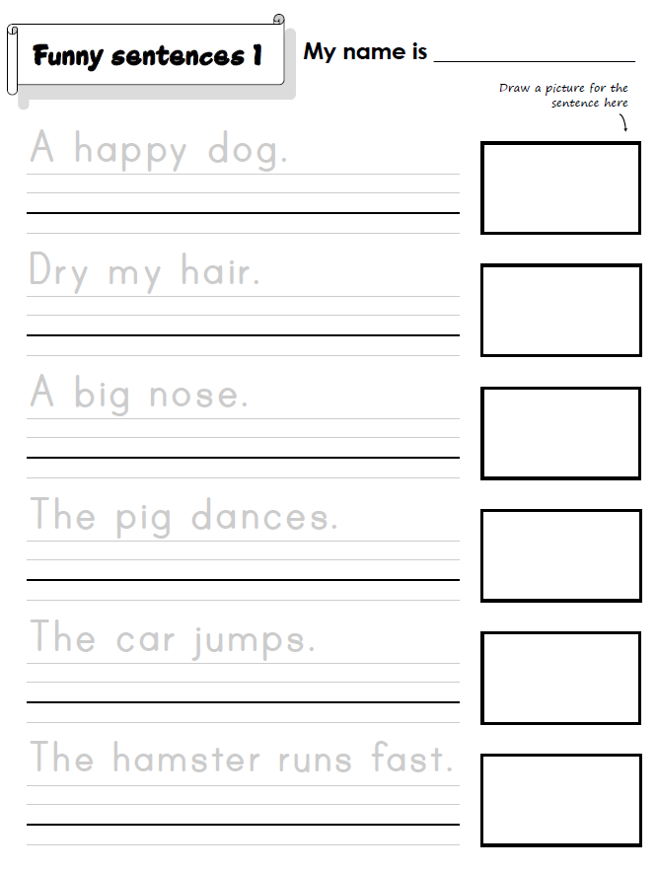
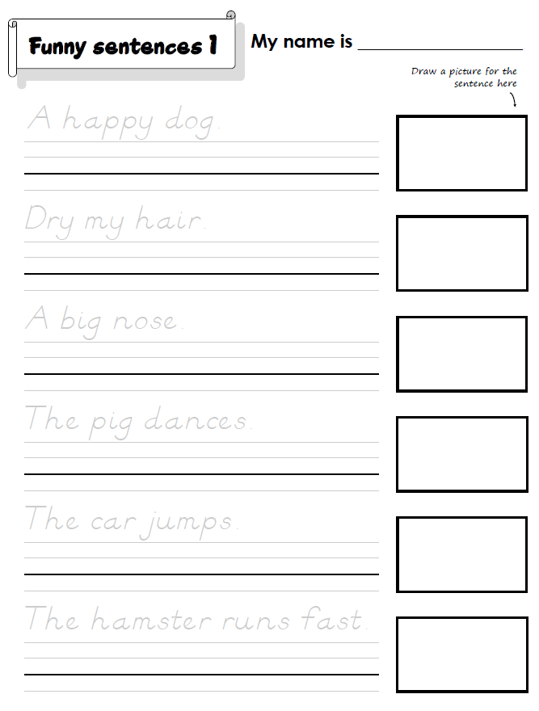

Do the “Funny sentences 1” printing sheet
We’ll finish with some printing practice.
Hold up the worksheet and model printing the letters in the first sentence. Clearly show the directions of printing each letter and emphasize the importance of staying on the line. Then draw a picture representing the sentence.
Have your students work on their worksheets. Spend time with each student helping, asking what the letters and words are, and praising.
The printing sheet is available in clear print letters or D’Nealian script. D'Nealian is a style of writing in cursive and print (block) handwriting.
Click to see
SAMPLE FOR EVALUATION
Join ESL KidStuff
to view without watermark.
Regular printing sheet
D’Nealian printing sheet
9 | © ESLKidStuff.com
[ Press space bar or left-mouse click to move to the next slide ]

Slide 11
SAMPLE FOR EVALUATION
Join ESL KidStuff
to view without watermark.

