Slide 1
Early words: a-o
6
Identify, recognize and print 15 lowercase letters, read and print some simple words.
None.
The ABC song (audio & video)
Early word printing a-o sheet
Blackboard / Whiteboard with chalk / markers
Use this mini-lesson within your main lesson for early word reading and printing practice.
This mini-lesson reviews the letters taught up to this point and introduces students to reading and printing some simple words.

Slide 2
Early words a-o
- Lesson 6 -

Slide 3


Teacher’s notes are here on every lesson slide.
Sing “The ABC song” Start this section of the lesson with the ABC song to indicate that it’s alphabet time.
Bring everyone’s attention to this slide and play the song.
Encourage everyone to clap along as you sing – after a few classes everyone will be able to sing along with you.
Lyrics for “The ABC song”
A B C D E F G
H I J K L M N
O P Q R S T U
V W and X Y Z
I can sing my ABCs,
Won’t you sing along with me?
Repeat
The ABC song
a
c
e
g
b
d
f
j
m
Song audio and video
only available to ESL KidStuff members.
Click here to remove message.
n
i
h
Song audio and video
only available to ESL KidStuff members.
Click here to remove message.
k
l
SAMPLE FOR EVALUATION
Join ESL KidStuff
to view without watermark.
Click to play song
o
p
q
r
s
t
u
Play song audio
v
w
x
y
z
Play song video
2 | © ESLKidStuff.com
[ Press space bar or left-mouse click to move to the next slide ]

Slide 4







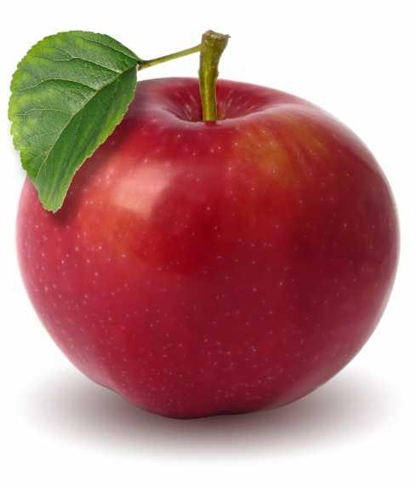






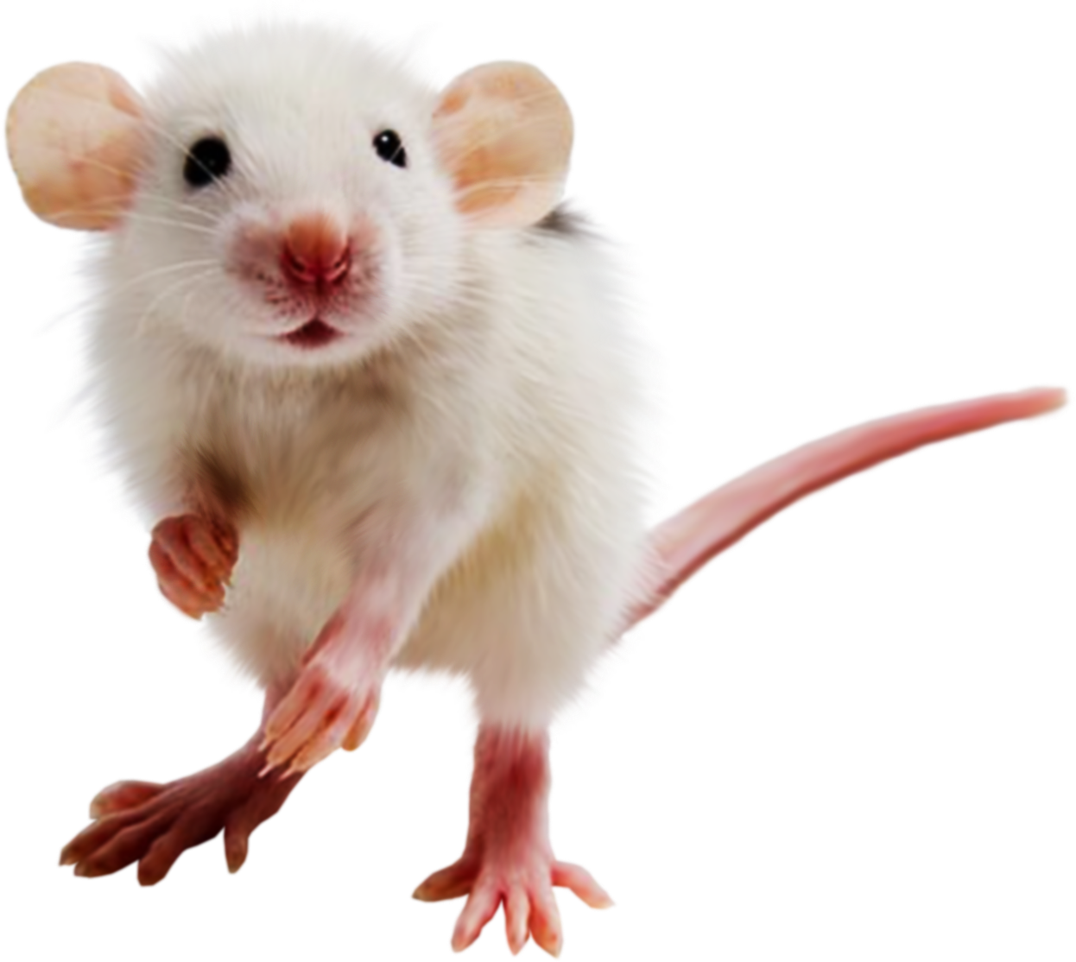

Letter quiz
Let’s review all the previous letters with a quiz.
The letters are shuffled in random order.
There is no audio for this part – get your students to say the letters, sounds and words by themselves!
[ Press space to start ]
1. Prompt everyone to say the letter.
2. Prompt everyone to say its sound.
[ Press space ]
3. Prompt everyone to say the word.
[ If correct, press space to go onto the next letter ]
4. Continue for all the letters.
Review quiz!
g
j
Say the letter
Say the sound
c
a
m
n
e
Say the picture word
i
o
d
f
h
b
l
k
Good job!
The quiz is finished.
Press ◄ to go back.
Press space to continue to next slide.
[ Press space bar
to start ]
SAMPLE FOR EVALUATION
Join ESL KidStuff
to view without watermark.
[ Press space bar or left-mouse click to move to the next slide ]

Slide 5



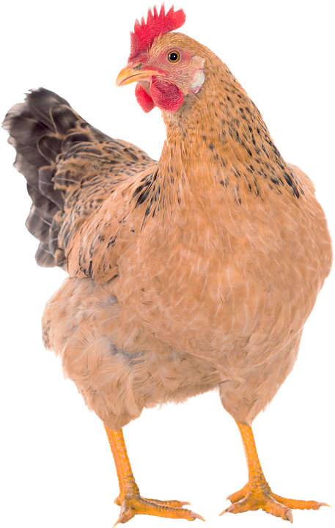

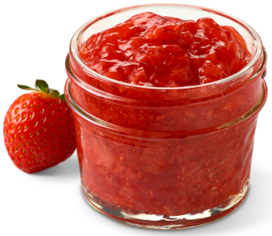
Introduce new words
Before starting to read some simple words, it is important to check that students know the words first.
[ Press space to start ]
Bring everyone's attention to first picture on this slide. Teach / Elicit the word. Then chorus 3-5 times.
[ Press space for next picture ]
Repeat for all the pictures.
Answers:
bed
hand
dog
hen
jam
leg
[ Press space bar to start]
SAMPLE FOR EVALUATION
Join ESL KidStuff
to view without watermark.
[ Press space bar or left-mouse click to move to the next slide ]

Slide 6
Test new words
Can your students remember the new words?
[ Press space to start ]
The first image slowly reveals itself – encourage students to shout out what it is as soon as they can.
[ Press space for next picture ]
Repeat for all the pictures.
Answers:
dog
jam
hen
leg
hand
bed
[ Press space bar to start]
SAMPLE FOR EVALUATION
Join ESL KidStuff
to view without watermark.
[ Press space bar or left-mouse click to move to the next slide ]

Slide 7

Read the words
(slide 1 of 6)
[ Press space to start ]
1. Bring everyone's attention to the letters on this slide.
2. Encourage your students to say the sound of each letter – you can click the audio icon to hear the sound.
3. Elicit the word.
[ Press space to see the picture ]
4. Check the picture to see if everyone is correct!
[ Press space to go to the next word ]
Let’s read!
e
l
g
SAMPLE FOR EVALUATION
Join ESL KidStuff
to view without watermark.
[ Press space bar to see picture]
[ Press space bar or left-mouse click to move to the next slide ]

Slide 8
Read the words
(slide 2 of 6)
[ Press space to start ]
1. Bring everyone's attention to the letters on this slide.
2. Encourage your students to say the sound of each letter – you can click the audio icon to hear the sound.
3. Elicit the word.
[ Press space to see the picture ]
4. Check the picture to see if everyone is correct!
[ Press space to go to the next word ]
Let’s read!
o
d
g
SAMPLE FOR EVALUATION
Join ESL KidStuff
to view without watermark.
[ Press space bar to see picture]
[ Press space bar or left-mouse click to move to the next slide ]

Slide 9
Read the words
(slide 3 of 6)
[ Press space to start ]
1. Bring everyone's attention to the letters on this slide.
2. Encourage your students to say the sound of each letter – you can click the audio icon to hear the sound.
3. Elicit the word.
[ Press space to see the picture ]
4. Check the picture to see if everyone is correct!
[ Press space to go to the next word ]
Let’s read!
e
h
n
SAMPLE FOR EVALUATION
Join ESL KidStuff
to view without watermark.
[ Press space bar to see picture]
[ Press space bar or left-mouse click to move to the next slide ]

Slide 10
Read the words
(slide 4 of 6)
[ Press space to start ]
1. Bring everyone's attention to the letters on this slide.
2. Encourage your students to say the sound of each letter – you can click the audio icon to hear the sound.
3. Elicit the word.
[ Press space to see the picture ]
4. Check the picture to see if everyone is correct!
[ Press space to go to the next word ]
Let’s read!
e
b
d
SAMPLE FOR EVALUATION
Join ESL KidStuff
to view without watermark.
[ Press space bar to see picture]
[ Press space bar or left-mouse click to move to the next slide ]

Slide 11
Read the words
(slide 5 of 6)
[ Press space to start ]
1. Bring everyone's attention to the letters on this slide.
2. Encourage your students to say the sound of each letter – you can click the audio icon to hear the sound.
3. Elicit the word.
[ Press space to see the picture ]
4. Check the picture to see if everyone is correct!
[ Press space to go to the next word ]
Let’s read!
a
m
j
SAMPLE FOR EVALUATION
Join ESL KidStuff
to view without watermark.
[ Press space bar to see picture]
[ Press space bar or left-mouse click to move to the next slide ]

Slide 12
Read the words
(slide 5 of 6)
[ Press space to start ]
1. Bring everyone's attention to the letters on this slide.
2. Encourage your students to say the sound of each letter – you can click the audio icon to hear the sound.
3. Elicit the word.
[ Press space to see the picture ]
4. Check the picture to see if everyone is correct!
[ Press space to go to the next word ]
Let’s read!
a
n
h
d
SAMPLE FOR EVALUATION
Join ESL KidStuff
to view without watermark.
[ Press space bar to see picture]
[ Press space bar or left-mouse click to move to the next slide ]

Slide 13
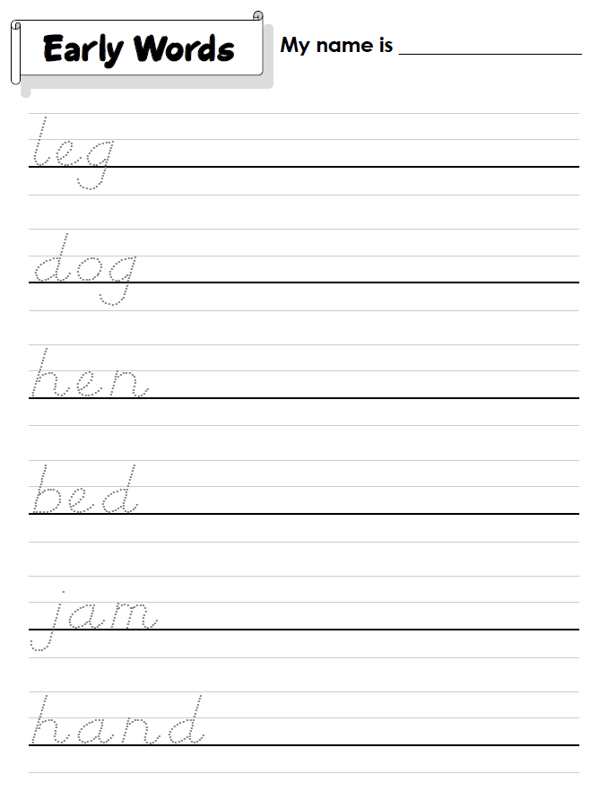


Do the “Early word printing a-o” sheet
We’ll finish with some printing practice.
Hold up the worksheet and model tracing and printing each word. Clearly show the directions of printing each letter and emphasize the importance of staying on the line.
Have your students work on their worksheets. Spend time with each student helping, asking what the letters and words are, and praising.
The printing sheet is available in clear print letters or D’Nealian script. D'Nealian is a style of writing in cursive and print (block) handwriting.
Click to see
SAMPLE FOR EVALUATION
Join ESL KidStuff
to view without watermark.
Regular printing sheet
D’Nealian printing sheet
12 | © ESLKidStuff.com
[ Press space bar or left-mouse click to move to the next slide ]

Slide 14
SAMPLE FOR EVALUATION
Join ESL KidStuff
to view without watermark.

